Slide 1
The Pediatric Emergency Care Coordinator / Pediatric Champion
(PECC)
PURPOSE STATEMENT
Explore the roles, responsibilities, and skill set of an effective PECC, and identify strategies to create and strengthen the role within your EMS agency, emergency department, or hospital.

Slide 2
We will be using Poll Everywhere to ask a few questions during each session.
Today’s Poll Everywhere can be accessed through:
Your web browser (use QR code or https://pollev.com/traumasprint )
OR
The mobile app – enter TRAUMASPRINT (Apple Store or Google Play)
OR
Text TRAUMASPRINT to 22333

Slide 3
Notes:
Do not modify the notes in this section to avoid tampering with the Poll Everywhere activity. More info at polleverywhere.com/support DO you currently have a PECC / pediatric champion in your ED?
https://www.polleverywhere.com/multiple_choice_polls/a8rlyeVI4AGAoyAwoBMKx

Slide 4
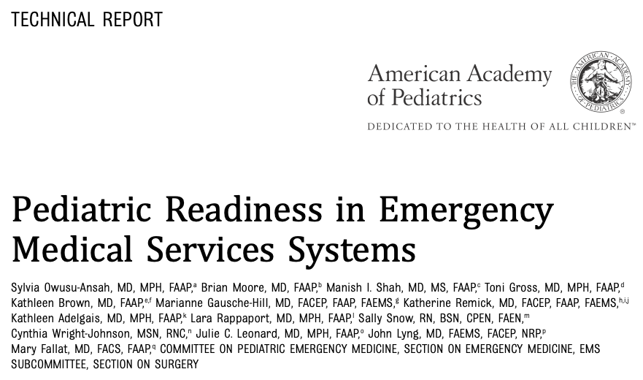
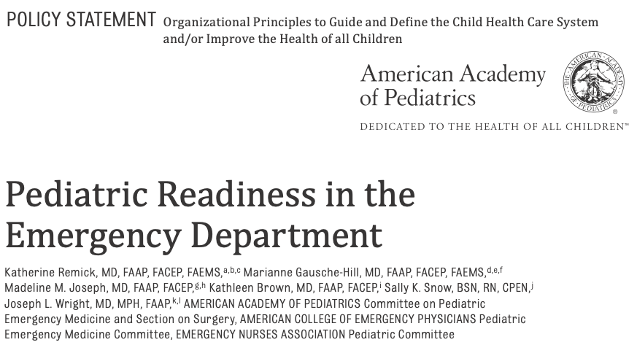
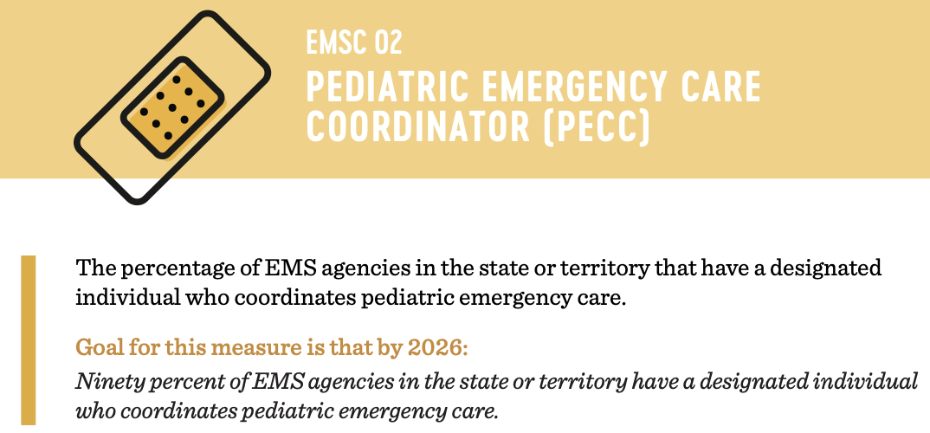
Background
Notes:
To provide a bit of level-setting, we're going to take a quick look at the background of the pediatric emergency care coordinator role.
Since 1983, Los Angeles’ Emergency Departments Medical recognition program, Approved for Pediatrics (or EDAP) program has required that EDs have a pediatric liaison nurse on staff.
Increased focus on the importance of the role is commonly attributed to the 2006 Institute of Medicine’s report: Emergency Care for Children: Growing Pains. Noting significant inadequacies in the nation’s emergency care system’s capacity to manage ill or injured children, this report called for both hospitals and EMS systems to identify qualified coordinators of pediatric emergency care.
In line with the Growing Pains report, the Health Resources and Services Administration Emergency Medical Services for Children (or EMSC) Program established a Performance Measure for their State Partnership Program Grantees that by 2026, 90% of all EMS agencies will have a PECC.
Lastly – both the Joint Policy Statement “Pediatric Readiness in the Emergency Department” and the Technical Report “Pediatric Readiness in Emergency Medical Services Systems” support the recommendations from the IOM.
To speak in terms of trauma, this is the orange book of pediatric readiness. Having a PECC is the key to pulling it all together. Analogy to the trauma program manager/coordinator for ED pediatric readiness.

Slide 5
What is a PECC?
An individual(s) who is responsible for coordinating pediatric specific activities.
Notes:
So what is a pediatric emergency care coordinator?
Ultimately a PECC is simply someone who is responsible for coordinating pediatric specific activities and helping assure an ED has the supplies they need to care for a critically ill or injured infant or child.

Slide 6
Notes:
Racheal

Slide 7
Notes:
Do not modify the notes in this section to avoid tampering with the Poll Everywhere activity. More info at polleverywhere.com/support Do you think that having both an EMS agency and an ED PECC improved the care of the baby in this scenario?
https://www.polleverywhere.com/multiple_choice_polls/SPWiQ6MZb3yxJRwUxkWhq

Slide 8
Notes:
Do not modify the notes in this section to avoid tampering with the Poll Everywhere activity. More info at polleverywhere.com/support If this was your ED, would it have gone the same way?
https://www.polleverywhere.com/multiple_choice_polls/mk96ACWZctvgDReo5HuY6

Slide 9
Roles & Responsibilities of a PECC
Notes:
Special interest in pediatrics
Knowledge and skill in emergency care of children through clinical experience
Someone whom is able to Demonstrated critical thinking and strong clinical skills
Does not have to be a provider or nurse, can be a pharmacist, EMT-P, advance practice (PA, NP)
They do not have to be a pediatric expert

Slide 10
Who can fill this role?
Notes:
So who can fill this role?
This individual does not need to have pediatric specialty training. They can be an EMT or paramedic, a registered nurse or an Advanced Practice Nurse, a Physician Assistant or Physician – or anything in between. The PECC does not have to be board certified or eligible in emergency medicine or pediatric emergency medicine and the Nurse PECC does not have to be certified in emergency nursing or pediatric emergency nursing.
Individuals don’t have to be dedicated solely to this role, although they COULD be. Recognizing that every ED and EMS agency will have varying levels of staff resources, the structure could be:
a single individual working within a single agency or hospital
Or a shared role among multiple individuals within a single agency or hospital
Or a single individual shared by multiple agencies or hospitals (consider a region or network)
Ultimately, you simply need to have a passion to provide the best care possible to children.

Slide 11
Roles and Responsibilities Physician or Advanced Practice Provider
Maintain competencies in pediatric-specific care
Assist in the development and review of ED specific policies and protocols to ensure inclusion of or specific to children
Promote pediatric skills and knowledge of provider team
Advocate for appropriate pediatric specific equipment and supplies
Participate in pediatric quality improvement
Notes:
The hospital PECC and if available, the physician PECC should work concurrently at improving comfort in caring for pediatric patients and focus on improving the quality of care for the pediatric population.
What types of activities could a PECC participate in?
The emergency department Provider PECC can help with
Promoting and verifying adequate skill and knowledge of ED health care providers in the emergency care and resuscitation of infants and children.
Participating in ED pediatric quality improvement, practice improvement, patient safety, injury and illness prevention, and clinical care activities.
Assisting with development and periodic review of ED policies and procedures and standards for medications, equipment, and supplies to ensure adequate resources for children of all ages.
From scenario
Pediatric evidence based protocols
Weight based dosing

Slide 12
Roles and Responsibilities Nurse or Other Healthcare Provider
Maintains competency in pediatric emergency care
Facilitates the inclusion of pediatric care in orientation and continuing education
Promote adequate pediatric skills and knowledge of team
Promotes inclusion of pediatric patients in disaster preparedness for the ED and integrate this into the hospital disaster committee
Notes:
Facilitating and participating in ED pediatric QI/PI activities.
Ensuring that initial and annual competency evaluations completed by the ED nursing staff are pertinent to children of all ages.
Promoting pediatric disaster preparedness for the ED and participating in hospital disaster-preparedness activities.
Promoting patient and family education in illness and injury prevention.
Providing assistance and support for pediatric education of out-of-hospital providers who are affiliated with the ED.
Working with clinical leadership to ensure the availability of pediatric equipment, medications, staffing, and other resources through the development and periodic review of ED standards, policies, and procedures.
Collaborating with the physician coordinator to ensure that the ED is prepared to care for children of all ages, including children with special healthcare needs.

Slide 13
Hospital PECC Collaboration
Promoting skills and knowledge
Participate in the quality improvement development of pediatric outcome metrics
Assist in assuring and reviewing ED policies, procedures and standards to assure pediatric considerations are included
Facilitate the inclusion of pediatric care in orientation and continuing education
Notes:
Collaboration in the care and resuscitation of infants and children
Input into how their respective discipline demonstrate competency
i.e. weight in kg, medication dosing, equipment appropriate for infants and children, disaster plans
Facilitate education for in and out of hospital ie. Prehospital providers

Slide 14
Notes:
Do not modify the notes in this section to avoid tampering with the Poll Everywhere activity. More info at polleverywhere.com/support Based on the overview just given, do you serve as a PECC at your organization (even if unofficial)?
https://www.polleverywhere.com/multiple_choice_polls/5tBAx82zSkPJyxsOQ3Qrq

Slide 15
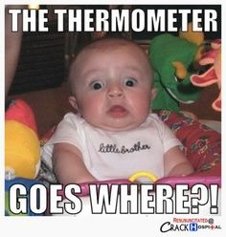
Pediatric patients often provoke discomfort and anxiety among healthcare personnel
Notes:
And we also need to remember that the child you are seeing probably doesn’t want to be in this situation either.
So recognizing this helps us understand the value of the PECC role

Slide 16
Value of the PECC Role Emergency Departments
of children arrive at general EDs (versus specialized pediatric EDs)
Increased pediatric readiness scores…
…are associated with decreased mortality
Notes:
In the United States, most children who seek emergency care present to general EDs versus specialized pediatric EDs.‍ The Institute of Medicine identified that these children are often seen in EDs that are not well prepared to care for them, both in terms of availability of equipment and supplies, as well as training and readiness of the ED staff.
Analysis of the National Pediatric Readiness Project Assessment data has found that EDs with a designated PECC were more ‘ready’ than those EDs who did not have PECCs identified. So we know that the presence of both nurse and physician PECCs is strongly correlated with improved pediatric readiness, independent of other factors.

Slide 17
Why This Role Matters
Increased staff confidence
Additional training opportunities
Improved care
Pediatric Voice
Notes:
Combining all of these concepts, having an individual in the ED who can coordinate pediatric emergency care has far reaching benefits.
We know that having someone in this role increases staff confidence; provides for additional training opportunities, improves care and has been shown to decrease mortality rates.
Having someone in this role also ensures that pediatric interests are represented throughout the organization.
Having a designated PECC can help ensure the highest quality of emergency care for all children by enhancing staff’s pediatric knowledge, skills, and confidence.

Slide 18
Summary of Benefits
Ensure resources are available
Establish QI plans
Maintain relationships
Equipment & supplies
Disaster preparedness
Hospital and EMS liaisons
Establish/maintain protocols
Family-centered care
Notes:
In summary benefits include:
Identifying gaps and ensuring that resources to care for children are available.
Maintaining a relationship with the state or territory EMS for Children infrastructure.
Working with state and local authorities and regional coalitions to develop strategies for addressing pediatric needs in the event of a disaster.
Establishing and maintaining offline and online pediatric protocols.
Establishing QI plans with pediatric-specific indicators.
Reviewing on a regular basis the medications, equipment and supplies available for the care of children and that all staff know where to find them. You can have the supplies and equipment but if staff do not know where they are or how to use them, they will not be beneficial when it is critical.
Liaising between local hospitals and EMS agencies to improve pediatric readiness in your community
Assisting in education and training of staff in the principles of family centered care

Slide 19
Aspen Di Ioli BSN RN PHN CEN TCRN MICN
Pediatric Liaison Nurse
Pediatric Emergency Care Coordinator
Pomona Valley Hospital Medical Center (Pomona, CA)

Slide 20
What the PECC?
What You Need to Know to Be A Pediatric Emergency Care Coordinator
Aspen Di Ioli, BSN, RN PHN, CEN, TCRN, MICN

Slide 21
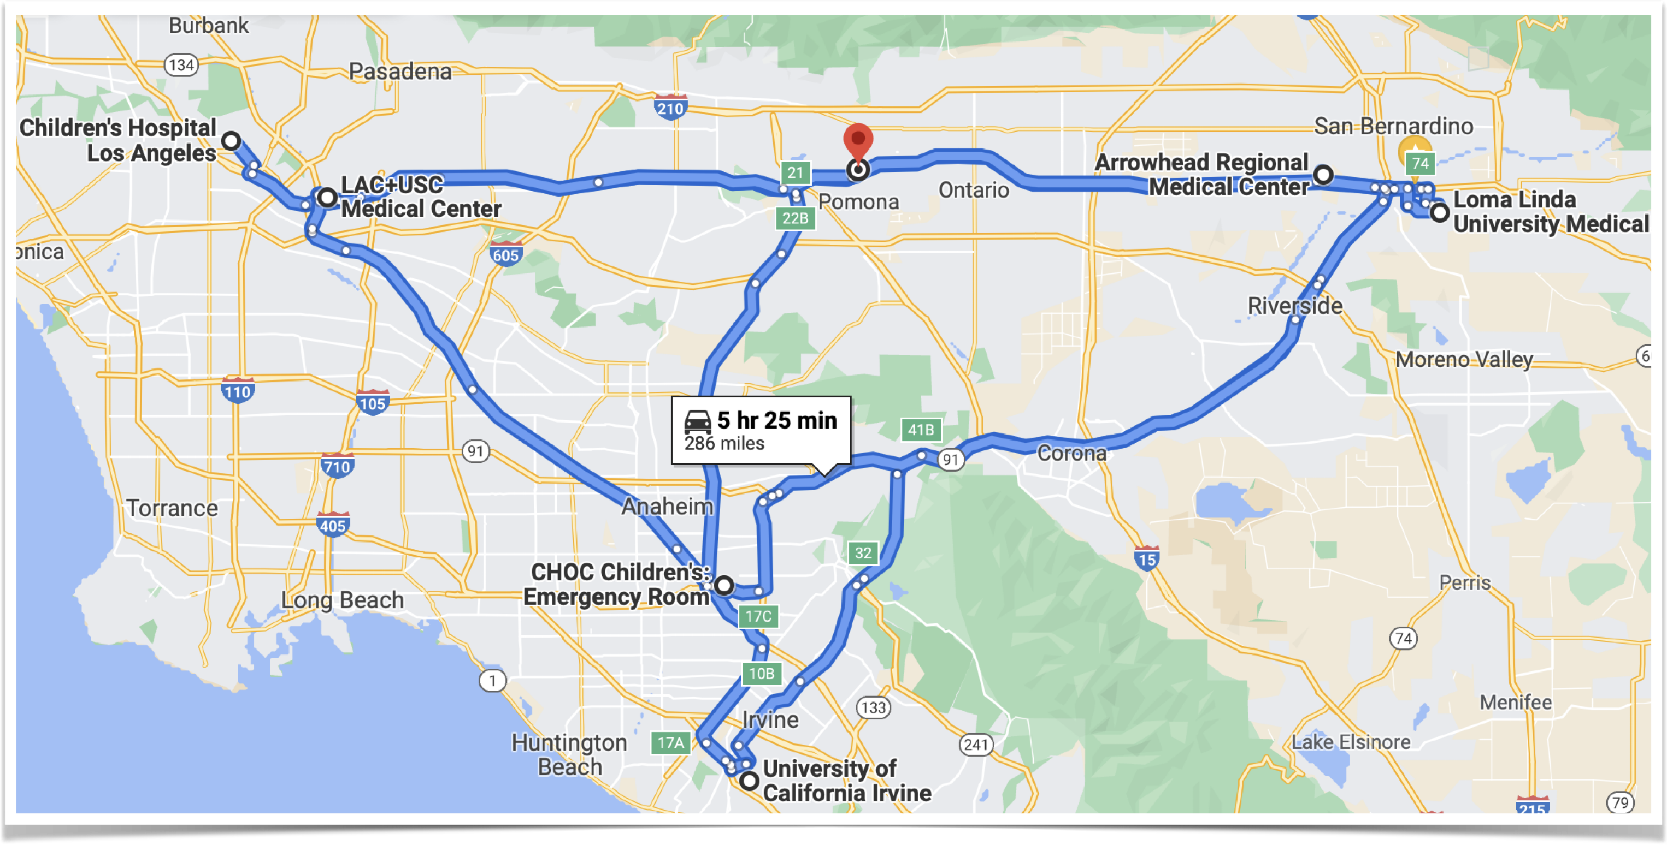
Location Location Location
Pomona Valley Hospital Medical Center

Slide 22
Base Hospital

Slide 23
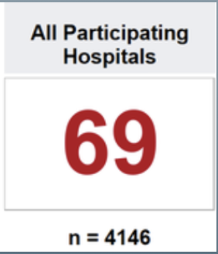
Are You Peds Ready?
Average Pediatric Readiness of All Hospitals Scores

Slide 24
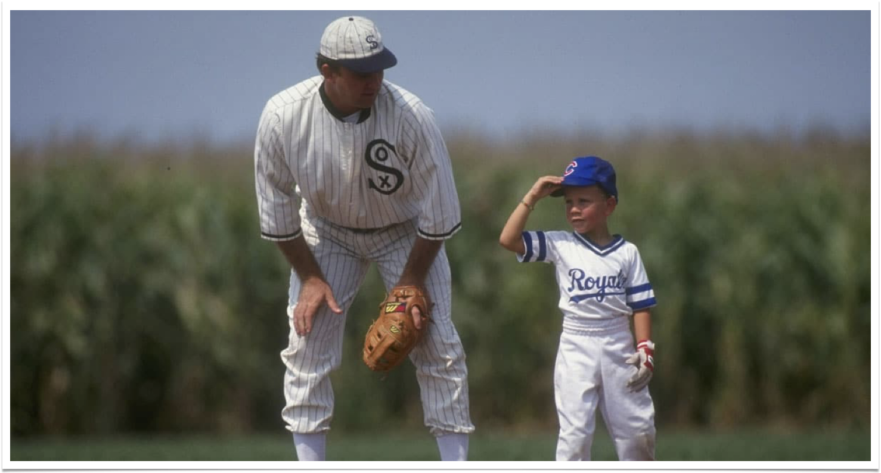
If You Build It They Will Come

Slide 25
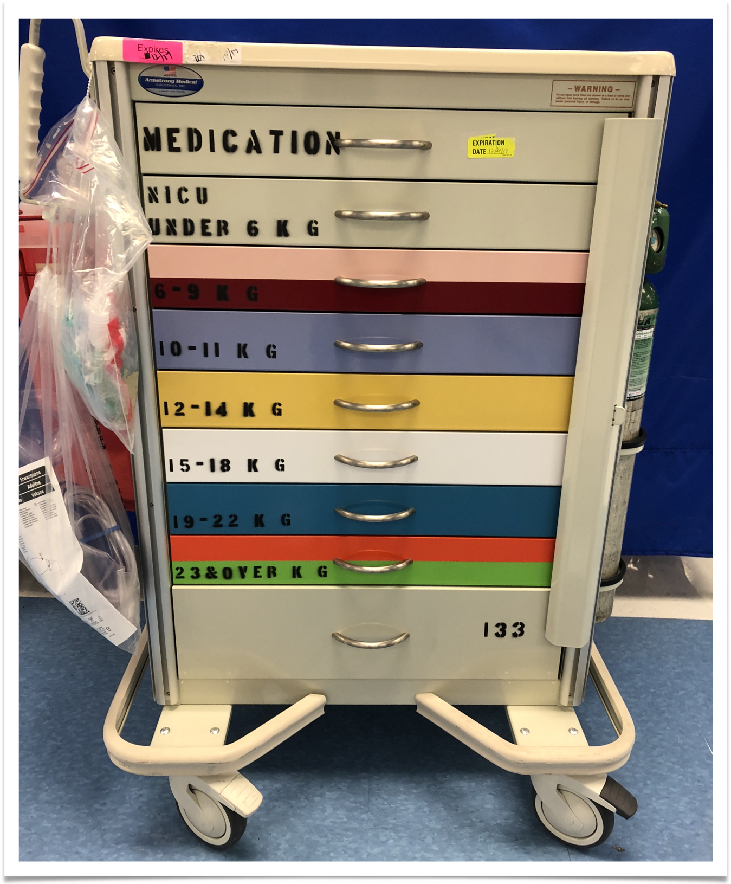
Hurry…Call A Code

Slide 26
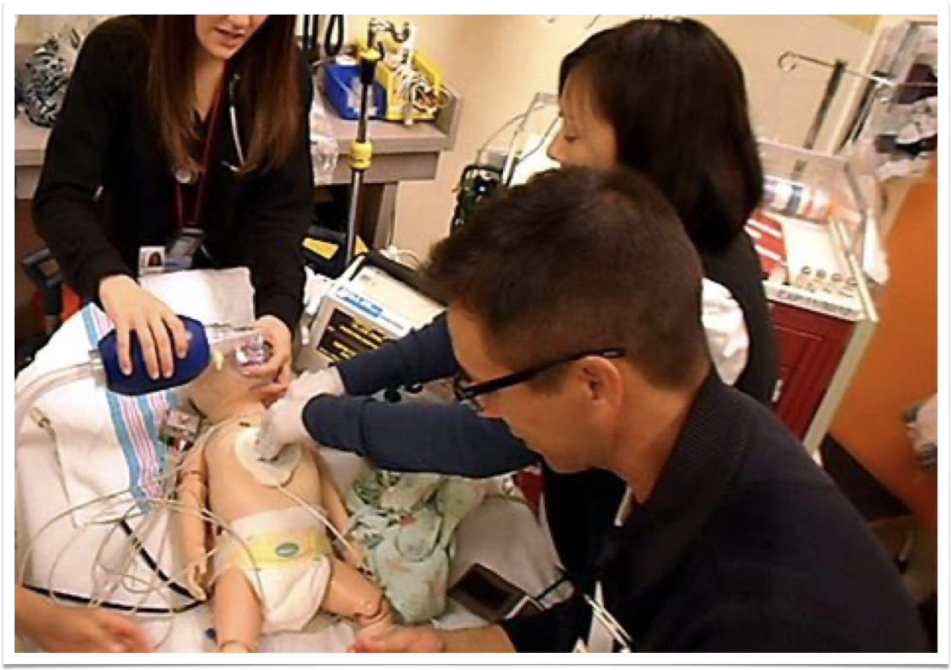
A Code Gone Bad…Very BAD!

Slide 27
Getting Comfortable

Slide 28
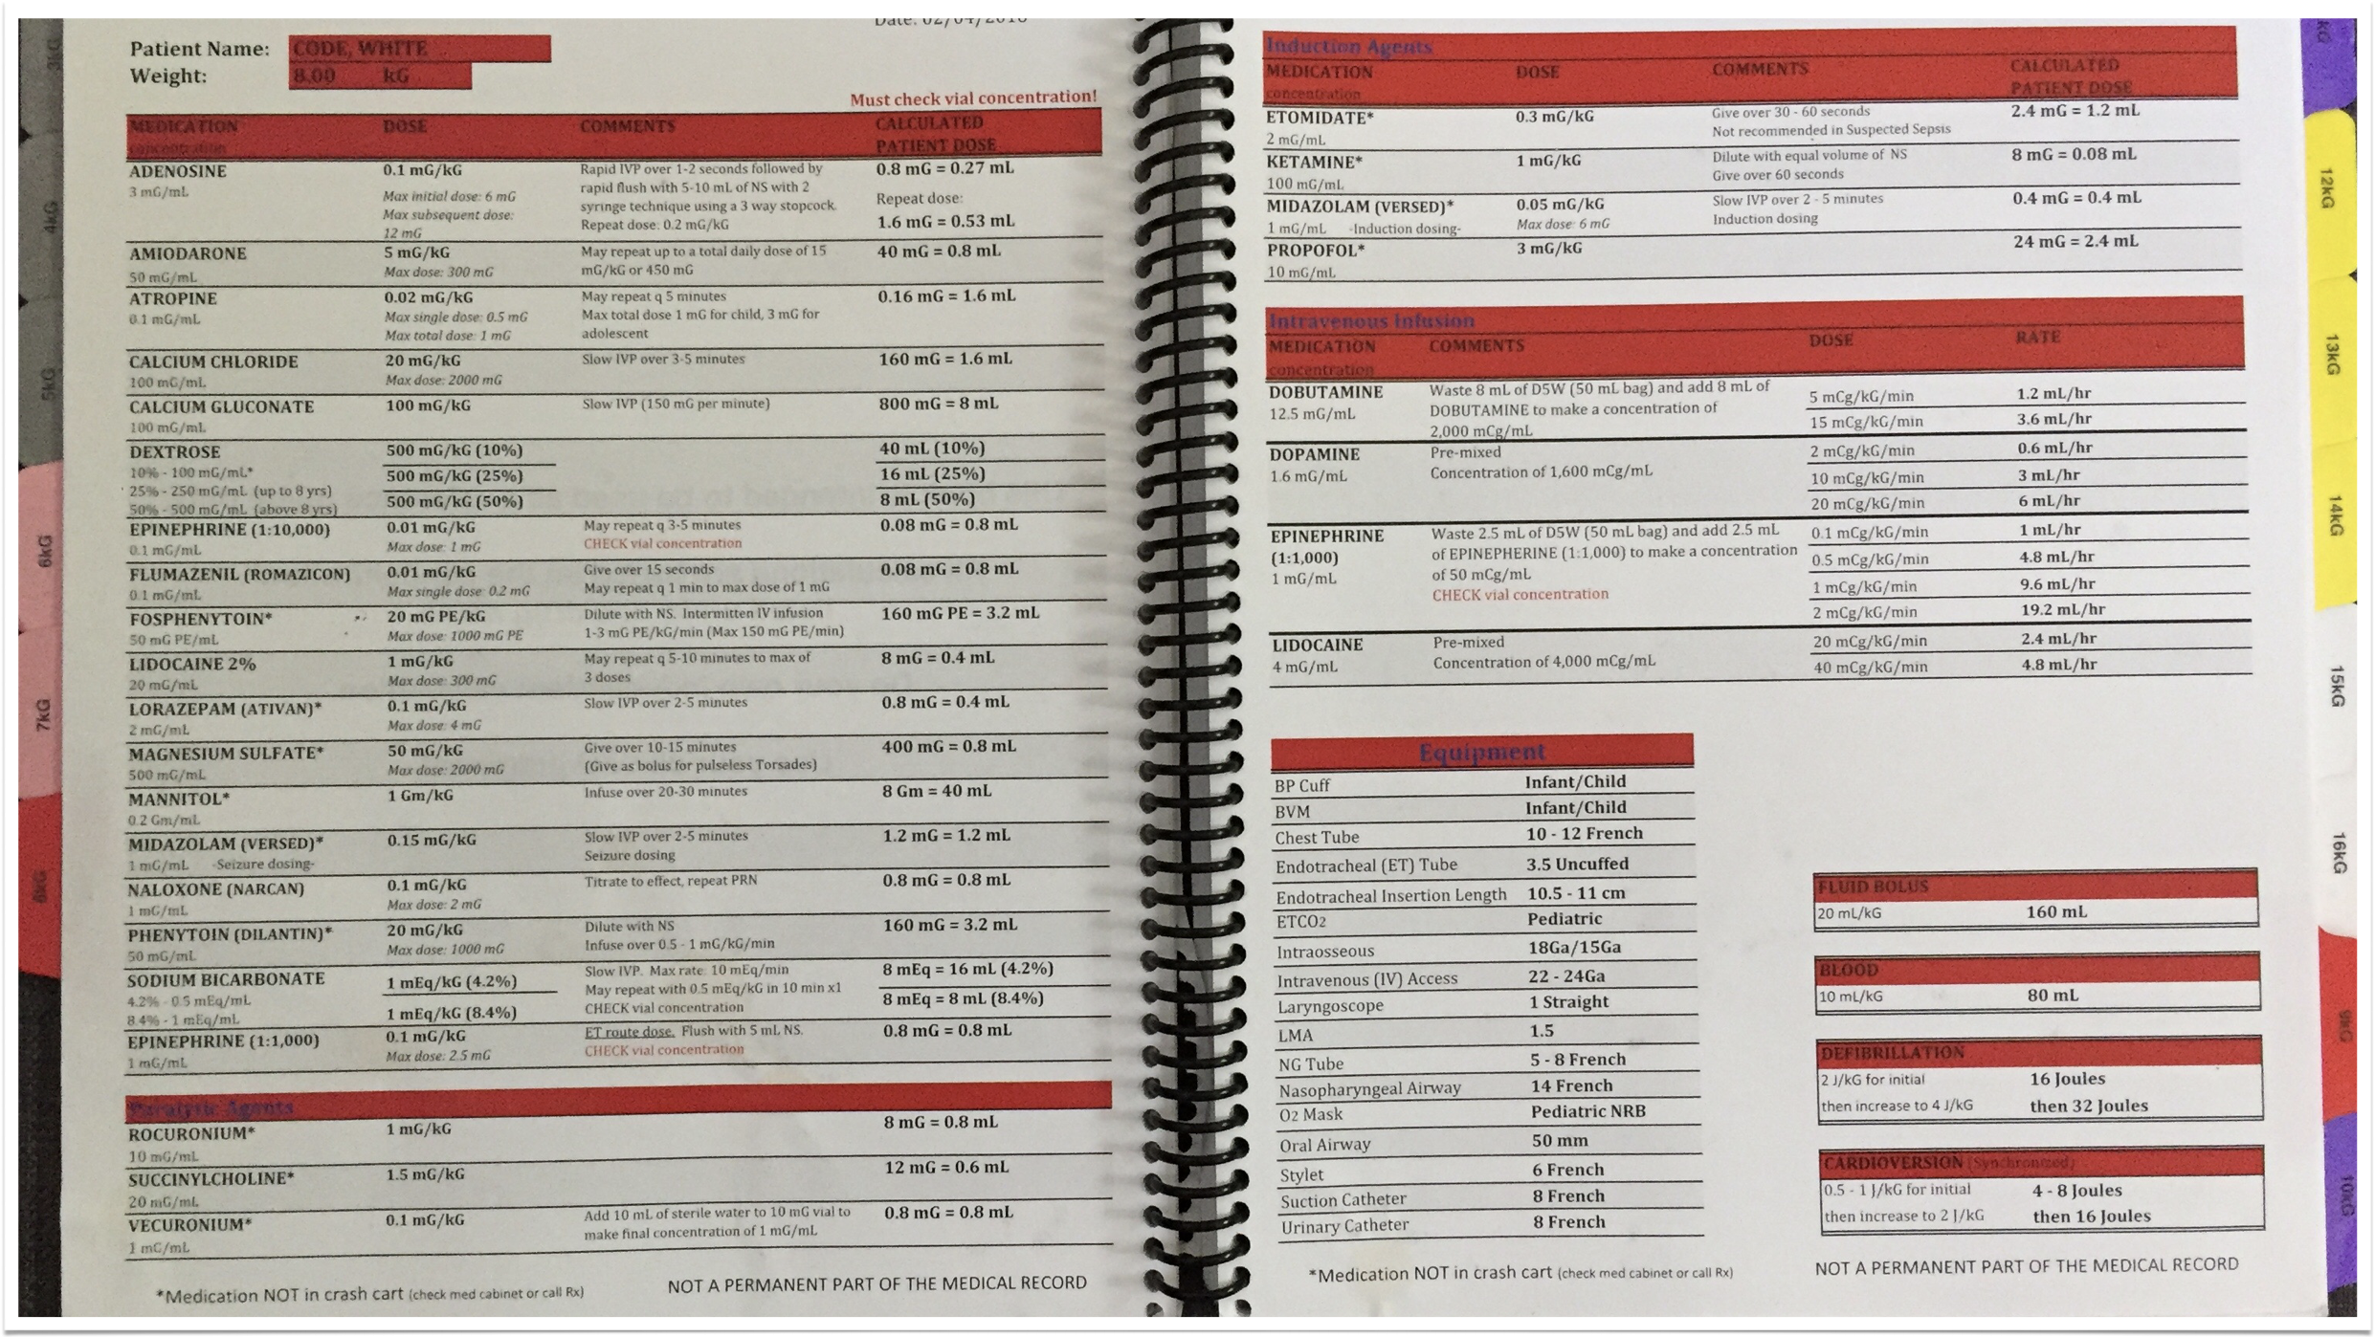
MATH 😫
HallelujaH
No More MATH!!!

Slide 29
With Kids, Life is Messy
and the Stakes are Higher

Slide 30
We are all Spokes in A Wheel

Slide 31
It’s OKAY to be Nervous

Slide 32
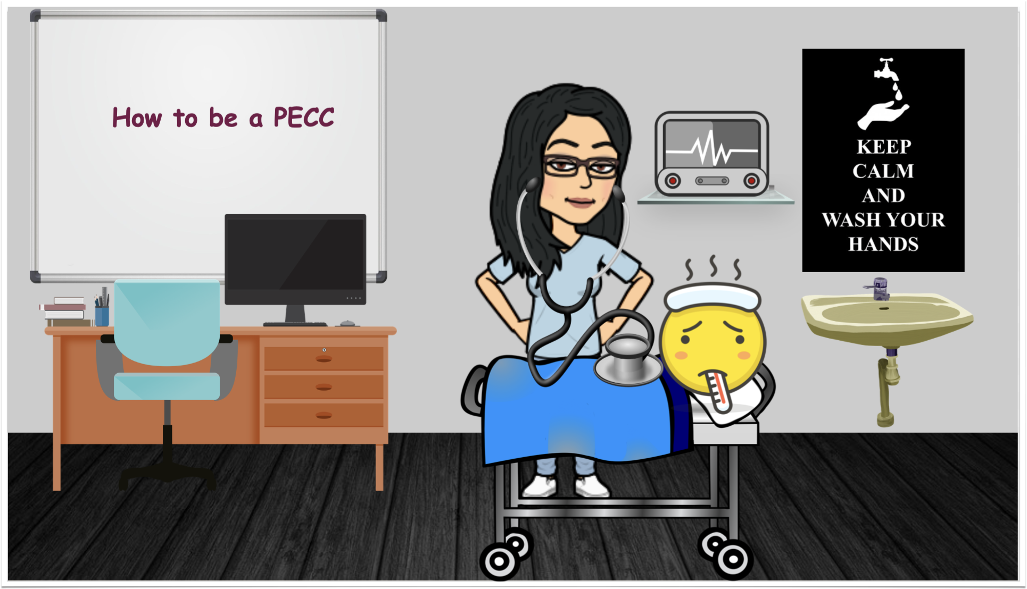
How I Spend My Time

Slide 33
Make your Pitch for a PECC
$320,000≈
$$$

Slide 34
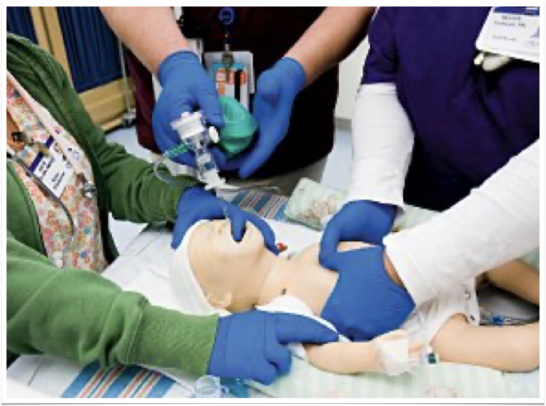

Slide 35
“No matter how big or small we all make a difference for better or worse”
Burger Barn Bathroom Wall - Bishop, CA

Slide 36
Thank You

Slide 37
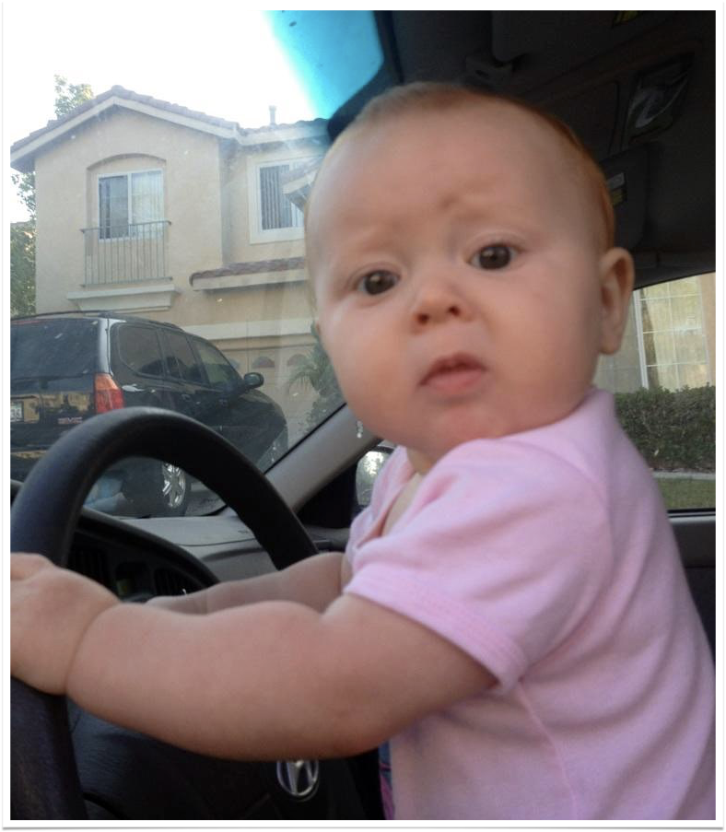
Questions
Now What?

Slide 38
References
Become a pediatric emergency care coordinator. Emergency Medical Services for Children Innovation and Improvement Center (EIIC). (n.d.). Retrieved November 14, 2021, from https://emscimprovement.center/collaboratives/pwdc/.
Disque, K. (2019). Pals: Pediatric advanced life support provider handbook. Satori Continuum Publishing.
ENA. (2020). Emergency nursing pediatric course: Provider manual (5th ed.). Jones & Bartlett Learning.
Getty Images/istock. (2020). Toddler spills a snack all over the floor, but seems content to eat it anyways. Parents Today. photograph. Retrieved from https://www.todaysparent.com/toddler/picky-eaters/what-to-do-when-your-toddler-wont-eat-anything-but-snacks/.
Glerum KM, Selbst SM, Parikh PD, Zonfrillo MR. Pediatric Malpractice Claims in the Emergency Department and Urgent Care Settings From 2001 to 2015. Pediatr Emerg Care. 2021 Jul 1;37(7):e376-e379. doi: 10.1097/PEC.0000000000001602. PMID: 30211835.
Johnathan Daniel/Getty Images. (n.d.). Field of dreams. Field of Dreams. Retrieved November 1, 2021, from https://www.desmoinesregister.com/picture-gallery/entertainment/movies/2014/04/18/field-of-dreams-at-25-scenes-from-dyersville-and-beyond/7878153/.
Remick, K., Gausche-Hill, M., Joseph, M. M., Brown, K., Snow, S. K., & Wright, J. L. (2018). Pediatric readiness in the emergency department. Pediatrics, 142(5). https://doi.org/10.1542/peds.2018-2459
National results. Emergency Medical Services for Children Innovation and Improvement Center (EIIC). (2014, March 21). Retrieved November 14, 2021, from https://emscimprovement.center/domains/pediatric-readiness-project/assessment/results-and-findings/national-results/.
Newgard CD, Lin A, Olson LM, et al. Evaluation of Emergency Department Pediatric Readiness and Outcomes Among US Trauma Centers. JAMA Pediatr. 2021;175(9):947–956. doi:10.1001/jamapediatrics.2021.1319
Pomona Valley Hospital Medical Center. (2016, February 4). Code White Medication Resource. Pomona; CA.

