Slide 1
Quality Improvement
PURPOSE STATEMENT
Participate in the development of pediatric components of the organization’s QI plan and facilitate QI activities related to pediatric emergency care.

Slide 2
Why QI? What is this QI thing? How does it differ from QA?
Why is it all so important?
Notes:
Common questions about QI include the significance, definition and how it differs from QA.
Let’s begin by spending a few minutes gaining a better understanding of this and why it is so important.

Slide 3
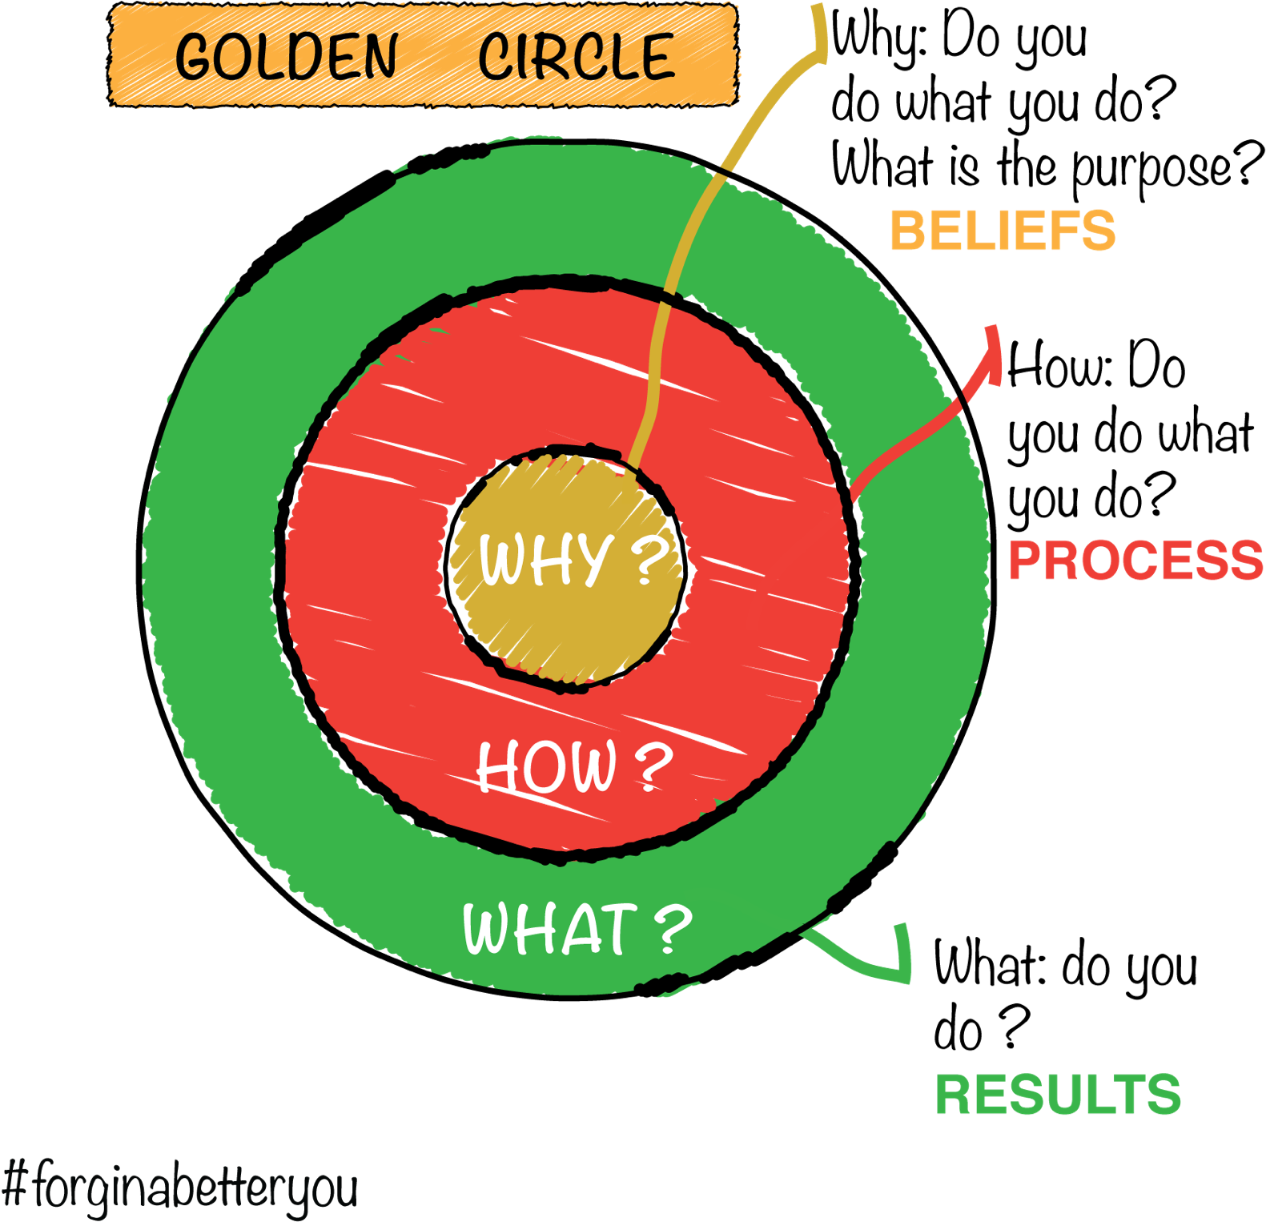
Start with our Why
Sinek, Simon. Start with Why. Penguin Books, 2011.
Notes:
If you are a fan of the author and speaker, Simon Sinek, you may be familiar with the concept of starting with the “WHY”.
Starting with our why means reminding ourselves of our true purpose. While QI is important, it is not our why. Our Why is something bigger. It is our true purpose.
Our why is more about improving the quality of and access to emergency care for ill and injured children everywhere.
QI is one of our “Hows” or “Models” we use to achieve our “WHY”.

Slide 4
HRSA Definition of Quality Improvement
Systematic & continuous actions
Measurable improvement
Health care services & health status
Target patient populations
https://www.hrsa.gov/sites/default/files/quality/toolbox/508pdfs/qualityimprovement.pdf
Notes:
So, does QI really mean.
This HRSA definition shows our true “WHY” on the right side of this graphic. It is what we are aiming for.
How we get there is through some actions that are ongoing and systematic meaning they focus on changing systems. We know we are changing systems by measuring our changes to seem if they lead to improvement. And the improvement we are seeking is somehow in the form of improving the health status for an individual or group OR improving the health services themselves.

Slide 5
Change - Traditional approach to Quality Assurance
Mean
1.96 std
1 box = 100 cases in a year
# of Cases
# of Cases
Excellent Outcomes
Poor Outcomes
Excellent Outcomes
Poor Outcomes
Option 1: Focus on Outliers
Strategy Eliminate the unfavorable tail of the curve or outliers (“quality assurance”)eliminate the unfavorable tail of the curve (“quality assurance”)
Result The impact in improving care is minimal
Macias, C.G. The Imperative of Linking Clinical and Financial Data to Improve Outcomes. Healthcare Analytics Summit 14. Oct 20 2014.
5
Notes:
5
f the outlier trim point is set at 1.96 standard deviations, only 2.5% of cases fall under the adverse outcome tail, so
In this QA case example, the focus is on the individual cases at the right tail of this curve. This represents only a small number of total cases (2.5% of cases).
This QA approach focuses on the “worse” outcomes and seeks to shift these to the left or toward the mean were others are.
Notice the amount of change when considering the entire population of cases is actually very small.
More importantly, we did not change the vast majority of the cases. Things stayed as they were with the mean remaining the same. We simply had a small few cases get closer to the mean.

Slide 6
Changing outcomes through QI
Mean
1 box = 100 cases in a year
# of Cases
# of Cases
Excellent Outcomes
Poor Outcomes
Excellent Outcomes
Poor Outcomes
Option 2: Focus On Inliers – improving quality outcomes across the majority
Strategy Using evidence and best practices, we target inlier variation and other strategies to improve routine processes (“quality improvement”)
Result Shifting more cases towards excellent outcomes has much more significant impact on the target population
Macias, C.G. The Imperative of Linking Clinical and Financial Data to Improve Outcomes. Healthcare Analytics Summit 14. Oct 20 2014.
6
Notes:
6
QI instead focuses on the inliers.
It proposes to shift outcomes for the majority of the cases towards the left including shifting the mean towards the left meaning even better outcomes.
This approach focuses on using evidence based practices and best practices to target variation in processes as well as other strategies.
This approach is applied to the inliers without a specific focus on the outliers.
The result is better outcomes for a much larger portion of our cases and a new mean or new standard.
Additional changes (cycles) can potentially provide additional movement toward even better outcomes.

Slide 7
What is QI?
Framework
QI
Problem
Goal
Aim
Measure
Analyze
Strategies
Models
Teams
A set of easy answers
An individual activity
A one-size fits all
Unique to one specific industry
Non-punitive
Tools
Systems
Processes
Defined Time Period
Notes:
With this in mind, it is easier to see that our focus needs to shift aware from looking at a small group and instead provide a plan for changing the majority.
QI provides us with a framework for doing this. It focuses on systems and requires us to think globally rather than one, single aspect of what we are seeking to improve.
It does involve many key components and uses various resources including teams, QI models, tools, processes and a focus on systems.
QI does not however give us a simple set of solutions to various problems. Instead, it gives us this framework that we can apply to many problems within various organizations and a variety of environments.
This makes QI much more powerful than a simple set of answers, templates or specific examples.

Slide 8
Both have a place. But the perspectives are very different
Where we have been.
How we did.
QA
QI vs QA
Where we want to be.
How we get there.
QI
This Photo by Unknown Author is licensed under CC BY-SA-NC
Notes:
Often when we speak of QI, the question of the difference between QI and QA comes up. Both have a place but their purpose and outcomes are very different. Often QA can even be a springboard to QI work.
QA works best when we have high confidence that our established standard is as good as it can get. And, our stakeholders are accepting of the established standard and don’t want anything better.
QI works best when we have high confidence that we can reach a higher or better standard. And, our stakeholders want the best results or something better than the current.
One way to conceptualize the different between QA and QI is with this type of visual.
QA takes a look at Where we have been and How well we did. It asks the question of whether we met our defined standard. It is retrospective; it looks backward in time and typically is static. And, it is often compliance focused.
QI on the other hand is interested in Where do we want to be and How to get there. It’s view is forward in time and is typically dynamic. It is more process focused and recognizes that change occurs over time. Rather than having a focus on a defined standard, QI seeks something better than the current state.

Slide 9
The Journey toward QI
A path to consider
This Photo by Unknown Author is licensed under CC BY-NC-ND

Slide 10
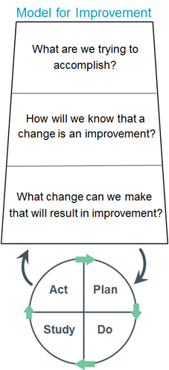
Start with a Good Model
The IHI Model for Improvement
http://www.ihi.org/resources/Pages/HowtoImprove/ScienceofImprovementHowtoImprove.aspx
Notes:
The IHI model for improvement is an effective approach to addressing a specific quality issue. As the name implies, this approach is a good example or model to follow and is one of the most commonly used QI approaches in healthcare today.
The IHI model consists of 3 essential questions. The sequence of addressing these questions is not absolute. But, addressing all 3 questions is important. These questions require us to define our Aim or specific desired point, how will you know the change is an improvement which requires measurement and the changes that can be implemented to lead to improvement.
Using this model, let’s walk through the process and a few tools as we travel this road to QI.

Slide 11
NOTE
The examples in the following slides are fictious and incomplete. They are for illustration purposes only.

Slide 12
What are you trying to accomplish?
Aim statement
SMART
Specific change? How much? By when?
By August 1, 2023, we will increase the appropriate utilization of analgesics to pediatric extremity trauma patients by 20%.
Sources: Environmental Scan; Past measures; Staff surveys; Patient satisfaction surveys; Process map the ideal
Notes:
The first question focuses on what we want to see meaning what is the performance or outcome or basic structure that we wish to see. Some might phrase this as defining the problem you are trying to solve.
In defining this, we create a SMART Aim statement. Some often create a global aim or purpose first before creating the Aim Statement. It is simpler to create and can help a QI team better understand the issue.
We have discussed Aim statements in a prior sessions.
Let’s walk through an example QI effort to see these steps in practice.
In this case, we are using a purely fictious and simplified example. Over the next few slides, the example statements will be included in the green boxes.
In this example, we used things like our environmental scan, surveys and maybe even a process map to define our Aim statement. Our Aim statement is By August 1, 2023, we will increase the appropriate utilization of analgesics to pediatric extremity trauma patients by 20%.
Notice the intention to include a specific, measurable, achievable, realistic and time bound statement.
Again, this is a simplified example for illustration purposes only.

Slide 13
What are you trying to accomplish?
Global aim
You may begin with a global aim (broad goal)
But then, progress to an Aim statement
Example Global Aim
If we treat pain in children with extremity trauma, we may improve assessment capability, improve patient and family satisfaction, and/or reduce complications.
Notes:
Again, the global aim is a broad goal or purpose. It should precede an Aim statement but it definitely does not replace a SMART Aim statement.
Notice how this global aim statement is broad without specific measurable improvement or time bound component. But, it can be a good starting point if you wish to include a global aim.

Slide 14
Build Your Team
Who
Leader
Project Manager
QI “expert”/QI Coach/ Improvement advisor
Subject Matter Experts
Frontline staff
Impacted stakeholders
Others?
Share Aims, Ideas, Hypotheses
Later with Experience:
Create a project charter (defines scope & Roles/Responsibilities)
Provide team with baseline QI framework
Sources:
Stakeholder grid
Organization leadership
This Photo by Unknown Author is licensed under CC BY-NC
Notes:
Though not a specific step in the IHI model as shown in this example, the IHI does recognize the value of building your QI team. With some degree of an aim created, it’s time to build your team.
Remember to consider the expertise or perspective each team member brings to the QI effort. These are example functions or expertise to consider.
Once the team is formed, come together to share the global aim, refine the aim statement and develop ideas or hypotheses for your QI effort.

Slide 15
How will you know that a change occurred and is an improvement?
Measures of Change
Define how to determine that change occurred
What are the specific measures? Which direction indicates improvement?
Are the data available?
Create EMR query for the number of children with extremity trauma
Sort by those receiving analgesics; Sort by those with documented contraindications; Identify adverse events
Create a proxy measures: satisfaction & decreased pain
Sources:
Your data systems
Defined standards for your healthcare setting
Newly created standards
Notes:
Using our IHI model, our next two questions can be addressed in either order.
Let’s start with the second question – how will you know that a change has occurred and it is an improvement?
This is the time to carefully break down your Aim statement to determine what change you will look for.
Then we determine ways to measure now only that change occurred but to what degree was this change meaning how much change occurred.
Take a look at data systems within your organization. Look for standards as a starting place where change may already be being measured and as a result data systems are already collecting data for this change.
In our example, we have chosen to query our EMR system to gather specific data. Since we already measure pain and medication use as well as adverse event occurrences, we do not need to create any proxy measures.

Slide 16
A Little More on Measures
Starts with your SMART Aim
What is the ideal?
How would you measure it?
How can you measure it?
Could proxy measures be used?
What data is available?
Define your measures
Remember to collect baseline data
Notes:
We have not spoken much on the topic of measures because it can be a little more complex. Analytics professionals are great team members to have for this specific reason.
As we work to define our measures, we can ask ourselves these relatively simple questions to help guide us.
In the end, we must define those measures that will inform us of change that occurs after implementing our change strategies and the degree plus direction of these changes.

Slide 17
More on Measures in a few minutes
Notes:
We will come back to measures in a few minutes.

Slide 18
What changes can you make to drive progress toward improvement?
Change Strategies
Define key drivers
What changes will impact these drivers?
What change will you choose as the first to test?
Identify impactful, realistic changes
Your first cycle – Post metric dashboard
Sources: Key driver diagram; Fishbone (cause & effect) diagram; Team theories & ideas
Notes:
Our next IHI model question asks us to define the change strategy we will implement as we seek to improve. A change strategy is…
Some useful places to start are to create a key driver diagram to include some possible change strategies. You could also use a fishbone or cause&effect diagram to identify the barriers to reaching the desired performance. Either way, the objective is to take a look at the possible change strategies. Then, select one that is likely to result in improvement.
Often we start with a fairly simple but effective change strategy so that the Team can gain a quick win. This approach also helps the Team refine its own PDSA processes.
In our example, we have chosen to regularly post a dashboard with our defined metrics. We will post this dashboard in a location where all staff can easily view it. As you might imagine, we are simply informing staff of our current performance. Our staff understand the value of analgesics but there may be other barriers to utilizing it in pediatric extremity trauma including a lack of awareness of under-utilization. We will ensure all staff are aware of the dashboard and encourage them to view it frequently.
We will frequently measure and post our performance for a defined period of time.

Slide 19
Notes:
Do not modify the notes in this section to avoid tampering with the Poll Everywhere activity. More info at polleverywhere.com/support What is one driver that you have (or will) focus on to make improvements?
https://www.polleverywhere.com/free_text_polls/7R5UvpuGWGWAKNgSIDWgR

Slide 20
3 Key Questions - Summary
Aim – What change do you seek? By how much? By when?
Measures – Is this change an improvement? Measure types - Structural, Process or Outcomes?
Changes – What changes/strategies will achieve the aim? Can these be measured?
Notes:
So far, we have worked through the first three questions of the IHI model.
We began with our Aim statement. We used the SMART Aim approach with a focus on defining a specific change, creating a desired amount of change and defined a time period for us to achieve this change.
Then, we defined the measures that will inform us of how we are doing. We will share more about the specific type of measures we chose.
Lastly, we defined a specific change strategy we plan to implement first and ensured this change can be measured for improvement.

Slide 21
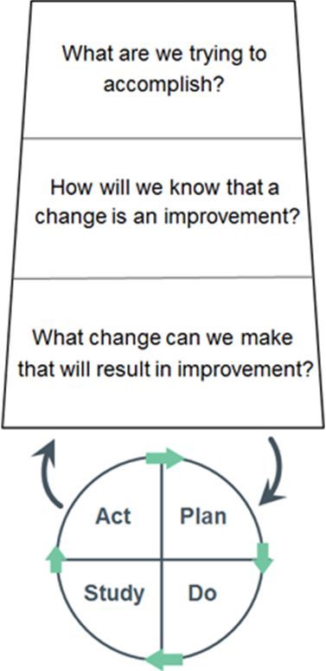
The PDSA Cycle
Testing Your Change Strategies
Notes:
Most of you have probably heard of a PDSA or PDSA cycle.
Over the next few minutes, we will walk you through this process as it is the most significant portion of the IHI model for improvement.
Let’s get started.

Slide 22
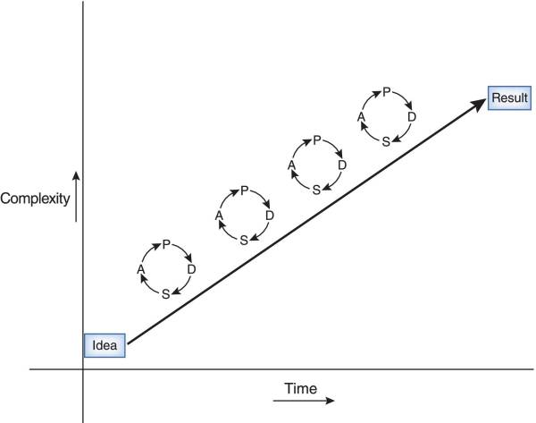
The PDSA Cycle
McQuillan, Rory Francis et al. “How to Measure and Interpret Quality Improvement Data.” Clinical journal of the American Society of Nephrology : CJASN vol. 11,5 (2016): 908-14. doi:10.2215/CJN.11511015
Notes:
The basic premise of the PDSA cycle is the begin with a single cycle that includes these four components of plan, do, study and act. The cycle is defined by implementing and measuring one specific change strategy.
The PDSA cycle is our process for testing our change strategy.
Each cycle should be fairly brief but with sufficient time to collect data that informs you about the change and improvement.
Since these are short cycles, the intention is not to simply use a single cycle to determine change.
Instead, QI uses multiple cycles to test successive changes as we seek to reach our Aim or even go beyond our initial Aim. In this way, we progress from an idea “If we do this, we should be able to see improvement here” to a result “We did this and as a result we improved that.”
Do not underestimate the power of implementing effective and meaningful changes, meaning several, in order to reach your Aim.

Slide 23
The PDSA Cycle
The 3 Key Questions
Theories & Ideas
Plan
Do
Study
Changes ➔ Improvement
Act
Celebrate!
Share!
Predict what will happen
What & Who
When, Where & How
Which data to collect
PDSA
Define next steps
Adopt, Adapt or Abandon the implemented change
Use driver diagram or fishbone
Plan a more impactful change strategy
Implement the change
Document what occurred
Document problems
Collect data
Analyze the data & results
Reflect on the plan
Compare to predictions
What did you learn?
Notes:
As we look a little close at the PDSA cycle, we can get a better idea of what specific actions we are to do.
We start with our theories and ideas of what will happen or where we want to be.
The planning step includes predicting what might happen as well as defining what specific changes you will make, where will this occur, how will it be done and who will do it. It may be that your analytics professional will define the specific metrics, maybe your graphics person (or creative staff member) will design the dashboard with the analytics person, the dashboard will be placed on the wall near all staff break areas, these steps will begin on June 1 and end on June 21, your clinical educator will explain the process to your staff and your team will update the dashboard every 3 days. You might do this with just a portion of your organization as a first step.
Now that you have a plan, make it happen. During this time document your observations about the change and about performance. What did you notice? What did not go so well? What awesome things did you observe? And of course, collect data.
After your cycle ends, study the results, your observations and the data. What does all of this tell you?
Now it is time to make a decision. Did change occur? Was it improvement? Should you adopt this change strategy, adapt it slightly or abandon it all together?
Then, plan your next effective, impactful change strategy and start your second cycle using the same process.
Don’t forget to celebrate the improvements that occurred and the successes you and the team had. Plus, celebrate the staff and their performance when improvement occurred.
After you have completed your cycles, consider whether your group can sustain these changes. Plus, how would you implement this across a larger group such as your entire hospital or entire EMS agency.
Finally, determine ways to completely integrate this change into your organization and your organization’s culture. That means, make it the way you do things around here.

Slide 24
Back to Measures
Remember - The examples in the following slides are fictious and incomplete. They are for illustration purposes only.
Notes:
Earlier, we talked a little about measures. Now, let’s review a little more.

Slide 25
A Little More on Measures
Types of Measures - Donabedian Model for Evaluating Quality
Structural
(Inputs)
Process
(Activities)
Outcomes
(Outputs or Results)
People
Infrastructure
Materials
Technology
Environment
What is done
How it is done
Procedures
Services
Diagnostics
Therapeutics
Change in health status
Survival
Decreased harm
Satisfaction
Adverse event rates
Balancing Measures
Side Effects
Unintended consequences
Notes:
You may have heard us speaking about structural, process or outcome measures.
This commonly utilized model for evaluating health services is credited to Avedis Donabedian, a physician and researcher in Michigan.
This model uses these three types of measures as a guide for evaluation. Those who have studied systems evaluations may know this approach as involving inputs, activities and outputs.
This slide provides examples of what you might measure in each of these categories. It is not necessary to have measures for each category in every QI effort. That would be nice but not necessary.
Most often, we all wish to focus on Outcomes. The reality is that we need structural elements in place in order for processes or activities to be able to be carried out. Without processes or activities, we can have no outcomes.
So, all are important. If you have effective structural elements already in place, then there is no need to measure these. Most of your measures will likely be processes and outcomes unless of course your QI effort is in an area that lacks structural components.
A fourth category of measures often utilized are referred to as balancing measures. Some refer to them as side effect measures. These types of measures seek to determine whether our change strategies created unintended or undesirable effects.
Ideally, we would like to have the greatest improvement on outcomes with the most minimal, infrequent or low impact side effects.

Slide 26
Example
By August 1, 2023, we will increase the appropriate utilization of analgesics to pediatric extremity trauma patients by 20%.
Change Strategy #1 – Key Driver: Staff Awareness
Post a dashboard displaying analgesic use over time
Dashboard includes statement on
Importance of decreasing pain in children with extremity trauma
Underutilization of analgesics in children compared to adults
Inform staff
Track changes in utilization
Track adverse events
Notes:
Back to our example.
Here’s our aim statement again.
This is our change strategy. Adding detail to this would create our plan and specifics surrounding our measures.

Slide 27
Example
By August 1, 2023, we will increase the appropriate utilization of analgesics to pediatric extremity trauma patients by 20%.
What data might you need?
# children with extremity trauma
# of these children receiving analgesics
# of children with documented contraindications to analgesics
Data sorted by month
Measures
Baseline
Rates or Proportion
Impact/Outcomes
Pain scores
Satisfaction survey (family)
Proxy – decreased heart rate following analgesic?
Balancing
Adverse events (apnea, hypoxia, etc)
Notes:
To capture these measures, we will need some specific data.
Here we have identified some specific data that we will need to obtain as well as measures we will need to calculate and then include in our dashboard.
Notice how this example includes pain scores and satisfaction as measures of change and improvement while measures of adverse events will serve as our balancing measure.

Slide 28
Notes:
Do not modify the notes in this section to avoid tampering with the Poll Everywhere activity. More info at polleverywhere.com/support What type of measure is this?
https://www.polleverywhere.com/multiple_choice_polls/n9dx42GAOHwqxCywtSWlq?state=opened&flow=Default&onscreen=persist

Slide 29
Summary
Aim – What change do you seek? By how much? By when?
Changes – What changes/strategies will achieve the aim? Can these be measured?
Measures – Did improvement occur? Which measures? Structural, Process or Outcomes
PDSA Cycle(s) – Test the change strategy
Plan – Who, What, When, How, Which Data
Do – Implement the change strategy on a small scale for a short time
Study – Document and review the observations and data collected
Act – Reflect on findings; Define next steps; Adopt, Adapt or Abandon
Goal is to move to a more impactful change strategy in cycle #2
Notes:
Now, putting the IHI model all together we have reviewed
The need to begin with creating our Aim statement
Identifying our changes
Identifying how we will measure our changes and improvement
And planned then tested our change strategy using a plan, do, study, act model.
Our expectation is to complete additional cycles to gain even further improvements using multiple change strategies.

Slide 30
A Simple Overview
Notes:
That is a lot of information to grasp. So, let’s look at a map to help guide you.

Slide 31
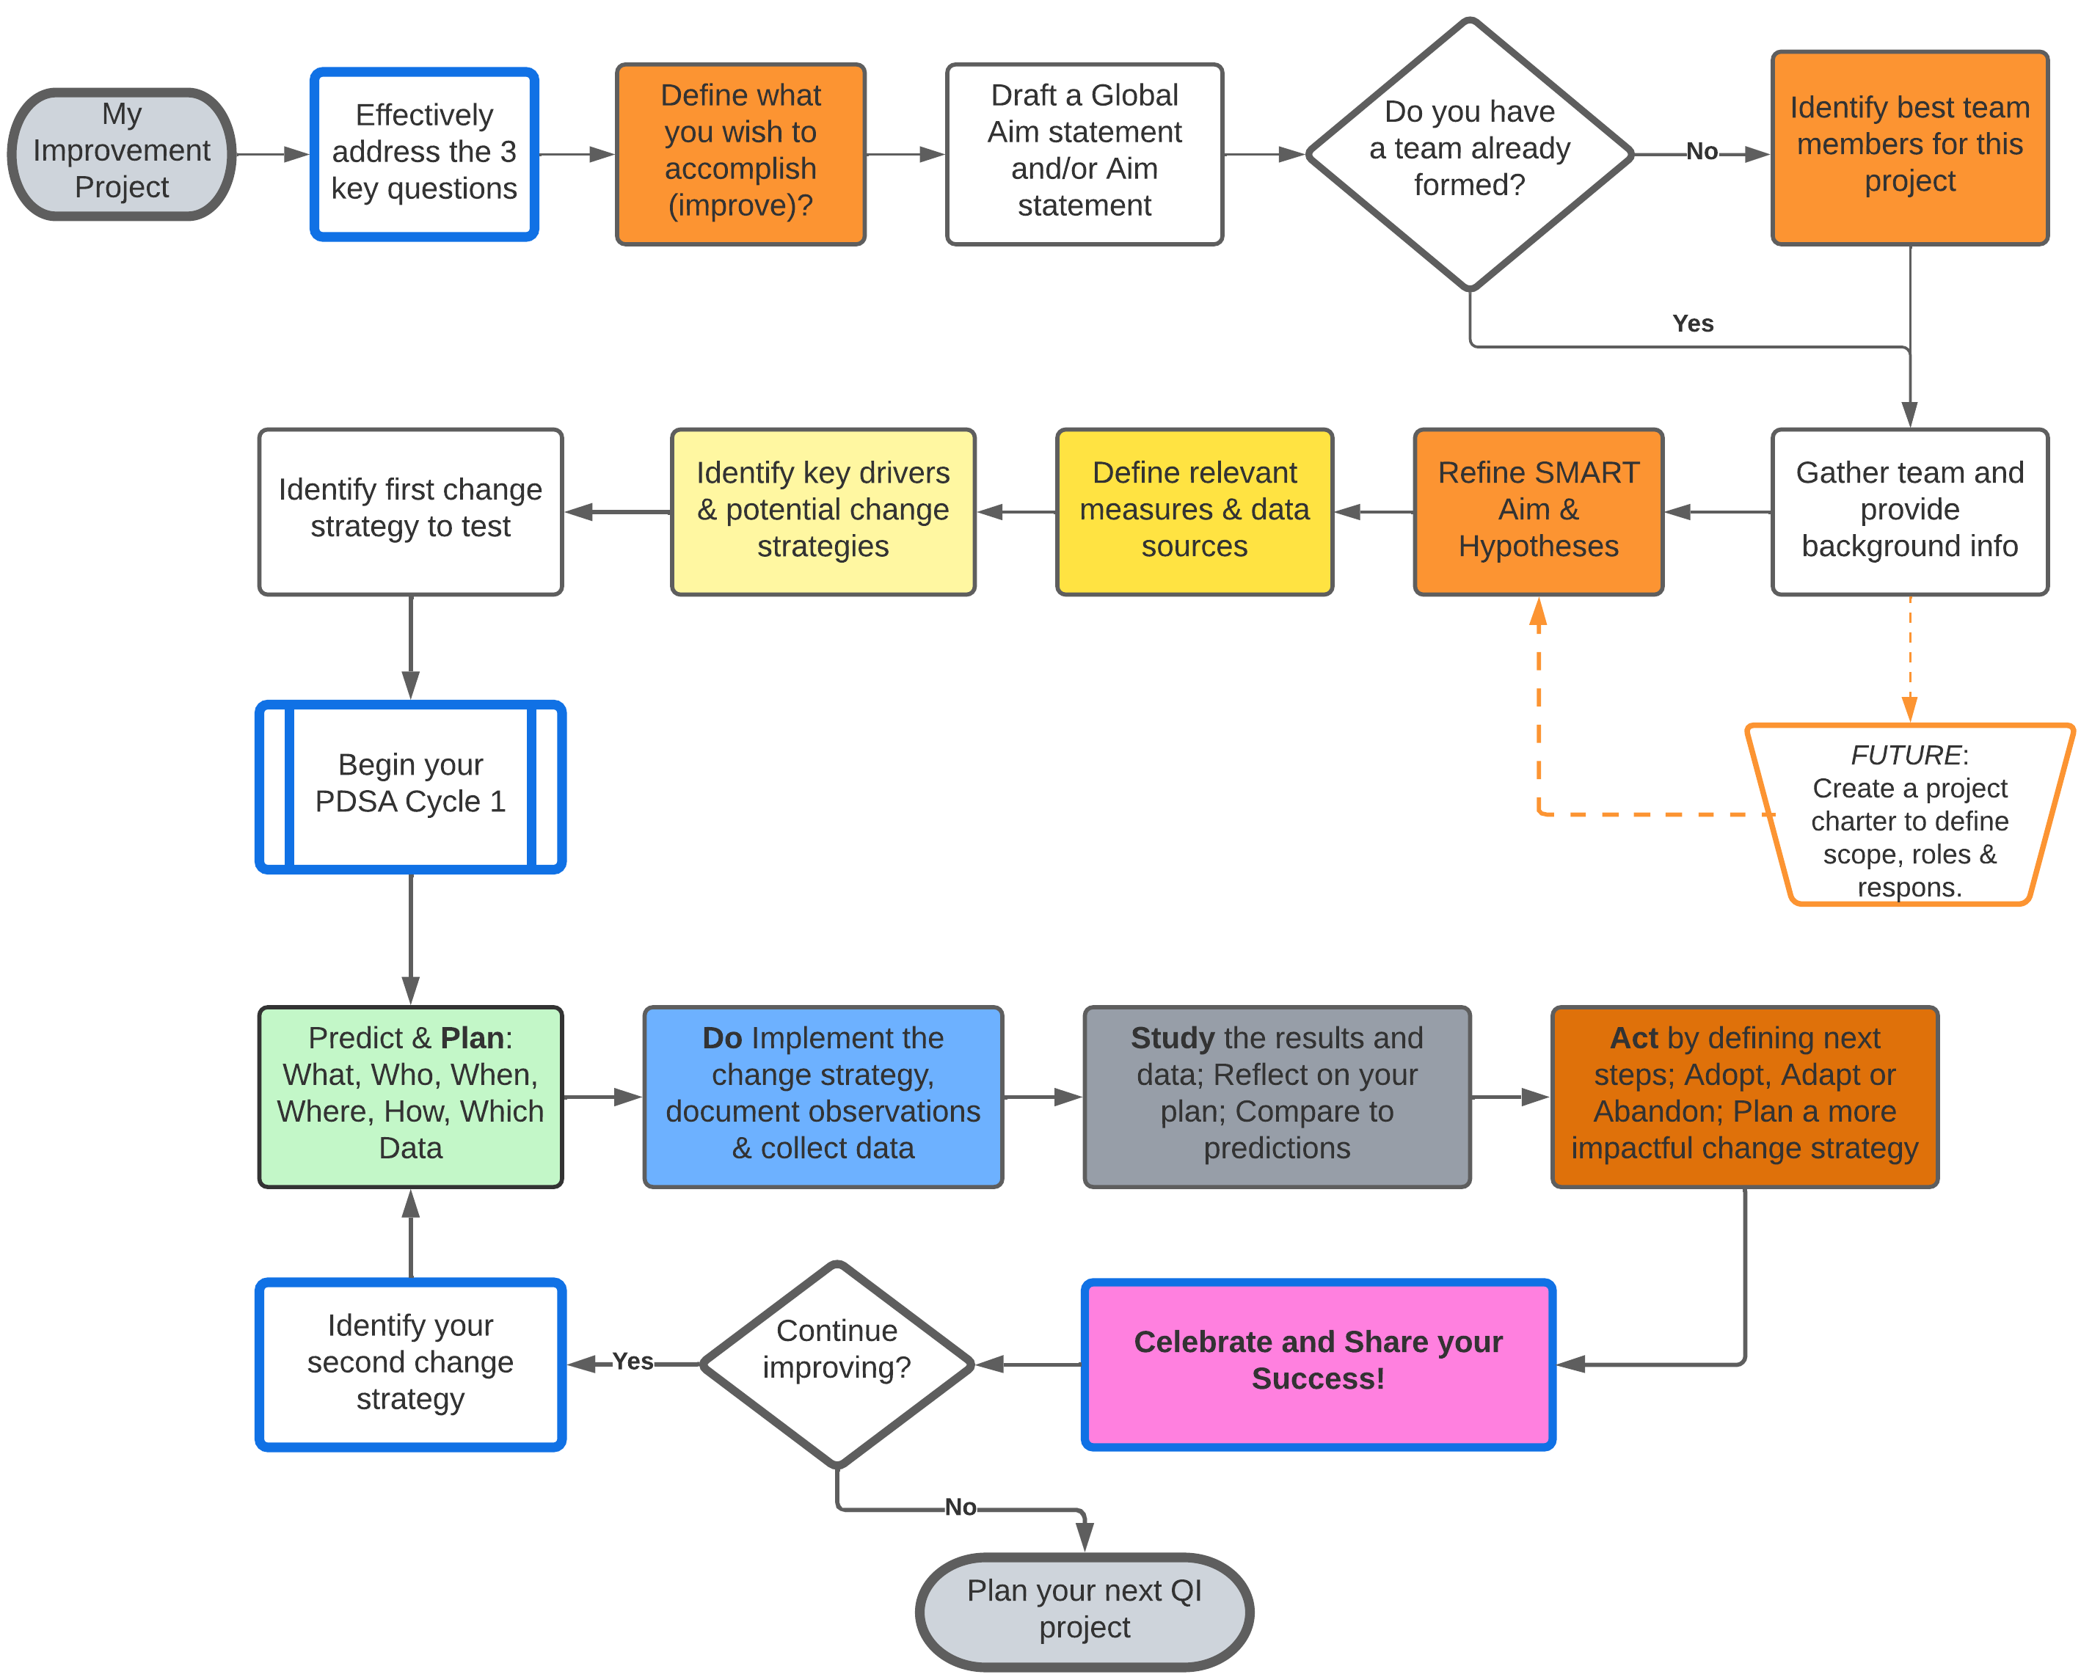
QI Process Flow
Notes:
This process flow map walks you through the steps we just reviewed.
We begin with the IHI model’s 3 key questions noted in shades of orange and yellow then progress to our PDSA cycle shown in green, blue, gray and dark orange.
Then, because we made great strides in improvement, we celebrated our success and then began our second cycle.
That’s it. Hopefully, this map will help guide you through your Project in Phase 2.

Slide 32
Just Culture
A critical culture aspect

Slide 33
What is it?
An open and fair organizational culture that incorporates shared accountability, recognizes human error but always aims to improve safety. It focuses on human behavioral choices not system failures.
Just Culture recognizes that safety requires
a learning culture,
safe systems design, and
a just approach to responding to behavioral choices

Slide 34
Just Culture
Risk & Human Behavior
Human Error
Slip, lapse, mistake
At-Risk Behavior
Inadvertent action
Reckless Behavior
Choice
Increases risk
Risk is not fully recognized
Risk mistakenly believed justified
Choice
Conscious disregard
Substantial & unjustifiable risk
Console
Coach
Punitive

