Slide 1
Learning Session
28-January 2020
Hosts:, FAAP, FACEP, FAEMS
Kate Remick, MD
Diana Fendya, MSN (R), RN
Meredith Rodriguez, PhD
Krystle Bartley, MA

Slide 2
ACKNOWLEDGEMENTS
The HRSA, MCHB EIIC is supported in part by the Health Resources and Services Administration (HRSA) of the U.S. Department of Health and Human Services (HHS) under grant number U07MC29829. This information or content and conclusions are those of the author and should not be construed as the official position or policy of, nor should any endorsements be inferred by HRSA, HHS or the U.S. Government.

Slide 3
ACKNOWLEDGEMENTS
This continuing nursing education activity was approved by the Emergency Nurses Association, an accredited approver by the American Nurses Credentialing Center’s Commission on Accreditation for 1.5 contact hours.

Slide 4
LEARNING SESSION DISCLOSURES
Note Faculty/Speakers and Planners for this learning session:
Kate Remick, MD
Diana Fendya, MSN (R), RN
Meredith Rodriguez, PhD
Krystle Bartley, MA
have no conflicts of interest. Additionally, no commercial support has been received for this activity.
Should participants detect any bias in this presentation please note such on the evaluation or reach out to Diana Fendya, nurse planner for continuing education.

Slide 5
TO OBTAIN NURSING CEs
Sign into the webinar: name, email address and name of your facility.
At the completion of the presentation a link will be provided which will take you to a short evaluation form which you will need to complete.
The evaluation must be completed within 2 weeks:
https://tch-redcap.texaschildrens.org/REDCap/surveys/?s=C3CHENDRY8
Within 48 hours of receiving your evaluation, your certificate will be sent to you electronically.

Slide 6
AGENDA
28-JANUARY-2020 LEARNING SESSION
Creating Sustainability– 15”
Sujit Iyer, MD
The Longhorn Kids
Dell Children’s Hospital, Austin TX
Aggregate Performance – 5”
PRQC Admin Team
Team Presentations– 30”
WISPR
LifesavERs
Housekeeping – 5”
Meredith Rodriguez

Slide 7
Investing in Community Pediatric Champions to Drive Improvement
Sujit Iyer, MD. FAAP, FACEP
Director, Pediatric ED Outreach, Seton Family of Hospitals
Assistant Medical Director, Dell Children’s Medical Center Emergency Department
Associate Fellowship Director, UT Austin Dell Medical School, Pediatric Emergency Medicine Fellowship
© 2017 Ascension
This work, including its content, may not be used, reproduced, duplicated, displayed or distributed absent express written permission from Ascension.

Slide 8
Faculty Disclosure
In the past 12 months, I have had no relevant financial relationships with the manufacturer(s) of any commercial product(s) and/or provider(s) of commercial service(s) discussed in this activity.
I do not intend to discuss an unapproved/investigative use of a commercial product/device in my presentation

Slide 9
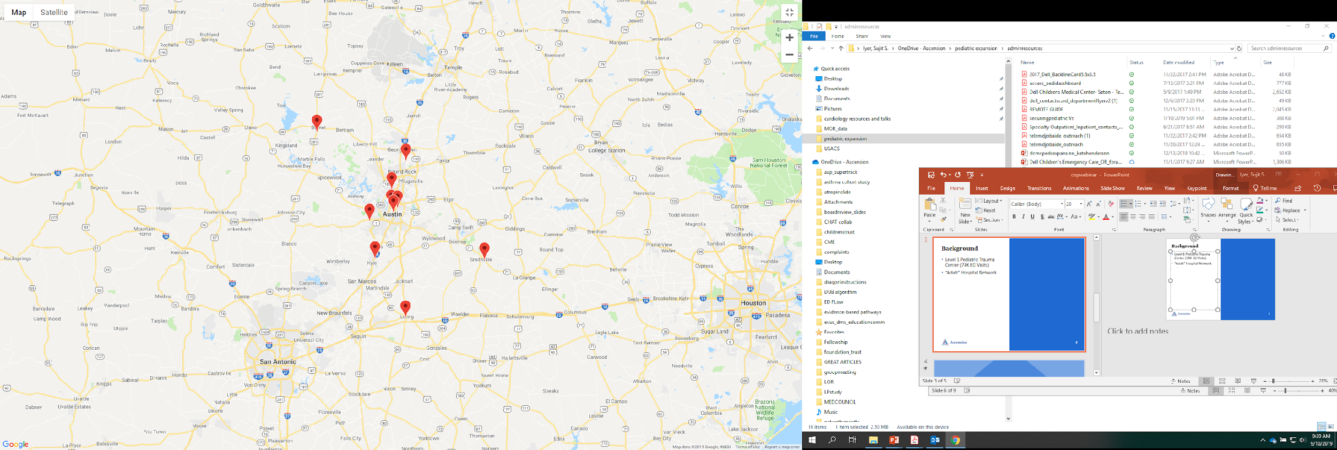
Background
Level 1 Pediatric Trauma Center (79K ED Visits)
“Adult” Hospital Network
10 community hospitals
Market: 149K Pediatric Visits
Community hospitals total
70K Pediatric ED Visits
Small community hospital
9,000 ED visits per year
Large Community Hospital
300 Peds ED visits per year

Slide 10
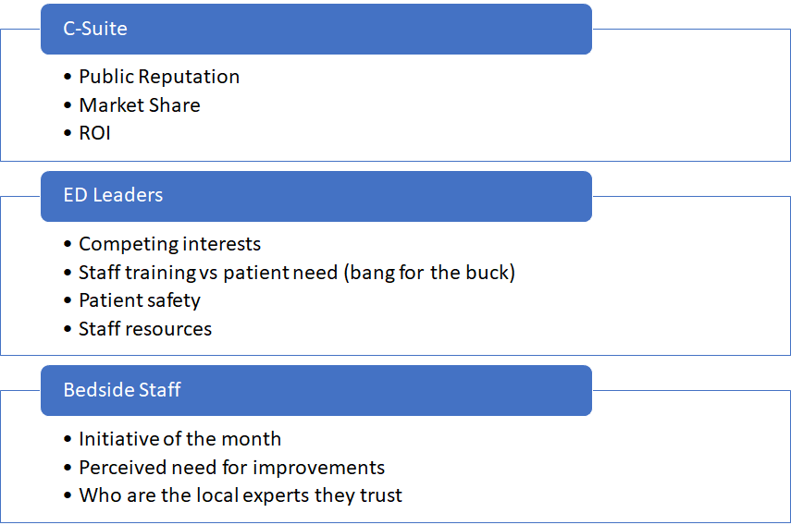
Different Drivers

Slide 11
Why should we work on this?
Improving Pediatric Care
Good enough for now
No specific complaints
Community Feedback
Competing initiatives
Market Share creep
No evidence to suggest need for improvement
Tangible benefits from Peds Readiness work
Limited resources

Slide 12
Prove the case for improvement
Clinical Case
Chart reviews of vital sign performance
Electronic dashboard for asthma
Peer pressure
Executive ownership
Market creep
Volume trend
Monthly business review
“Parent’ hospital responsibility
Designated outreach directors (MD &RN )
Commitment to supplies
On site improvement plans

Slide 13
“Peer” pressure

Slide 14
More than “pushing information”
Supplies
Review checklist and fill in gaps
Expired supply process
On site training
Clinical training
Cross trained personnel
On site training
Video training series
Data
“Home” site reviews charts
Develop monthly operational review
Keep it simple
Advocate
Present needs to c-suites
Aim for success (not the stars)
Praise the wins

Slide 15
Always help with the “easy”
“Free” infant scale
Take expired supplies
“Pediatric cart:
Supplies
“Hosting” at children’s hospital
Directed by sites - multimodal
Training
Back line office numbers
Centralized protocols and information
Case management
Access

Slide 16
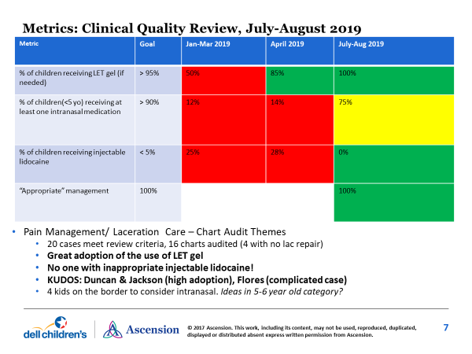
Keeping pediatrics on the radar

Slide 17
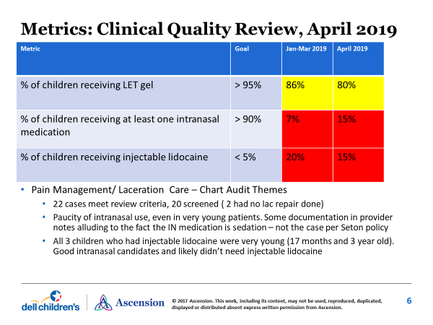
Momentum is hard
Site Name | 2013-14 Score | 2015-16 Score | Last Listed Champion
Seton Hays | 60 | 100 | Jennifer Valencia
Seton Edgar B Davis | N/A | 99 | David Indorf
Seton Main | 71 | 100 | Jan Duich
Seton Williamson | N/A | 100 | Anita Moran and Laura Pittman
Seton Highland Lakes | 60 | 74 | Vickie Spaw and Sherry Brown
Seton Northwest | 60 | 86 | Sue Phillips and Jessi Ray
Seton Southwest | 60 | 89 | Rebecca Mull
Dell Seton Med Center at UT | 97 | 81 | Bryony Anderson
Seton Smithville |  |  | Melinda DeLong
Providence Health Center | N/A | N/A
Dell Children’s Medical Center | 100 | 100 | Denita Lyons/Kate Remick
Different strategies for different places?

Slide 18
Pushing the right buttons
C suite buy-in
Empower bedside staff
Make the “personal” business case
Must work for that site
Distribute the work
Everyone likes free
Define issue
Develop solutions
Successes and Barriers
Implementation
Define the “needs”
Define the real barriers
Peer pressure (and coaching)
Simple quality audits
Bedside interviews

Slide 20
TEAM PRESENTATIONS

Slide 21
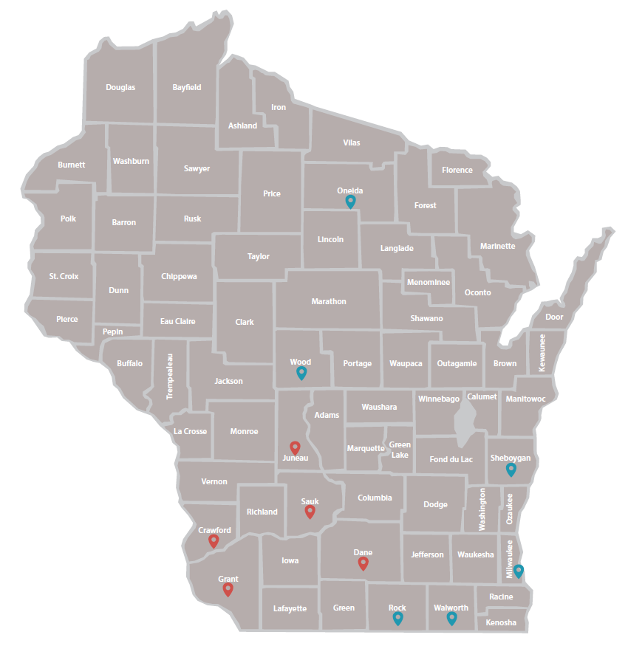
Team 12 – WISPR
14 original affiliate hospitals
11 active affiliate hospitals
Mix of rural and urban
25 – 505 beds
Peds volume: Low (<1,800), medium, (1,800-4,999) and medium high (5,000-9,999)
Pads volume: Low (<1,800), medium
(1,800-4,999) and medium high (5,000-9,999)
Notes:
Hello, I am ( ), one of the trainers for Team 12, WISPR. WISPR is located in WI. We had 14 original affiliate hospitals. Of those, we have 11 active affiliate hospitals, as three of our hospitals left the collaborative due to staff turnover and competing priorities. Our team is made up of a mix of rural and urban hospitals. They range in beds from 25-505, and range in pediatric volume from low to medium high.

Slide 22
Team 12 - WISPR
Crossing Rivers Health
Sauk Prairie Healthcare
Southwest Health Center
Mile Bluff Medical Center
UnityPoint Health - Meriter
Howard Young Medical Center
Ascension - Franklin
Mercy Health Hospital and Medical Center - Walworth
Mercy Health System and Trauma Center - Janesville
Aurora Sheboygan Memorial Medical Center
Marshfield Medical Center
Training team
Lorin Browne, DO
Matt Pinsoneault, NRP
Michael K. Kim, MD
Ben Eithun, MSN, CRNP, RN, CPNP-AC, CCRN
Notes:
Our team includes the following hospitals:
Crossing Rivers Health
Sauk Prairie Healthcare
Southwest Health Center
Mile Bluff Medical Center
UnityPoint Health - Meriter
Howard Young Medical Center
Ascension - Franklin
Mercy Health Hospital and Medical Center - Walworth
Mercy Health System and Trauma Center - Janesville
Aurora Sheboygan Memorial Medical Center
Marshfield Medical Center
And four trainers from Children’s Wisconsin and American Family Children’s Hospital:
Lorin Browne, DO
Matt Pinsoneault, NRP
Michael K. Kim, MD
Ben Eithun, MSN, CRNP, RN, CPNP-AC, CCRN

Slide 23
Bundle Selection
Notes:
We have hospitals participating in each of the 4 bundles, but abnormal vital signs has been most popular, with 8 total hospitals.
Crossing Rivers is currently enrolled in both the interfacility transfer and abnormal vitals bundles.

Slide 24
WISPR Data Entry and PDSA Cycles
7 affiliate hospitals entering data
Total of 824 pediatric charts entered
2 disaster planning drill completed
16 PDSA cycles completed
Crossing Rivers Health (4 cycles)
Ascension Franklin (2 cycles)
Aurora Sheboygan Memorial (6 cycles)
Mile Bluff Medical Center (3 cycles)
Sauk Prairie Hospital (1 cycle)
Notes:
Of our 11 affiliate hospitals, 7 have begun entering data and a total of 584 pediatric charts have been entered and 2 disaster planning drills have been completed. (Ascension Franklin - 63 Aurora Sheboygan – 180, Crossing Rivers – 152 , Mile Bluff – 76, Sauk Prairie -50, Southwest Health – 30, Unity Point – 24, Mercy Health Janesville – 2 disaster drills)
4 of our affiliate hospitals are actively running PDSA cycles; Crossing Rivers Health, Aurora Sheboygan Memorial and Southwest Health. A total of 11 PDSA cycles have been completed by WISPR affiliate hospitals.

Slide 25
Challenges
Delays in completing DUA
Pediatric champion turnover
Competing priorities at affiliate hospitals
Current focus
Encourage hospitals to move from baseline data entry to PDSA cycles
Notes:
Our team has experienced many of the same challenges addressed in previous learning sessions.
Completing DUAs was much more time intensive than we originally expected. We experienced significant delays establishing DUAs for affiliate hospitals that are part of national health systems (Ascension). We have 1 affiliate site that is still in the process of completing a DUA (Marshfield Clinic) and we are hopeful that the agreement will be signed shortly.
We also experienced turnover in pediatric champions and competing priorities that hindered progress at our affiliate hospitals.
Our training team is focused on encouraging all affiliate sites to begin PDSA cycles and complete data entry. We have several hospitals (Southwest Health and UnityPoint Meriter) that have baseline data entered, but no PDSA cycle data entered)

Slide 26
Best Practices
Monthly team meetings
Regular communication between pediatric champions and training teams
Utilize WI EMSC State Partnership Program Manager
Monthly pulse-checks with team at EIIC
Notes:
Our monthly team meetings have been especially helpful for bringing all of our pediatric champions together to discuss their challenges, brainstorm solutions and providing reminders about PRQC deadlines.
Our trainers have also encouraged our champions to reach out regularly to ask questions or seek resources to assist with their QI projects, which has been especially helpful.
Our team has also been able to utilize the WI EMSC State Partnership Program Manager to be responsible for many of the administrative aspects of PRQC, such as; organizing team meetings, sending reminders about timelines, and following-up on DUAS.
Our team also has benefited from monthly pulse-checks with Diana and Meredith at EIIC. We are very appreciative of the support and technical assistance they have provided!
Now, our pediatric champions from Ascension Franklin, Marybeth Heise and Drinka Marinkovic have offered to share their experiences with PRQC

Slide 27
Ascension Franklin Emergency Department

Slide 28
Pediatric Readiness
Marybeth Heise, RN, CEN, CPEN
Drinka Marinkovic, BSN, RN

Slide 29
All abnormal vital signs on pediatric patients will be recognized and communicated to the ED provider (MD or APP) and documented using the provider communication tab.
Aim Statement

Slide 30
Pediatric Readiness
Ascension Franklin
Process
Needed to establish a standardized method for notifying the ED provider of abnormal vital signs in pediatric patients (pediatric being classified as anyone <18 years old).
Use the provider communication tab in EPIC to document action of “notifying provider.”
Nursing judgement will determine if you have that face to face conversation or indicate the abnormality in comments section on the tracking board.
Sampling strategy – every 5th patient up to 30-35 charts.
21,000 visits annually, 3,000 pediatric visits annually.

Slide 31
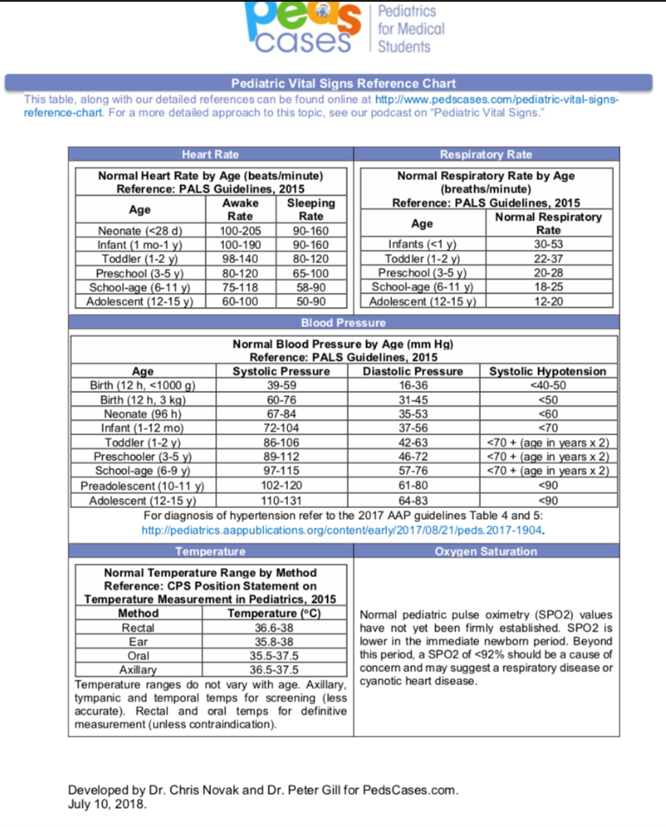
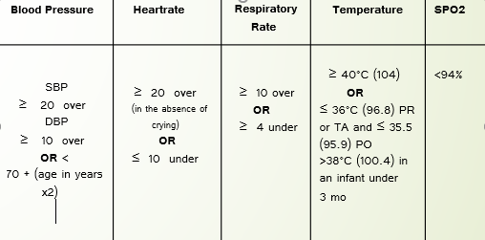
Pediatric Readiness
Ascension Franklin
Thresholds

Slide 32
Pediatric Readiness Barriers
Ascension Franklin
Late data user agreement
Entering data: 1. time format 2. no place in IV intervention for pre-hospital or undocumented in chart (time isn’t accurate).
Scheduling conflicts with learning sessions.
Competing with other initiatives that require staff buy-in (sepsis and stroke protocol).
EMR optimization: cannot change build in EPIC.

Slide 33
Pediatric Readiness Best Practices
Ascension Franklin
-Adapted new vital sign parameters which are more age-specific, to avoid “lumping” broad ranges.
-Will be including an expected timeframe for 1st set of vitals into triage policy.
-EDTs should make sure they are entering the time of vitals as the time actually taken.
-Staff reinforcement: vital signs including blood pressure on age 3 and up, and as appropriate for other ages.
-Revisiting ESCAPE screen with staff and discussing better strategies for assessing mental health/suicide on the pediatric population.

Slide 34
Pediatric Readiness
Ascension Franklin

Slide 35
Pediatric readiness quality collaborative data
Ensuring Emergency Care for All Children
Ashley Vossekuil, RN BSN

Slide 36
PDSA Cycle # 1- Obtain Full set of Vital signs on every pediatric patient in the month of November
Summary after our chart audits:
80% of chart did obtain a full set of vital signs.
Blood pressure and Pain scale were the two missed documented vital signs.
Barriers
-Staff expressed it was difficulty to obtain a blood pressure on the younger
pediatric patients and to assess pain.
Workflow change after doing chart audits:
Education on abnormal vitals signs
Implemented abnormal vital signs worksheet that are easy assessable for staff
-Positive feedback from patients and clinics

Slide 37
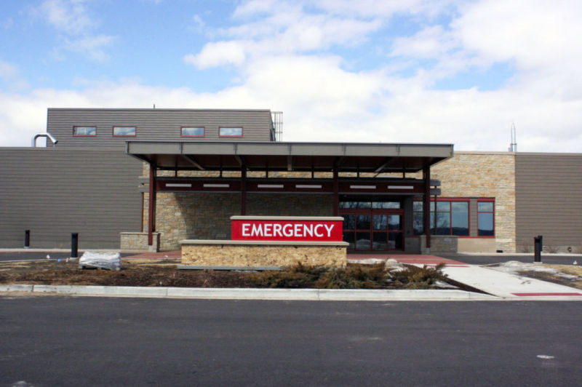
PSDA cycle #2
Recognition of abnormal vital signs on any pediatric patient and informing the provider.
After the triage nurse recognizes any abnormal vitals, they will need to inform the provider and document that in a new query we made in our computer database.

Slide 38
# 2 PDSA cycle= Recognition of abnormal vital signs/ informing the provider
What do we need our staff to do?
Still need staff to obtain a full set of vitals on every pediatric patient that is 3- 17 years of age, during the triage assessment.
This still includes doing vital signs on pediatric patient regardless if they are ER, URC, or fast-track.
Standard set of vital signs include:
Temperature
Heart Rate
Respiratory Rate
Pulse Oximetry
Blood Pressure
Pain

Slide 39
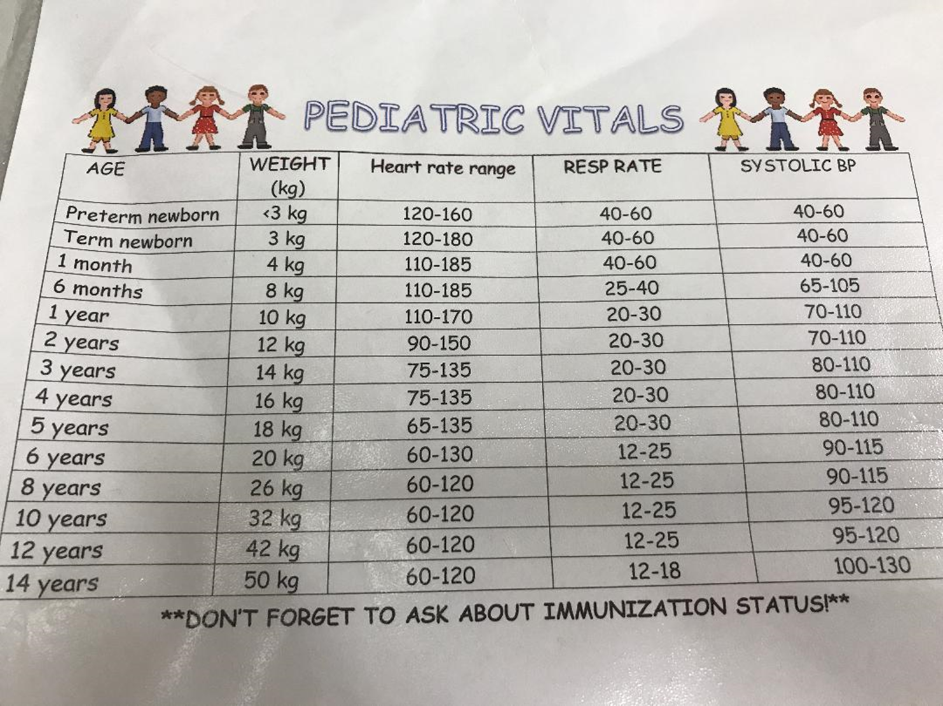
These are guidelines that our nurses use when recognize any abnormal vital signs:
Temperature: Contact MD if the following
3 year and under and is greater than 100.4
3 years and older and is greater than 101
Contact MD if Pulse oxygen sat is lower than 94%.

Slide 40
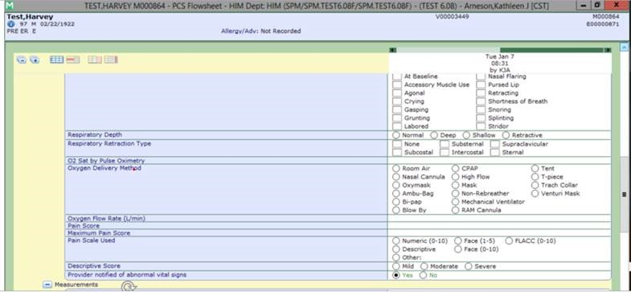
Documentation that the Provider was notified of abnormal vital signs
This new query was added to our computer database, for our staff to have an easy and fast way to document that they notified the provider. They will only check this box if there is an abnormal vital sign and have notified the provider.

Slide 41
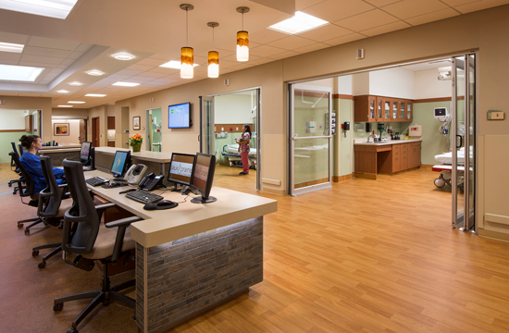
Sauk Prairie Healthcare
Starting January 9th, 2020 staff will continue documenting a full set of vitals on any pediatric patients that are between the ages 3-17 years old. Regardless of their registration status- (ER or Urgent Care). After obtaining triage vitals, the nurse should recognize any abnormal vitals and document that they informed the Provider.
After January, chart audits will be done to recognize any barriers or areas for improvements.

Slide 42
PRQC-pediatric readiness quality collaborative
Updates as of 01/09/2020

Slide 43
Pediatric 0-14 General: intervention
Chief complaint of all pediatric patients should be “Pediatric 0-14 General”
This will prompt a pediatric vital sign intervention that is required documentation-within documentation is the question “do these vitals fall WNL for age of the pt”, also a place to state provider was notified if the answer is no.
Has been live in Meditech since 9/29/2019
Laminated normal pediatric vital signs can be found throughout the ER-also linked into Meditech by clicking on the globe.

Slide 44
Chart audits
63 charts audited from 12/9/19-01/09/2020
All peds visits with ESI levels 1, 2, 3 audited
All visits that were ER with Peds general complaint audited (including ESI 4 and 5)
There were a total of 97 pediatric ER visits from 12/9-01/9 :36 of the 97 visits used the appropriate intervention (37%)
48.3% is an improvement from 29.6% from the last audit!!!!!!!
37% is a significant decline from the 48.3% of the charts that were correct in the last cycle.
20 of the 36 visits that used the appropriate complaint were used correctly (all documentation complete)-which is down from the 24 that were correct last audit

Slide 45
So what’s next?
1st cycle of audits was looking for the documentation (completion of the appropriate interventions) Still improving!!
2nd cycle of audits will address if nursing staff is appropriately recognizing when pediatric vital signs are not within normal limits All vitals that were outside of normal limits except 2 were documented as outside of normal limits!
3rd cycle of audits will address proper physician notification Notification is still not being done even though nurses are recognizing the abnormal vitals.
Feel free to find me/email me with any questions, comments, concerns!

Slide 46
Graphs

Slide 47
And the graphs mean??
Our average time from first vitals being taken to intervention (meaning IV start etc) is 33 minutes. (keep in mind that a majority of our peds patients don’t get IVs and when they do its right before they transfer or are admitted)
What we really need to be working on is the pink line. This shows in essence if the process was completed or not. (recognition→appropriately documented provider notification). We are at 36%--this number should ideally be 100%
We have some work to do, improvements to be made. Although this project is nearing an end, I do intend on following these trends and educating appropriately.

Slide 48
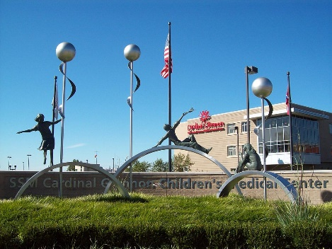
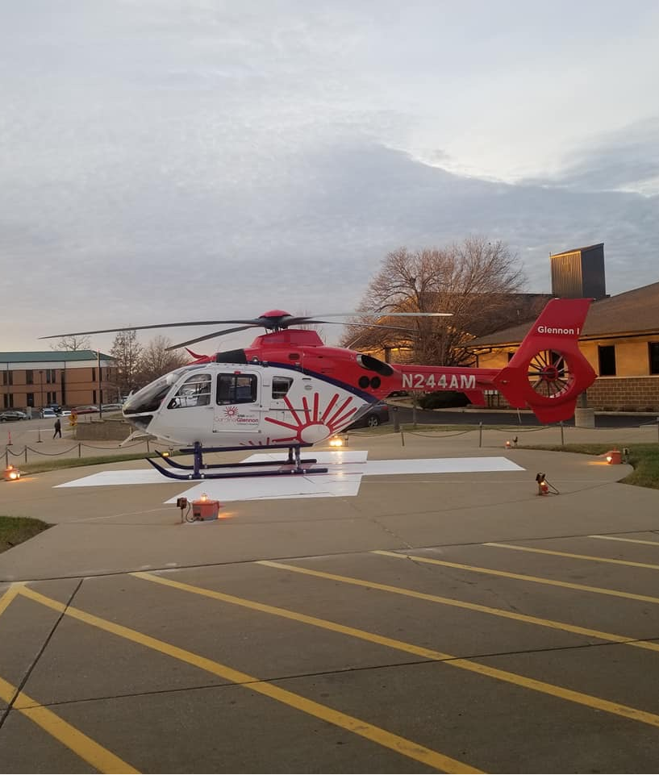
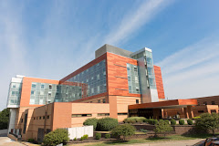
Glennon Transport Team at SJ LSL
SSMHealth Cardinal Glennon
SSMHealth St. Joseph Hospital Lake St. Louis
SSM Health St. Joseph Hospital, Lake St. Louis St Charles Missouri
Timothy Staed, MD SJ LSL Physician Lead EMSC PRQC
MJ Irwin, RN SJ LSL Nurse Champion EMSC PRQC
Cherie Coletta, PNP SJ LSL Nurse Champion EMSC PRQC

Slide 49
SSMHealth St. Joseph Lake St. Louis Update 1/28/2020
Lessons Learned

Slide 50
SSM Health St. Joseph Lake St. Louis It takes a Team
Involve as many people as you can on your team
Not everyone is available all the time – so encourage many people to participate
More participants = more buy-in from the hospital

Slide 51
SSM Health St. Joseph Lake St. Louis Drive fast AND Look at your Dashboard
Your Dashboard is your friend to assess how well you are meeting your goals
Getting data in quickly to increase number of PDSA cycles improves chances of seeing significant improvement

Slide 52
SSM Health St. Joseph Lake St. Louis REPORT to Administrators
Tell the people who are NOT part of the project what progress you are making
They will more likely support changes you want to make

Slide 53
SSM Health St. Joseph Lake St. Louis Celebrate victories and say Thank You
Each step forward is a victory that takes hard work and someone’s time
Participants are giving up their most valuable resource – their TIME. And not necessarily being reimbursed. Tell them how much you appreciate their contribution.

Slide 54
AGGREGATE PERFORMANCE
Data deep dives are coming
Over 6,200 charts entered

Slide 57
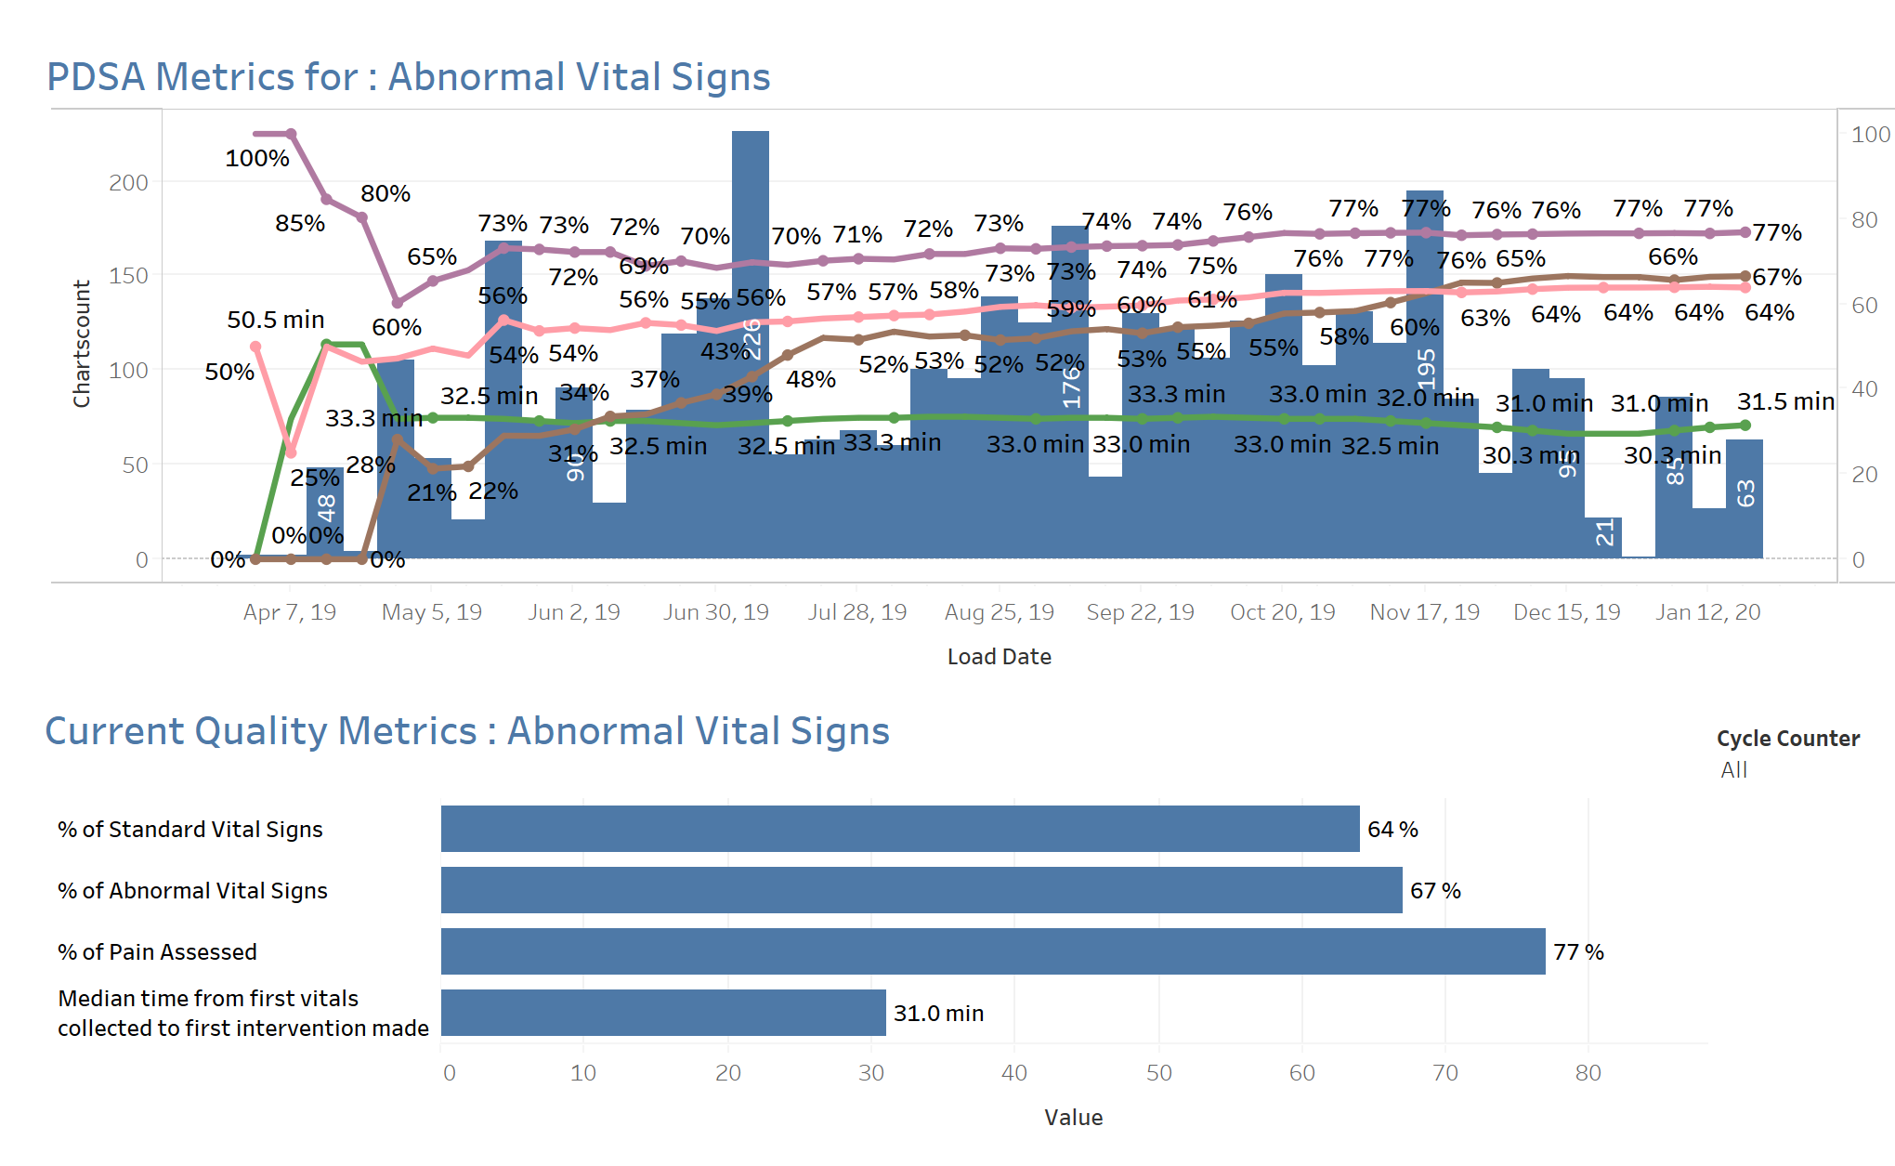

Slide 60
HOUSEKEEPING

Slide 61
All Teach, All Learn Culture
All working together
Share what works!
Get help and advice from others

Slide 62
Consider Sharing Resources
Policies &
Procedures
Charts & Newsletters
PowerPoint Presentations
Badge Buddies

Slide 63
Close of Collaborative: NPRP Assessment
April 1-30th
PRQC-specific website
Issues: email Meredith (mrodrqu@bcm.edu)

Slide 64
2020 Peds Ready Assessment
Assessment opens June 1st
www.PedsReady.org

Slide 65
Close of Collaborative
Final site visits:
Redcap Survey to be sent soon
Reflect on progress
Final team presentations-April
Certificate of Appreciation signed by HRSA
Poll: Would you continue to use the DES?
PRQC V2 will be coming

Slide 66
2020 Learning Sessions
March 3, 2019
Team updates
Sustainability planning
April 7, 2019 & April 28, 2019
Final presentations
Invite hospital leadership!

Slide 67
Key Information
CNE Link: https://tch-redcap.texaschildrens.org/REDCap/surveys/?s=C3CHENDRY8
Google: EMSC PRQC (Password also)
Email: qeca@texaschildrens.org | dcc_prqcsupport@hsc.utah.edu

