Slide 1
Learning Session
16-July 2019
Presenter(s): MD, FAAP, FACEP, FAEMS
Kate Remick, MD
Krystle Bartley, MA
Diana Fendya, MSN (R), RN
Meredith Rodriguez, PhD
NEDARC Representatives

Slide 2
ACKNOWLEDGEMENTS
The HRSA, MCHB EIIC is supported in part by the Health Resources and Services Administration (HRSA) of the U.S. Department of Health and Human Services (HHS) under grant number U07MC29829. This information or content and conclusions are those of the author and should not be construed as the official position or policy of, nor should any endorsements be inferred by HRSA, HHS or the U.S. Government.

Slide 3
ACKNOWLEDGEMENTS
This continuing nursing education activity was approved by the Emergency Nurses Association, an accredited approver by the American Nurses Credentialing Center’s Commission on Accreditation for 1.5 contact hours.

Slide 4
LEARNING SESSION DISCLOSURES
Note Faculty/Speakers and Planners for this learning session:
Kate Remick, MD
Krystle Bartley, MA
Diana Fendya, MSN (R), RN
Meredith Rodriguez, PhD
NEDARC Representative(s)
have no conflicts of interest. Additionally, no commercial support has been received for this activity.
Should participants detect any bias in this presentation please note such on the evaluation or reach out to Diana Fendya, nurse planner for continuing education.

Slide 5
TO OBTAIN NURSING CEs
Sign into the webinar: name, email address and name of your facility.
At the completion of the presentation a link will be provided which will take you to a short evaluation form which you will need to complete.
The evaluation must be completed within 2 weeks:
https://tch-redcap.texaschildrens.org/REDCap/surveys/?s=C3CHENDRY8
Within 48 hours of receiving your evaluation, your certificate will be sent to you electronically.

Slide 6
MEMBERSHIP
The Last Frontier Kids
LifesavERs
MOKAN ROCKS
The Longhorn Kids
-Subject Matter Experts
- Advisory Committee
- NEDARC
- EIIC
- HRSA
North Texas Division HCA
Fight or Flight Response Team
New England EMSC
Eight is Enough
ReTEE FORE Kids
Pit Crew
Remoc Minions
WISPR
WranglER for Kids
Oregon Pediatric Readiness Program
ETCH
Pediatric Peaches
Notes:
Krystle

Slide 7
AGENDA
16-JULY 2019 LEARNING SESSION
State of the Collaborative – 10”
Meredith Rodriguez
Team Updates – 25”
Diana Fendya
-WrangLER for Kids Angela Graves
-Mokan Rocks Olivia Kaullen
-WISPR Erica Kane
-Last Frontier Kids Heather Anderson
Housekeeping – 5”
Krystle Bartley
Aggregate Performance – 5”
Kate Remick
Run Chart Interpretations – 15”
Eddie Zamora
Harshan Nagulapally
PDSA Cycle Timeline – 5”
Krystle Bartley
Bundle Feedback – 20”
All Participating Teams
Subject Matter Experts
PRQC Admin Team

Slide 8
STATE OF THE
COLLABORATIVE

Slide 9
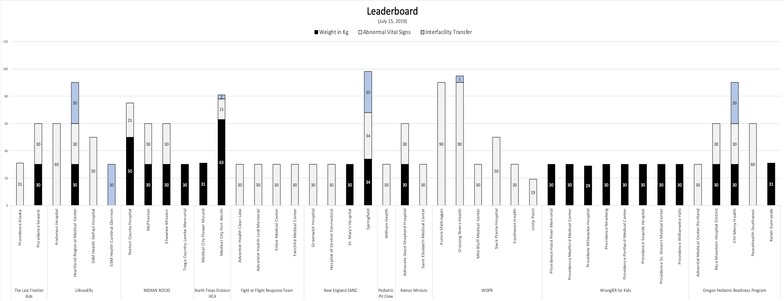
Data Leaderboard

Slide 10
Welcome!
The following sites have newly-executed DUAs:
Sweetwater Hospital Association
St. Elizabeth O’Fallon
SSM Health – St. Joseph Hospital – Wentzville
SSM Health – St. Joseph Health Center
Cohen Children’s Medical Center
Long Island Jewish Valley Stream
REDCap QI/Data Steward Survey:
https://tch-redcap.texaschildrens.org/REDCap/surveys/?s=CXELJK8ECF

Slide 11
AGGREGATE PERFORMANCE

Slide 12
PDSA CYCLE TIMELINES

Slide 13
PDSA Cycle Timeline
Our Mantra
Start Pacing Yourself for the Marathon

Slide 14
PDSA Cycle Timeline
Mile Marker 1: Start with Baseline Data
Goal: Must be submitted by July 12
Mile Marker 2: Begin Collecting & Entering Data for 1st PDSA
Goal: July 16 to Labor Day (September 2)
Mile Marker 3: Begin Collecting & Entering Data for 2nd PDSA
Goal: Labor Day to Halloween
Mile Marker 4: Begin Collecting & Entering Data for 3rd PDSA
Goal: Halloween to MLK (January 2, 2020)
Two-Bundle Approach: Keep steady momentum | Set internal deadline to work through PDSA Cycles 3 & 4 cycles

Slide 15
TEAM UPDATES
Team 13: WranglER for Kids
Team 3: MOKAN ROCKS
Team 12: WISPR
Team 1: Last Frontier Kids

Slide 16
PRQC Learning Session July 2019
WranglER 4 Kids
Providence St Vincent Medical Center (Training Site)
Providence Newberg Medical Center
Providence Seaside Hospital
Providence Portland Medical Center
Providence Willamette Falls Medical Center
Providence Hood River Memorial Hospital
Providence Medford Medical Center
Providence Milwaukie

Slide 17
Sampling Strategy: 30 charts from each ED randomly selected by a report created by our ED Quality department.
Our report was able to pull all information by key variables except the specific medications.
Each chart had to be checked manually for medications and doses.
Approximately 1.5-2 hours was required to input the baseline data per ED.

Slide 18
Findings
Wins
Opportunities
Almost all of our Baseline data for Bundle #1 is complete
Findings were better than expected
All Data Stewards, except one new hire have log-ins
Loss of momentum/enthusiasm
Multiple ED Leadership and Champion changes
Need to add how weight was obtained in report for our next round of data (stated vs actual)

Slide 19
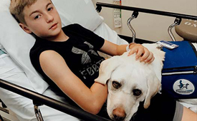
Questions?

Slide 20
MOKAN ROCKS (MO, KS Readiness On Call for Kids)
July 16th Learning Session Update

Slide 21
Data
10-32 minutes/chart
Experience collecting baseline data
Process for Data Submission
13 y/o and 18 y/o
Focused in on data collection and entry over 1-3 days
Reviewing charts individually- sometimes this is just simpler!
Notes:
Positive experience collecting data
Positive process for submission but sometimes it freezes up
13 y/o and 18 y/o misc charts
Data collection all at once
No reports
Varying times to look at charts probably based on different charting systems

Slide 22
Decision-Making Process for PDSA Cycles
Input data Meet with Leadership Review with Staff
Some expected results/ some a surprise
Notes:
Leadership meets to determine where to make improvements
This part is great- While trying to fix the issue, we find other issues. Found that we needed some documentation standardization/education

Slide 23
Yay for improvements!
Weight in kg- already documenting but now they have scales that LOCK!
Finding barriers
Creating policies
Notes:
Also finding that standing policies were in place but couldn’t be used. For example, if a child had a fever the nurse can give medication.. But… they were documenting a temp so this can’t be done.

Slide 24
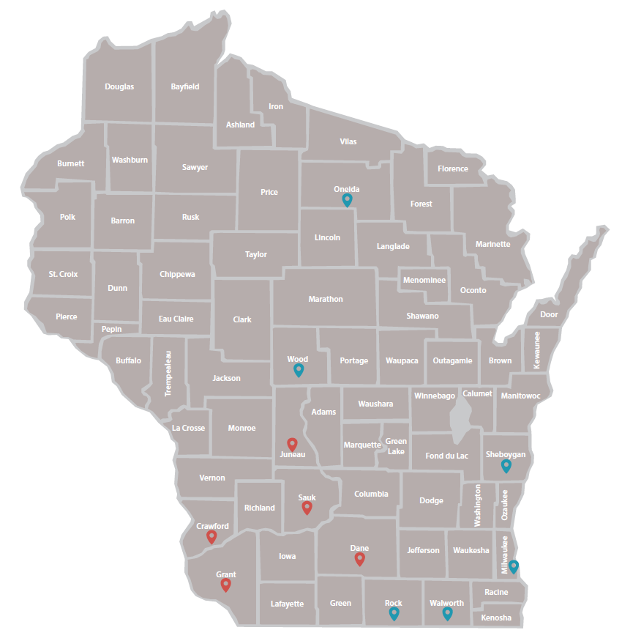
Team 12 – WISPR
14 original affiliate hospitals
11 active affiliate hospitals
Mix of rural and urban
25 – 505 beds
Peds volume: Low (<1,800), medium, (1,800-4,999) and medium high (5,000-9,999)
Pads volume: Low (<1,800), medium
(1,800-4,999) and medium high (5,000-9,999)
Notes:
Hello, I am (Michael Kim/Matt Pinsoneault), one of the trainers for Team 12, WISPR. WISPR is located in WI. We had 14 original affiliate hospital. Of those, we have 11 active affiliate hospitals. Our team is made up of hospitals that are a mix of rural and urban, range in beds from 25-505, and range in pediatric volume from low to medium high.

Slide 25
Bundle Selection
Notes:
We have hospitals participating in each of the 4 bundles, but abnormal vital signs has been most popular, with 8 total hospitals.
Crossing Rivers is currently enrolled in both the interfacility transfer and abnormal vitals bundles.

Slide 26
WISPR Data Entry and PDSA Cycles
7 affiliate hospitals entering data
Total of 299 pediatric charts entered
1 disaster planning drill completed
Of these, 3 affiliate hospitals actively running PDSA cycles
Crossing Rivers Health
Aurora Sheboygan Memorial
Southwest Health
Notes:
Of our 11 affiliate hospitals, 7 have begun entering data and a total of 299 pediatric charts have been entered and 1 disaster planning drill has been completed. (Aurora Sheboygan – 90, Crossing Rivers – 95, Mile Bluff – 30, Sauk Prairie -50, Southwest Health – 30, Unity Point – 4, Mercy Health Janesville – 1 disaster drill)
3 of our affiliate hospitals are actively running PDSA cycles; Crossing Rivers Health, Aurora Sheboygan Memorial and Southwest Health.
Our pediatric champion from Aurora Sheboygan Memorial, Dawn Tasche, and Ben Harris, Trauma Program Manager from Crossing Rivers Memorial have offered to share their PRQC experiences.

Slide 27
Aurora Sheboygan Memorial
Pediatric Champion: Dawn Tasche
Bundle selection: Abnormal vital signs
Data collection experience
It takes time!
Develop a system for organization and time management
Data submission process
Print 30 paper-based data collection forms and fill out all 30 and include the MRN from the chart
Enter all of the paper-based data collection forms into the online data entry system, and record the generated ID number
Typically, complete paper-based data collection forms in one day, and online entry another day

Slide 28
Aurora Sheboygan Memorial
Decision making process for PDSA cycles
Initial general audit to learn weaknesses
Reviewed charts for transferred and admitted pediatrics
Developed tool to identify abnormal vital signs and begun educating staff
Tools and education are tweaked based off of the results of each PDSA cycle
Assistance needed from subject matter experts
Online learning sessions and fireside chats are very helpful
Data entry system would be more efficient if we could type in a time rather than clicking through all of the numbers to enter a time

Slide 29
Crossing Rivers Health
Pediatric Champion: Heidi Kirschbaum
Bundle selection: Abnormal vital signs and Interfacility transfer
Data collection experience
Already had a report in Epic, which included all patients 14 years and younger.
Collect data on all admissions and transfers and then the rest are discharged patients.
Data submission process
Use Epic report exported to Excel spreadsheet to gather information and then while reviewing each chart, enter the information into the data base. Do not use the paper forms but track the ID number on the Excel spreadsheet. Can usually complete 30 records in about 2 hours if uninterrupted!!
Would help to have a better way to record the time. Also the questions about does the patient have abnormal vitals signs, do you have a process for reporting, etc. are very repetitive and not intuitive.

Slide 30
Crossing Rivers Health
Decision making process for PDSA cycles
We had already been collecting data on pediatric patients having a full set of vital signs (including blood pressure on all those 3 yrs. and older) for 2018 and already had an established pediatric committee.
Goals are decided on by the Pediatric Committee and then developed ways to accomplish each goal with support of the team.
Assistance needed from subject matter experts
Enjoyed fireside chat which explained the “why” behind each data collection and also gave us resources to help us reach goals.
Would like to share this with staff and our committee.

Slide 31
The Last Frontier Kids: Providence Alaska
Karen Richardson, RN – Asst. Clinical Manager, Emergency Dept.
Dr. Richard Navitsky, MD – Medical Dir. Children’s emergency care
Dr. Clifford Ellingson, MD – Pediatric Emergency Physician
Heather Andersen, RN – QI Specialist, The Children’s hospital

Slide 32
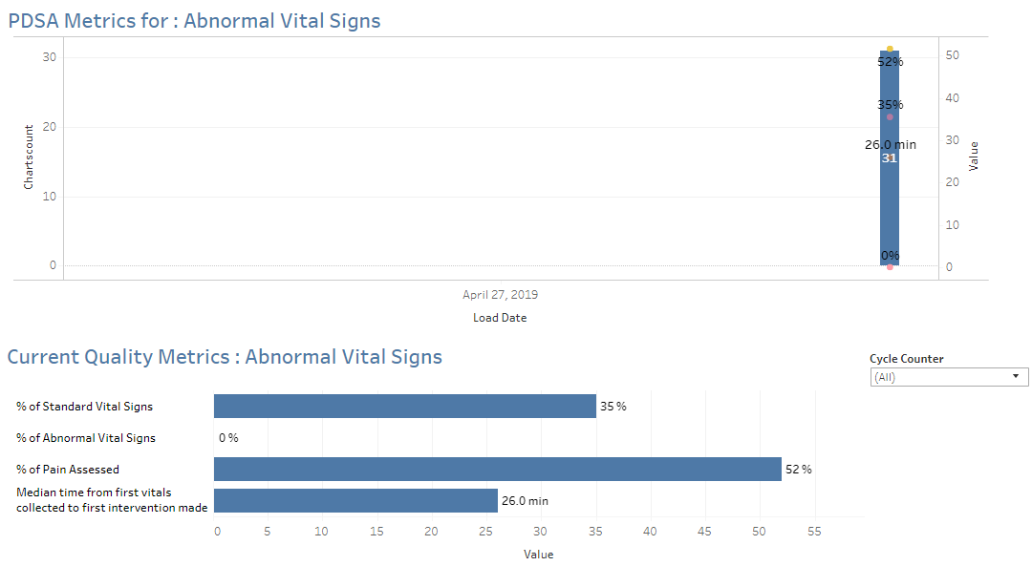
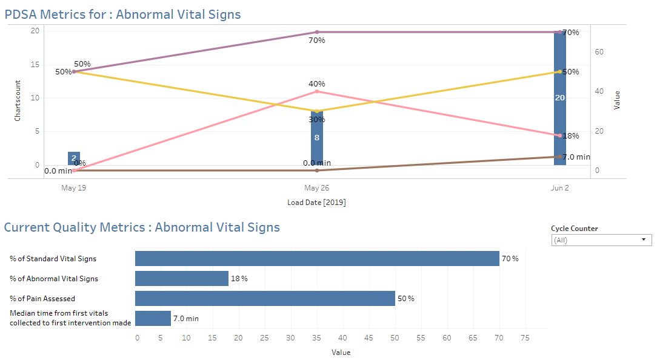
Status update
Providence Alaska Medical Center
Baseline data entered
PDSA #1 complete – data entry pending
Providence Seward Medical Center
Baseline data entered
Need to evaluate and plan PDSA

Slide 33
Baseline data – Process and Challenges
Ran report with all ED visits <18. Random selection representing different shifts and days of the week.
PAMC – 30 days
PSMC – 12 months
Challenges
Different interpretations of the data field definitions
EPIC records both Kg and lbs so unclear how it was initially recorded.
Time consuming
Individual submissions versus batch submissions
Time dials versus direct entry
Notes:
Different interpretations of the statement: Does your site have a process for abnormal vital sign notification?
RN leaders interpreted this as did the nurse actually talk to MD and document
MDs interpreted this as they saw the vitals in red on the board, therefore they were notified.
Consensus – admission vitals per board / other vitals (including discharge – verbal)

Slide 34
PAMC PDSA #1 - Plan
Collaborative decision making:
Met with MD champions to review data
Identified first area of opportunity and drafted first PDSA
Problem Identification:
Discharge/transfer vital signs were not consistently being recorded within 30 minutes of leaving the ED as per policy.
If done, no record of MD notification of abnormal VS.
Significance:
Status changes not recognized
Escalations in care or return to care

Slide 35
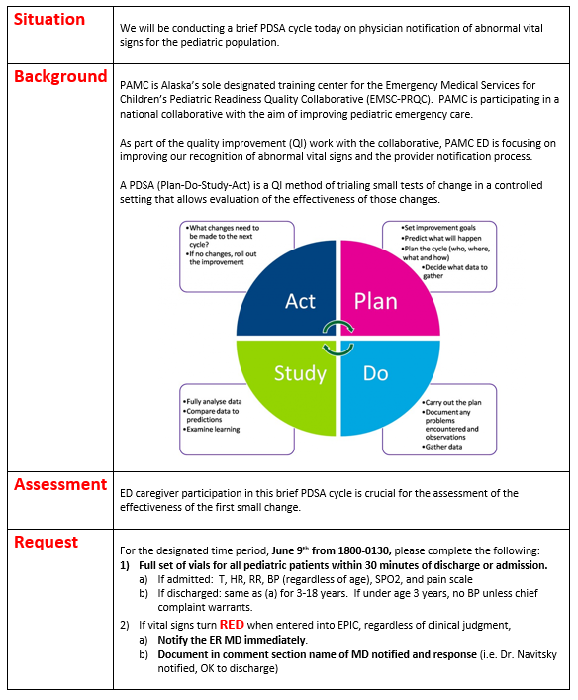
PAMC PDSA #1 - Plan
Just in time communication & education
Designated times in CEC when MD champions were working
Only included caregivers working directly with MD champions
MD-led education, ACM support
SBAR to explain the what, why and how.

Slide 36
PAMC PDSA #1 - Do
For the designated time period, June 9th from 1800-0130, please complete the following:
Full set of vials for all pediatric patients within 30 minutes of discharge or admission.
If admitted: T, HR, RR, BP (regardless of age), SPO2, and pain scale
If discharged: same as (a) for 3-18 years. If under age 3 years, no BP unless chief complaint warrants.
If vital signs turn RED when entered into EPIC, regardless of clinical judgment,
Notify the ER MD immediately.
Document in comment section name of MD notified and response (i.e. Dr. Navitsky notified, OK to discharge)

Slide 37
PAMC PDSA #1: Study and Act
Data collection
Not all captured in PRQC data – created spreadsheet for additional info.
Analysis of data
Determine next steps

Slide 38
PSMC
Next Steps:
Evaluate the baseline data
Plan first test of change.

Slide 39
RUN CHART INTERPRETATIONS

Slide 40
BUNDLE SPECIFIC FEEDBACK

Slide 41
Any difficulty implementing a bundle or submitting data?
Reminder: Each bundle has a corresponding workbook that provides a description of possible interventions and resources. Key drivers (which are requested in the DES) can be found in the intervention workbooks.
What was your experience with the 1st PDSA cycle?
Team 2
Training Site: Cardinal Glennon
Team 4
Training Site: Dell Children’s
Team 5
Training Site: Medical City Dallas
Team 6
Training Site: UC Davis
Team 7
Training Sites: Yale & Connecticut Children’s

Slide 42
Any difficulty implementing a bundle or submitting data?
Reminder: Each bundle has a corresponding workbook that provides a description of possible interventions and resources. Key drivers (which are requested in the DES) can be found in the intervention workbooks.
What was your experience with the 1st PDSA cycle?
Team 8
Training Site: Cohen
Team 9
Training Site: Augusta U
Team 10
Training Site: Riley
Team 11
Training Site: Comer
Team 14
Training Sites: OHSU & Randall

Slide 43
Any difficulty implementing a bundle or submitting data?
Reminder: Each bundle has a corresponding workbook that provides a description of possible interventions and resources. Key drivers (which are requested in the DES) can be found in the intervention workbooks.
What was your experience with the 1st PDSA cycle?
Team 15
Training Site: East Tennessee
Team 16
Training Site: Piedmont Columbus

Slide 44
Bundle 1: Weight in Kg
Any Questions or Concerns?

Slide 45
Bundle 2: Abnormal VS
Question:
When should mental/behavioral/social health assessment be completed?
Two-step triage: ABC’s then full vital sign triage in exam room (absolutely)
Goal – is that mental/social health be assessed prior to discharge/admission

Slide 46
Bundle 3: IFT
Questions:
How is feedback going from receiving sites? Is there a process in place? Have you identified a specific contact at receiving sites to provide feedback?
Have you developed a family packet for transfers? What should you put in this?
See toolkit
Does it include evaluation piece?
Directions, consent, evaluation form, reason for transfer, information regarding hotels, where to report at receiving site
Role of receiving center in developing packet?
Is anyone not using packet? Electronic vs. paper?

Slide 47
Bundle 4: Disaster
Announcement:
SMEs will be reaching out to those sites that will be focusing on this bundle.
Let us know if you plan to work on this bundle, but have not formally declared the bundle as your 1st or 2nd choice (source: QI/Data Steward Survey)

Slide 48
Bundle 4: Disaster
Questions:
Have you started drills? Which domains are you focusing on? Have there been any internal meetings regarding bundle/drills?
Advice: Complete site level data (Domain 1: Disaster Coordination) in DES.
Advice: Review environmental scan for possible answers!
Have you developed a paper version of the DES to complete during the drill?
Advice: Copies can be found on PRQC Members Only (Disaster Bundle Section)
Where should we be with bundle 4? How do we enter data? Is this part of our dashboard?
Feedback: Two SMEs (Sarita Chung and Brent Kaziny will be contacting participating sites to provide 1:1 assistance.

Slide 49
HOUSEKEEPING

Slide 50
Housekeeping
Reminders
Requests for CNE credit must be submitted within 2 weeks of sponsored event
Extension letter can be found on Members Only Section of PRQC Website
Action Items
Submit Baseline Data
Mid-Collaborative Survey
Environmental Scan

Slide 51
Housekeeping
Coming Soon
PRQC Newsletter will be released end of July
Learning Sessions
August 27 (More Team Updates)
October 1
November 19
December 3rd

Slide 52
Key Information
CNE Link: https://tch-redcap.texaschildrens.org/REDCap/surveys/?s=C3CHENDRY8
Google: EMSC PRQC (Password also)
Email: qeca@texaschildrens.org | dcc_prqcsupport@hsc.utah.edu

