Slide 1

Disaster Planning for a Pediatric Population
Intervention Bundle Deep Dive
https://bcm.box.com/v/prqcdisasterbundle

Slide 2

ACKNOWLEDGEMENTS
The HRSA, MCHB EIIC is supported in part by the Health Resources and Services Administration (HRSA) of the U.S. Department of Health and Human Services (HHS) under grant number U07MC29829. This information or content and conclusions are those of the author and should not be construed as the official position or policy of, nor should any endorsements be inferred by HRSA, HHS or the U.S. Government.

Slide 3
CNE | CME CREDITS
Sign Up for Credit
PRQC members joining today’s deep dive can earn Continuing Nursing Education or Continuing Medical Education credit.
Please complete the following survey to receive additional information: https://is.gd/PRQCLS
Name of Learning Session Attending: DISASTER DEEP DIVE

Slide 4
DISASTER BUNDLE DEEP DIVE
Welcome to the Pediatric Readiness Quality Collaborative (PRQC)
TALKING POINTS | SPEAKERS
IHI Collaborative Model Common Concepts for QI Collaboratives Support Available for Affiliate Sites PRQC: Culture Disaster Bundle: Framework Disaster Bundle: Background; Aim Statement; Change Strategies; Quality Measures; Variables Next Steps Housekeeping | Dr. Kate Remick Krystle Bartley Diana Fendya

Slide 5
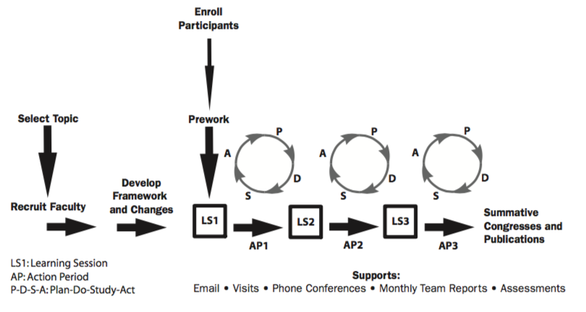
IHI COLLABORATIVE MODEL
The Breakthrough Series: IHI’s Collaborative Model for Achieving Breakthrough Improvement. IHI Innovation Series white paper. Boston: Institute for Healthcare Improvement; 2003. (Available on www.IHI.org)

Slide 6
COMMON CONCEPTS
Aim Statements
Model for Improvement | Plan-Do-Study-Act (PDSA) cycles
Quality Measures/Metrics
Tools: Key Driver Diagrams; Workflows; Process Maps; SWOT Analyses; Fishbone Diagrams/Cause and Effect Diagrams

Slide 7
SUPPORT FOR AFFILIATES
Level 1: Trainers that committed to providing mentorship to series of affiliate hospitals on their team (Expertise in PEM; QI; EMSC)
Level 2: Formal QI education available through Institute for Healthcare Improvement Open School AND Reinforce concepts throughout the collaborative
Level 3: Sharing of best practices at intervention-specific webinars and learning sessions
Level 4: Distribution of new content/resources available

Slide 8
PRQC CULTURE
Ensure high quality emergency care for all children!
All Teach – All Learn!
Grass-Root Effort
Sharing Progress & Challenges with Trainers
Improvement
=
Success
Transparency

Slide 9
TEAM MEETINGS
Planned exclusively for training site(s) and their designated affiliate sites
Trainers will be scheduling team meetings in the coming months (virtual; in-person; teleconference)
Topics of Discussion
  Bundle Selection; Implementation Plan; Hospital Engagement; QI Integration (Smart Aims/Tools Available/Change Strategies); Progress

Slide 10
Disaster Planning for a Pediatric Population
Intervention Bundle Deep Dive

Slide 11
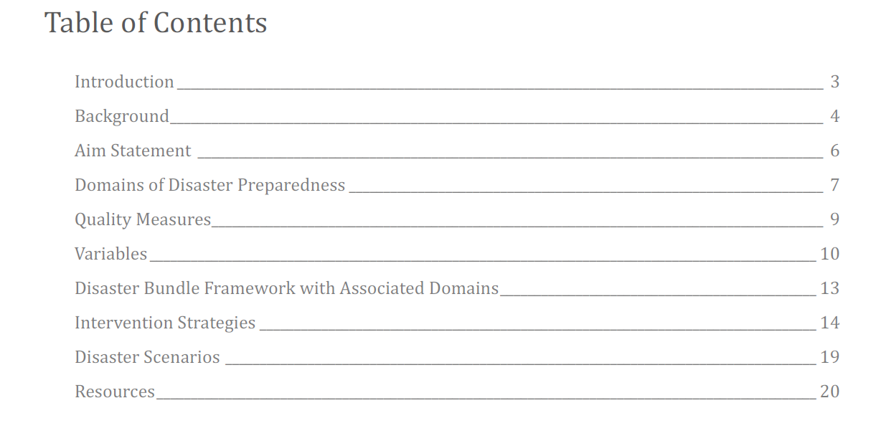
BUNDLE FRAMEWORK

Slide 12
cONSIDERATIONS
This intervention bundle was designed exclusively for sites participating in the Pediatric Readiness Quality Collaborative, and as such, this content should not be used for other purposes or by other sites without written consent from the EMSC Innovation and Improvement Center.
Hospital disaster plans are unique to each facility and community; hence, hospital administrators and managers are encouraged to work closely with their local, regional, and state healthcare systems and healthcare and/or disaster coalitions, national disaster partners, and their corresponding local chapters to adapt recommendations based on resource availability, strategies, and their local needs.

Slide 13
Introduction
subject matter experts
Steven Krug, MD, FAAP
Professor of Pediatrics, Northwestern University Feinberg School of Medicine
Chief of Emergency Medicine, Ann & Robert H. Lurie Children’s Hospital of Chicago
Chairperson of the American Academy of Pediatrics (AAP) Disaster Preparedness Advisory Council
Brent Kaziny, MD, MA, FAAP
Assistant Professor of Pediatrics, Baylor College of Medicine
Section of Emergency Medicine, Texas Children’s Hospital
Director of the EMSC Innovation and Improvement Center’s Disaster Preparedness Domain
Patricia Frost, RN, MS, PNP
Director of Emergency Medical Services, Contra Costa Health Services

Slide 14
Introduction
subject matter experts
Ireal Fusco, MD
Pediatric Emergency Medicine Fellow
Dell Children’s Medical Center at the University of Texas at Austin
Oscar Enriquez, EMT
Emergency Preparedness Coordinator, Dell Children’s Medical Center of Central Texas
Laura Aird, MS
Manager, Disaster Preparedness and Response
American Academy of Pediatrics
Breanna Smith
Program Coordinator, Emergency Readiness
American Academy of Pediatrics

Slide 15

BACKGROUND
In 2013, 53.2% of 4,146 EDs self-reported the lack of a disaster plan that includes children.
More than 50% of Emergency departments lack a disaster plan that includes pediatric-specific needs

Slide 16
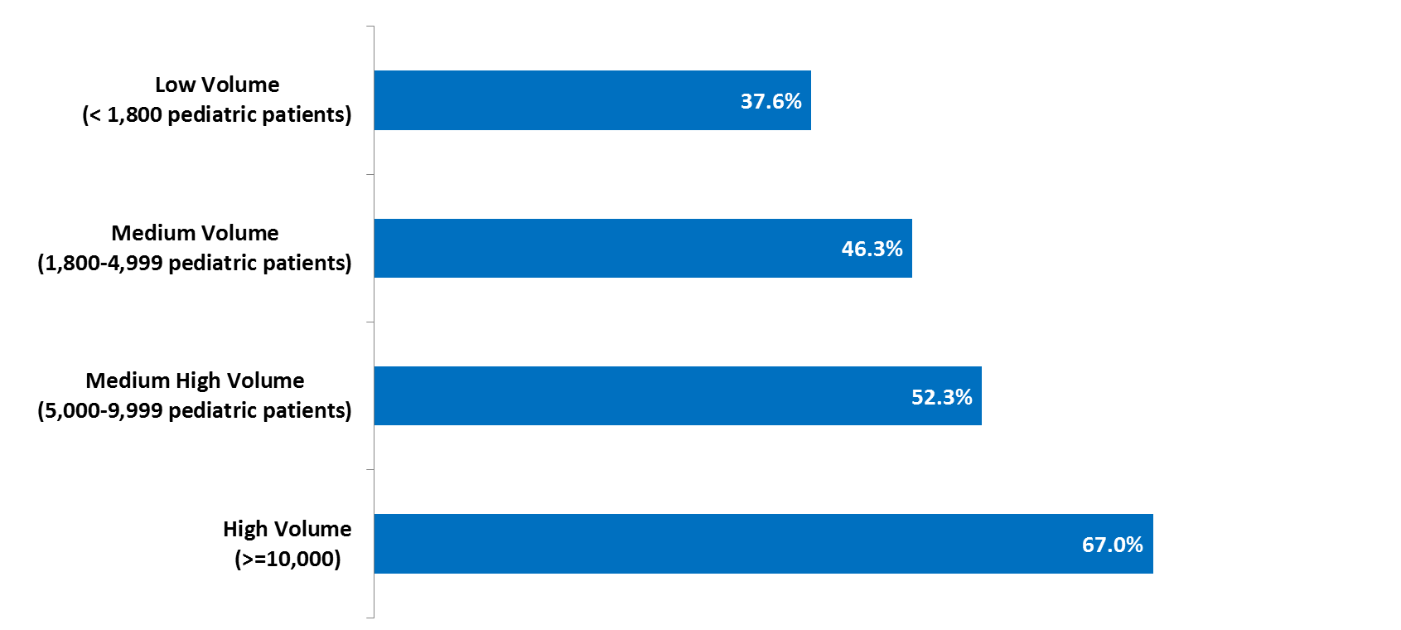
Disaster Plan Addresses Issues Specific to the Care of Children
NATIONAL ASSESSMENT OF PEDIDATRIC READINESS OF EMERGENCY DEPARTMENTS

Slide 17
CURRENT STATE OF PEDIATRIC DISASTER PREPAREDNESS
The US Emergency Care System is “poorly prepared for disasters.”
Deficiencies in day-to-day operational readiness are exacerbated during a disaster

Slide 18

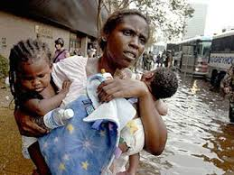
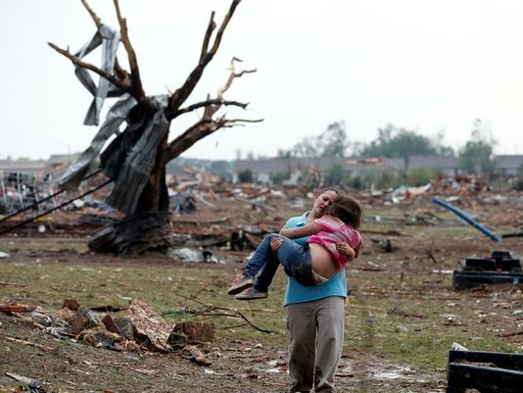

RECENT DISASTER EVENTS
September 2001 World Trade Center towers
  3000 dead or missing
August 2005 Hurricane Katrina
  more than 1800 dead, thousands sick or injured
April 2011 Tornado Outbreak
  346 dead
Dec 2012 Sandy Hook Elementary School
  26 dead
April 2013 Boston Marathon
  More than 260 people injured
May 2013 Tornado outbreak in Great Plains
  More than 270 injured and 24 dead
2017 Hurricane Harvey and Irma and Maria…

Slide 19
CHILDREN AFFECTED
Children are disproportionately effected in disasters
More likely to be sickened or injured
  Rapid breathing, thin skin, prone to dehydration/blood loss, heat loss, outdoor play and hygiene, low to the ground
Require help from adults
Understanding of event, communication, medical decision making, shelter, transportation, protection
  Mental stress can be more difficult for children
Poor understanding of event, less control

Slide 20
SURVEY of
ED PREPAREDNESS
Source: A State Survey of ED Preparedness for the Care of Children in a Mass Casualty Event
80 hospitals surveyed (90% response rate)
13% pediatric mass casualty protocols
28% disaster plan includes pediatric specific issues
64% include pediatric patients in disaster drills

Slide 21

2010 NATIONAL COMMISSION on CHILDREN & DISASTERS
Persistent deficiencies in every functional area of pediatric disaster preparedness
Children more often an afterthought than a priority
Children often categorized as an “at risk,” “special needs,” or “vulnerable” population
Notes:
Report to President Obama and Congress

Slide 22

2013 PREPAREDNESS, RESPONSE, AND RECOVERY: CONSIDERATIONS for CHILDREN & FAMILIES
“Current state and local disaster plans often do not include specific considerations for children and families.”

Slide 23
EMSC & HOSPITAL PREPAREDNESS

Slide 24

Domain 1: Staff coordinator to champion pediatric disaster coordination and response
Domain 2: Partnership building to facilitate surge capacity
Domain 3: Essential resources necessary for building pediatric surge capacity
Domain 4: Triage, infection control, and decontamination
Domain 5: Family tracking, security, support, and reunification
Domain 6: Legal/ethical issues
Domain 7: Behavioral health
Domain 8: Children with special health care needs
Domain 9: Staffing, exercises, drills, and training
Domain 10: Recovery and resiliency

Slide 25
Aim Statement
By December 2019, 100% of the sites implementing the disaster bundle will have a plan that addresses four essential domains of pediatric disaster preparedness - disaster coordination, internal coalition building, surge capacity, and pediatric resources.

Slide 26
DISASTER DOMAINS
Domain 1: Pediatric Disaster Coordination
Domain 2: Coalition-Building (local and/or regional)
Domain 3: Pediatric Surge Capacity (local and/or regional)
Domain 4: Essential Pediatric Resources
Domain 5: Pediatric Disaster Triage
Domain 6: Pediatric Decontamination
Domain 7: Tracking and Reunification
PHASE 1
9/1/2018

Slide 27
BUNDLE IMPLEMENTATION
  Phase 1
    Best Practice: Start with Domain 1 and progress to Domain 4
    No expectation that sites will complete ALL 7 DOMAINS
    Minimum expectation that sites will complete Domain #1
  Phase 2
    Will be released January 2019 and cover Domains #5 - 7
Notes:
This disaster bundle may seem laborious, but the PRQC intent to meet all levels of readiness (

Slide 28
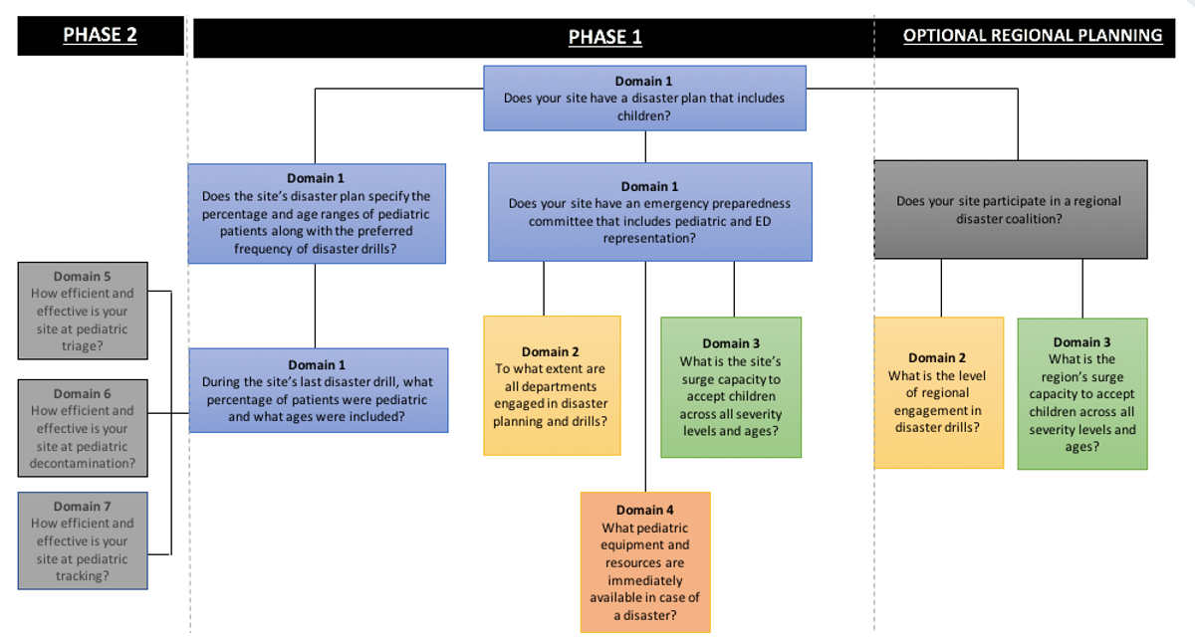
Disaster Bundle Framework with Associated Domains

Slide 29
Domain 1: Pediatric disaster coordination
A comprehensive hospital disaster plan that includes the needs of children and families requires the identification of a committed pediatric representative to lead the cooperative effort among hospital departments, personnel and leadership.
Using an all-hazards approach, the disaster plan integrates the unique needs and responses of the pediatric patient.

Slide 30
Domain 2: Coalition-Building (local and/or regional)
The goal of a coalition is to facilitate collaboration amongst public health, healthcare, pre-hospital entities, and various community partners to prepare for, respond to, and recover from an emergency or disaster.
During a disaster, hospitals will need to coordinate with local and regional partners.
Additionally, hospitals need to ensure that internal departments are coordinated in communication and response to support the immediate hospital needs and those of the larger coalition during a disaster.

Slide 31
Domain 3: Pediatric Surge Capacity (local and/or regional)
Surge capacity represents the ability to manage a sudden influx of patients. It is dependent on both internal communication across hospital departments and external communication across members of a regional coalition.
Hospitals must develop and maintain outpatient and inpatient surge capacity for the triage, treatment, and tracking of patients at the facility or in alternative sites of care or alternative hospitals.
Effective surge capacity planning integrates facility plans with a regional disaster coalition involving other area health care institutions and considers hazard vulnerability assessments (HVAs) and historical natural disaster threats.

Slide 32
Domain 4: Essential Pediatric Resources
Specific resources and supplies (pediatric-sized airway tools, medications, etc.) are required for the care of children in the daily operations of all hospitals.
However, hospitals that infrequently care for children may have challenges in both identifying what resources are needed for daily operations and having access to these resources if/when large numbers of children may present in a disaster setting.
Such resources include bedding (e.g. isolettes), diet needs for children of all ages (including formula-fed infants), and other equipment to support children with special needs (e.g. ventilators; backup generators).

Slide 33
DISASTER BUNDLE
Disaster Plan
Domain 1
Pediatric Disaster Coordination
Key Personnel
Education
By December 2019, 100% of the sites implementing the disaster bundle will have a plan that addresses four essential domains of pediatric disaster preparedness.
Domain 2
Coalition-Building
Team Building
Infrastructure
Domain 3
Pediatric Surge Capacity
Education
Simulation
Domain 4
Essential Pediatric Resources
Infrastructure

Slide 34
Disaster Plan
Domain 1
Pediatric Disaster Coordination
Key Personnel
Education
key driver 1: Disaster plan
Change Strategies:
Work with the emergency preparedness coordinator and use the disaster checklist as a framework for creating your site’s disaster plan: Checklist of Essential Pediatric Domains and Considerations for Every Hospital's Disaster Preparedness Policies
Define role/responsibilities of a pediatric disaster coordinator
Define role/responsibilities of disaster coordinator

Slide 35
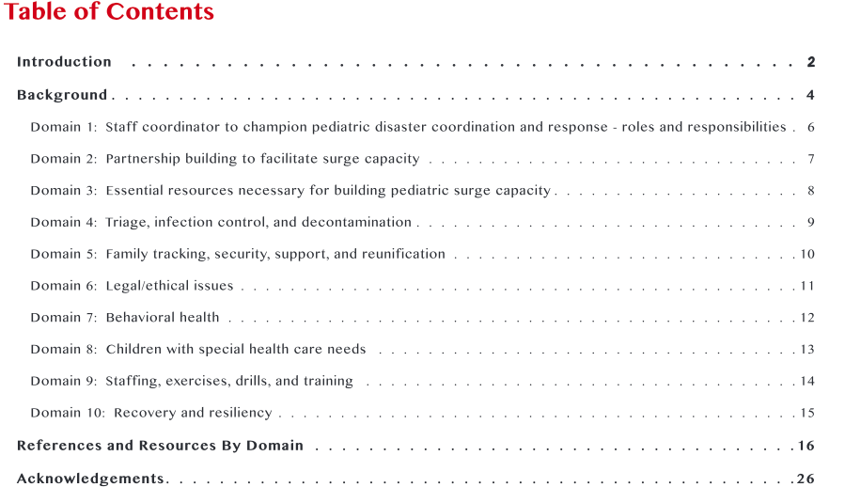
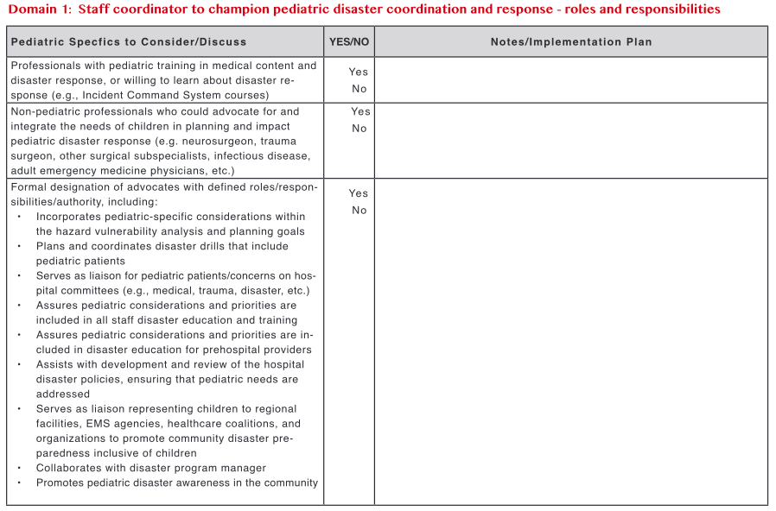

Slide 36
key driver 2: key personnel
Change Strategies:
Identify an individual with expertise and/or interest in pediatrics and disaster planning
  A member of care team (MD, RN, NP)
  Strongly encourage the recruitment of emergency preparedness manager that is currently on site
  Garner support from ED and Hospital Leadership
Offer educational opportunities for the disaster coordinator to enhance their foundational knowledge (e.g., FEMA courses, TEEX). Recommendation: Visit the National Pediatric Disaster Coalition Listserv and ASPR TRACIE
key driver 3: Education
Change Strategies:
Develop a training/educational program for care team on site’s disaster policy
Learning objectives should include the 7 disaster planning domains; activating resources in time of disaster, communication strategies for care team
Identify training delivery modality (e.g., online, in-person staff meetings, peer to peer)
Inform members of care team about the role and responsibilities of the disaster coordinator

Slide 37
Domain 2
Coalition-Building
Team Building
key driver 1: team building
Change Strategies:
Compile a list of hospital departments (clinical and non-clinical) to support disaster response
Establish an internal communication strategy across all hospital departments
Compile a list of regional hospital and non-hospital stakeholders (e.g., primary care, churches, medical homes, EMS, schools, daycare centers, Red Cross, Red Cross shelters). Begin process by reaching out to EMS Agencies and Emergency Operations Managers in your region.
Establish a partnership with the relevant stakeholders (e.g., regional disaster coalition, Hospital Preparedness Program
Develop an after action report for disaster drills

Slide 38
Infrastructure
Domain 3
Pediatric Surge Capacity
Education
Simulation
key driver 1: Infrastructure
Change Strategies:
Develop a process/plan to measure, prioritize, and expand pediatric surge capacity and capabilities based on resource availability
Establish a process to determine which patients are transported to a particular location based on capacity
Develop a process to augment existing capacity as well as create capacity by limiting elective appointments and procedures and practicing ”surge discharge” of patients that can be effectively managed in non-hospital environments.
Develop a process to maximize conventional capacity as well as plan for contingency capacity (adapting patient care spaces to provide functionally equivalent care) and crisis capacity (adapting the level of care provided to the resources available when usual care is impossible)
.
Define pediatric transfer processes, i.e., agreement and guidelines to facilitate movement of children needing pediatric specialty facilities as well as those more stable children needing to be moved to increase surge capacity of specialty centers (See PRQC Bundle #3: Interfacility Transfers)
Develop telemedicine/telephone consultation agreements, processes, and equipment to facilitate provision of pediatric care in facilities not typically caring for children
Meet with regional stakeholders and develop a method to integrate facility disaster policy with community and regional disaster plans, including prehospital systems of care

Slide 39
Infrastructure
Domain 3
Pediatric Surge Capacity
Education
Simulation
key driver 2: Education
Change Strategies:
Develop a training/educational program for each hospital department focused on processes for determining surge capacity
  Learning objectives should include importance of maximizing conventional capacity as well as plan for contingency capacity (adapting patient care spaces to provide functionally equivalent care) and crisis capacity (adapting the level of care provided to the resources available when usual care is impossible).
Inform members of care team about the role and responsibilities of EMS and staff in the setting of a disaster
Discuss internal communication strategies and processes for collaborating on surge capacity
Work with coalition to discuss external communication strategies, timing, and processes for determining regional surge capacity

Slide 40
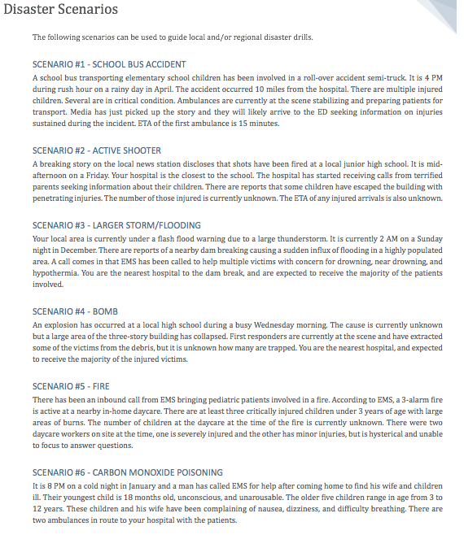
Infrastructure
Domain 3
Pediatric Surge Capacity
Education
Simulation
key driver 3: simulation
Change Strategies:
Conduct table top exercises to assess internal communication in the setting of a simulated disaster, ensure all hospital departments are engaged
Conduct table top exercises to assess external communication in the setting of a simulated disaster, ensure all regional stakeholders are engaged

Slide 41
Domain 4
Essential Pediatric Resources
Infrastructure
key driver 1: infrastructure
Change Strategies:
Develop a comprehensive list of pediatric supplies and medications needed in cases of disaster
  Consider needs for children of all ages from infancy through adolescence
  Include resources needed for dietary, daily care, and sleeping accommodations
  This should be an assessment of day-to-day use of staff, space, and resources, and then projected based on surge level.
Create a source document that outlines the location and constraints involved with securing the essential supplies and resources
Create a checklist for pediatric resources and supplies that can be used during a disaster

Slide 42
Quality Measures
Domain 1: Pediatric Disaster Coordination
Structural Measure #1:
A disaster plan that includes pediatric-specific needs
Structural Measure #2:
A disaster plan that outlines the number of pediatric patients that must be involved in a disaster drill
Structural Measure #3:
Hospital disaster committee with pediatric representation

Slide 43
Variables
Domain 1: Pediatric Disaster Coordination
Has your hospital established a disaster plan?
List the domains included in the disaster plan
Does the disaster plan specify the number of pediatric patients that must be involved in disaster drills?
Does your hospital’s disaster committee include a representative specifically for pediatrics?

Slide 44
Quality Measures
Domain 2: coalition building
Structural Measure #1:
Emergency department participation in a regional disaster coalition
Structural Measure #2:
A catalog of entities that participate in a regional disaster coalition
Process Measure #1:
Percentage of internal departments that are mobilized during a disaster drill
Process Measure #2:
Median time to recruitment of internal departments during a disaster drill
Optional Process Measure: Percentage of external entities involved in a disaster drill

Slide 45
Variables
Domain 2: coalition building
Does your hospital participate in a regional disaster coalition?
Does your hospital have a catalog of entities (organizations/agencies) that participate in a regional disaster coalition?
Details about internal/external coalition-building drills (clinical departments/services involved; timestamp of the initiation of disaster drill; timestamp of when final clinical department/service was mobilized)

Slide 46
Quality Measures
Domain 3: pediatric surge capacity
Process Measure #1:
Median time to determination of emergency department surge capacity services
Process Measure #2:
Median time to determination of surgical services surge capacity
Process Measure #3:
Median time to determination of inpatient services surge capacity
Optional Structural Measure: Determination of external pediatric surge capacity for region

Slide 47
Variables
Domain 3: pediatric surge capacity
Does your regional disaster coalition have a mechanism to determine pediatric surge capacity in real time?
Details about internal surge capacity drills:
  Identification of care team availability and bed capacity;
  Resources stratified by patients’ criticality for surgical and inpatient services;
  Number of pediatric patients triaged during drill

Slide 48
Quality Measures
Domain 4: essential pediatric resources
Process Measure #1:
Median time to determination of essential pediatric equipment and supplies

Slide 49
Variable
Domain 4: essential pediatric resources
Time to identification of available pediatric surge equipment and supplies during drill

Slide 50
DATA COLLECTION
Data Use Agreements Must Be Established
Data Portal in Development
  ”How-To” guide for data submission will be released this summer
Each site will have ownership of their own data
Dashboards available – control charts; run charts
    Intervention-Specific (benchmarking purposes)
    Site-Specific (based on selected intervention bundle at site)
    Comprehensive PRQC Dashboard (all intervention bundle progress)

Slide 51
RESOURCES
File-Sharing Site
  Pre-Readings; Checklists; Pertinent Articles
  https://bcm.box.com/v/prqcdisasterbundle
Educational Webinars Coming Scheduled Soon – Partners at American Academy of Pediatrics

Slide 52



Slide 53
HOUSEKEEPING
  Action Items:
    Educational Purposes: Complete IHI QI Modules; Consider Attending AAP’s Seminars; Complete Suggested Reading
    Administrative: Establish data use agreement
    Collaborative-Specific: Complete Environmental Scan; Site Visit Survey (if not completed already)
    Dates:
      July 1: Anticipated completion of DUA process; Link for Environmental Scan and Process for Registering for QI Education will be released
      July 31: Environmental scan due along with contact information for data champions
      July 31: Disaster Deep Dive Part II (Recipe for Success: How to Operationalize DP Bundle)
      September 1: Go Live

Slide 54
ENVIRONMENTAL SCAN
Baseline assessment that seeks information about hospital infrastructure, care team, policies/procedures/guidelines, and resources currently available for the respective bundle
Results from the scan can also assist in the selection of change strategies for PDSA cycles/improvement cycles
Important Dates
  Scan released on July 1
  Submit completed scan by July 31

Slide 55
BUNDLE RELEASE DATES
Abnormal Vital Signs
Bundle Release Date: Friday, June 22
Bundle Deep Dive Webinar: Tuesday, June 26
Interfacility Transfers
Bundle Release Date: Friday, July 6
Bundle Deep Dive Webinar: Tuesday, July 10
Weight in Kilograms
Bundle Release Date: Friday, July 13
Bundle Deep Dive Webinar: Tuesday, July 17
Disaster Planning Part II
Focus on implementation of disaster bundle (workflows; data submission)
Bundle Release Date: Friday, July 27
Bundle Deep Dive Part II: Tuesday, July 31
Release Date: All Content Available Online
Deep Dive Webinar: In-Depth Description of Bundle with Subject Matter Experts, Data Support Team, & Admin Team

Slide 56
DISASTER BUNDLE DEEP DIVE
PART II
  Purpose:
    Recipe for Success: How to Operationalize the Disaster Bundle
    Review workflows for domains 1-4 and integration of simulation exercises
    Review data submission
    Address all questions from participating sites regarding the bundle
    TUESDAY, JULY 31ST
    8:00am - 9:30am AKDT / 9:00am - 10:30am PDT / 11:00am - 12:30pm CDT / 12:00pm - 1:30pm EDT

