Slide 1
Pediatric Disaster Preparedness Quality Collaborative (PDPQC)
Learning session #1: The Pediatric champion
July 14, 2020
12:00 ET / 11:00 CT
Please MUTE your phone when not speaking

Slide 2
Recording
This session is being recorded. A recording of this session will be posted to the Participants–Only website here:
Participants-Only website:
https://emscimprovement.center/collaboratives/pediatric-disaster-preparedness-quality-collaborative/pdpqc-participants-only/
Password: PedsDisasterReady

Slide 3
Acknowledgements & Disclaimer
Funding Sources
The EGLPCDR is funded by the U.S. HHS Office of the Assistant Secretary of Preparedness and Response (ASPR) totaling $6 million to pilot the creation of Pediatric Disaster Care Centers of Excellence (COE) to improve disaster response capabilities for children in the United States.
The EIIC is supported by the Health Resources and Services Administration (HRSA) of the U.S. Department of Health and Human Services (HHS) as part of the Emergency Medical Services for Children Innovation and Improvement Center cooperative agreement totaling $1,500,000 with 0% financed with non-governmental sources.
Disclaimer
The content presented here and throughout the collaborative is that of the authors and do not necessarily represent the official views of, nor an endorsement by, ASPR, HRSA, HHS, or the U.S. Government.

Slide 4

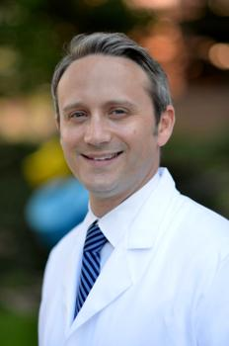
Today’s Speakers
Meredith Rodriguez, PhD, CCRC
Senior Project Manager, EMSC Innovation and Improvement Center
Meredith.rodriguez@austin.utexas.edu
Brent Kaziny, MD, MA, FAAP
Medical Director, Emergency Management. Texas Children’s Hospital
Assistant Professor, Baylor College of Medicine
Director, Disaster Preparedness Domain, EMSC Innovation and Improvement Center

Slide 5





Agenda
Environmental Scan Results
  -Aggregate score
  -Common strengths
  -Areas for improvement
Tabletop Exercise
  -Aim of the exercise
  -Who should participate
  -After Action Report
The Pediatric Champion
  -Definition
  -Roles
  -Change Strategies
Discussion & Questions
Current disaster plan/ drill history for pediatric inclusion
-Critically evaluate the plan
-How to identify gaps
  -Making the case for pediatric inclusion

Slide 6
Environmental Scan
results
July 7 - 14

Slide 7
Environmental Scan Results
First, a few words about scoring…
This is a baseline.
The score is a simple method to identify common gaps and quantify the progress made in the collaborative.
The is NOT intended to be a robust assessment of your hospital’s disaster preparedness or a comprehensive measure of your hospital’s ability to receive and treat children in a disaster…we’re working on that.
Suggestions are always welcome

Slide 8
Environmental Scan Results
Overall Results
Total Responses: 19
Total Possible Points: 44
Collaborative Average: 25 (58%)
The full results are available on the Participants-Only website: https://emscimprovement.center/collaboratives/pediatric-disaster-preparedness-quality-collaborative/pdpqc-participants-only/modules/ (password: PedsDisasterReady)

Slide 9
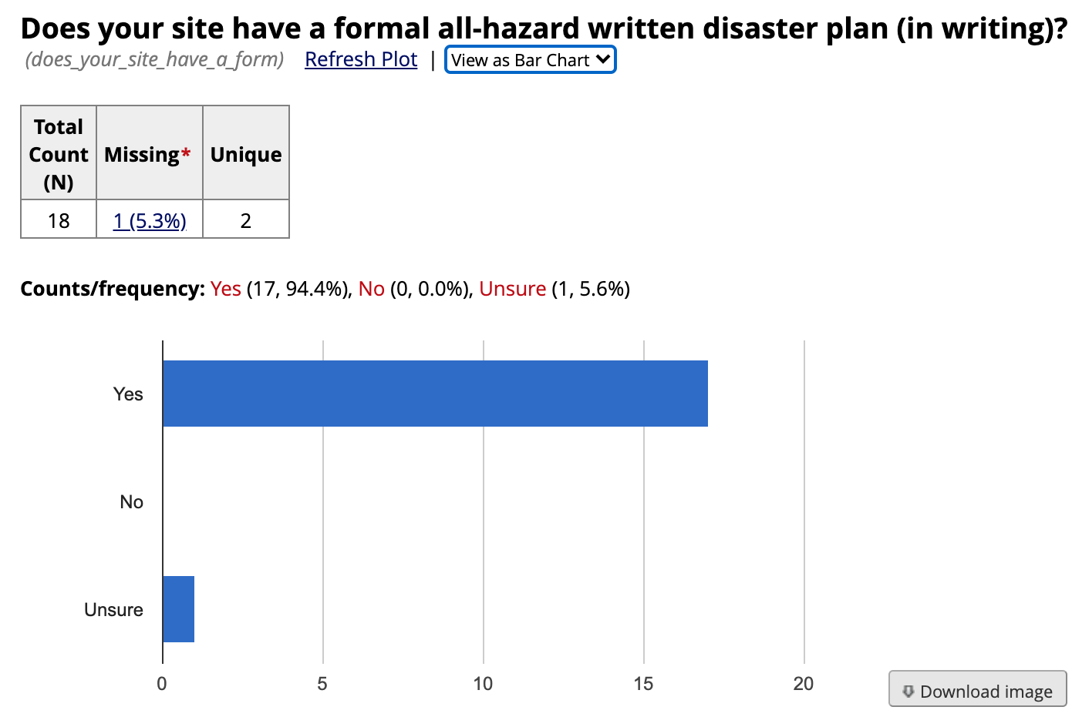
Almost all have a formal plan

Slide 10
Top Hazards
Tornado
Winter Storm
Infectious pandemic
Information Security / Communications Failure
Workplace violence / Violent Patient

Slide 11
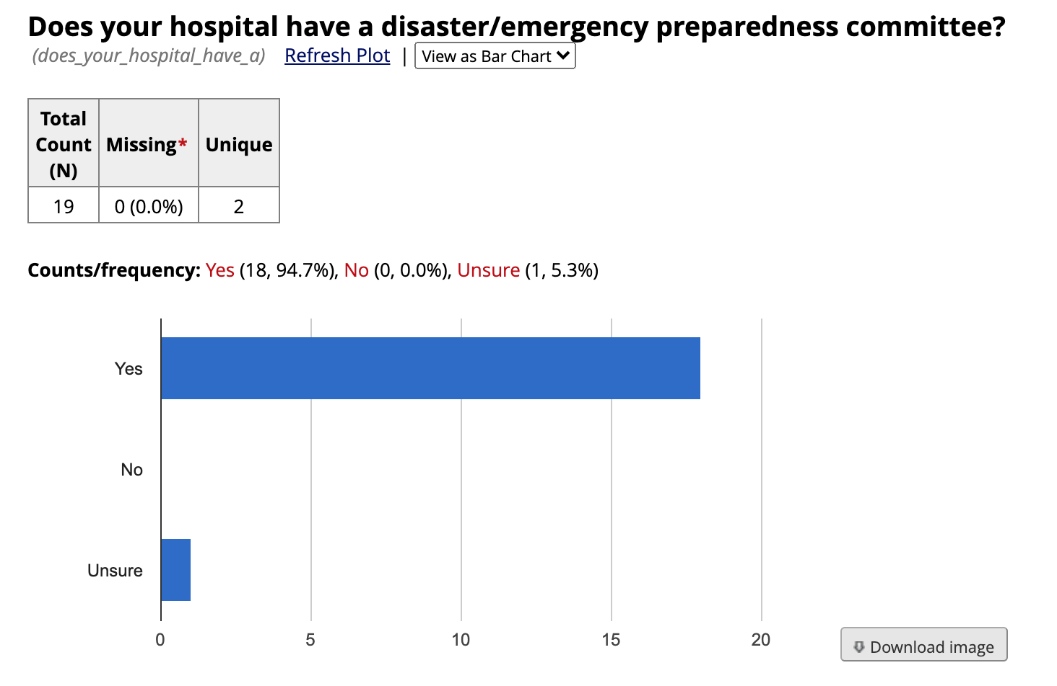
Almost all have disaster preparedness committee

Slide 12
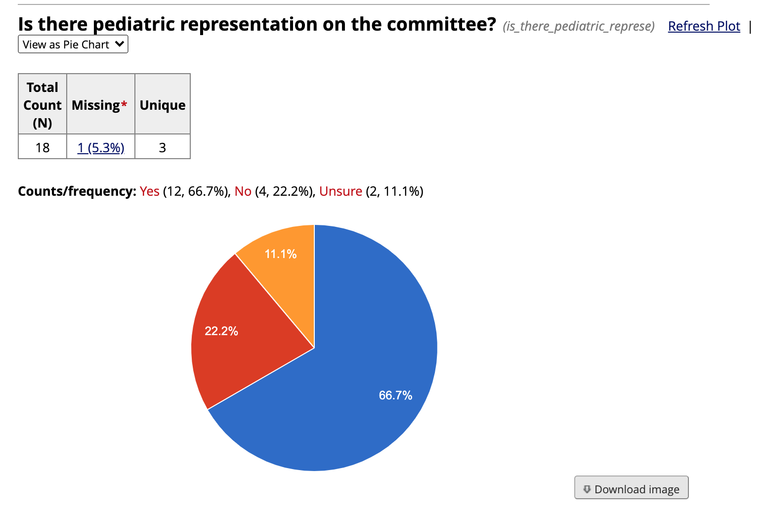
Slight majority have pediatric representation on the committee

Slide 13
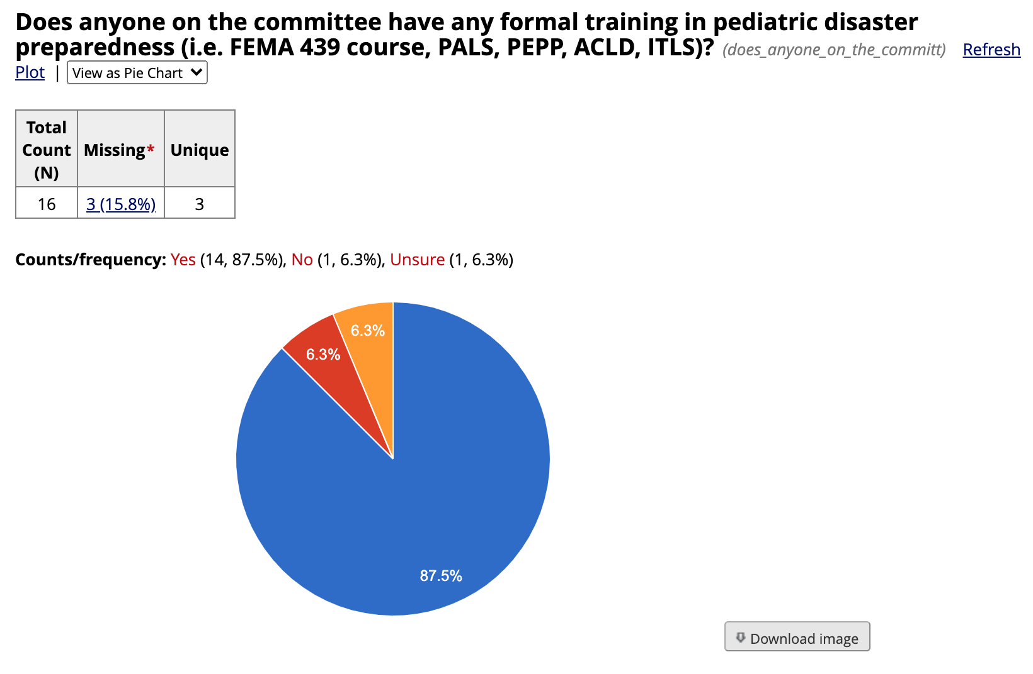
Strong majority have someone on the committee who has formal training in pediatric care

Slide 14
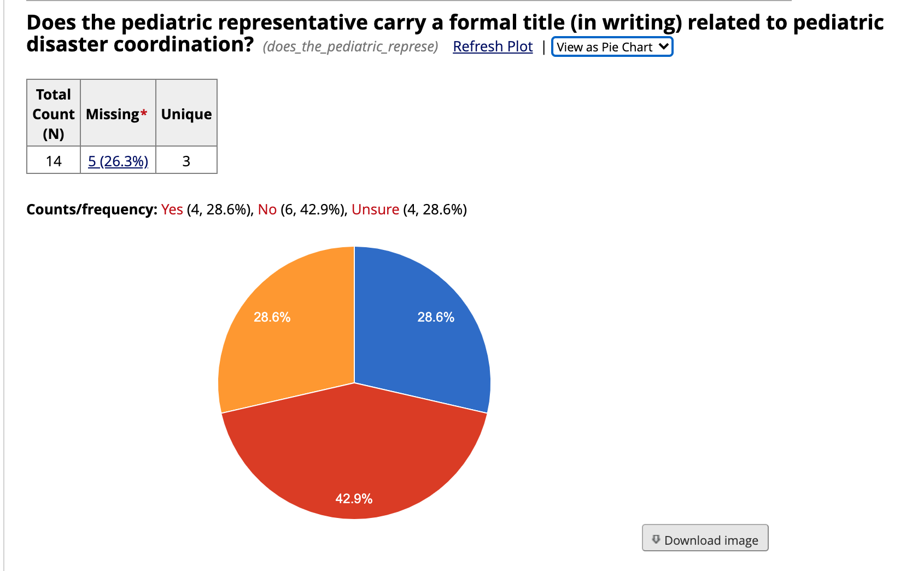
However, he/she does not tend to carry a formal title

Slide 15
Environmental Scan Results Summary
Common Strengths
ED staff are trained on the disaster protocol in multiple ways
Processes in place to decontaminate pediatric patients*
Adoption of a pediatric triage tool
Criteria for and defined mode of transport for interfacility transfer
Frequency of drills conducted
Participation in regional disaster coalition
What does your decontamination setup look like (eg: pop up tent vs permanent showers)?
What are the hospitals with cold weather are doing to protect the children from the elements during decontamination?

Slide 16
Environmental Scan Results Summary
Common Areas for Improvement
Formal title for the pediatric representative on the disaster preparedness committee
Tool/process for calculating ED pediatric surge capacity
Pediatric tracking tool for unaccompanied children
Percentage of children (live or simulated) represented/participating in drills
Determination of pediatric surge capacity at the regional coalition level

Slide 17
Environmental Scan Results Summary
What you would like to learn
Patient tracking and reunification
Staff education and training
Care for children and youth with special healthcare needs
Pediatric surge plan
Psychological first aid for both patients and responders

Slide 18
The Pediatric Champion
Module 1
July 15-28

Slide 19
The Pediatric Champion
Also known as Pediatric Emergency Care Coordinator (PECC)
An individual—physician, nurse, or other healthcare staff member—that has a desire to improve pediatric emergency care at their institution.
Role is defined in the 2018 Joint Policy Statement, “Pediatric Readiness in the Emergency Department” put forth by the American Academy of Pediatrics (AAP), American College of Emergency Physicians (ACEP) and the Emergency Nurses Association (ENA)

Slide 20
General Roles and Responsibilities
Ensure the availability of essential pediatric supplies and equipment
Staff are adequately trained on the use of equipment in line with the emergency care and resuscitation of infants and children.
ED policies and procedures consider the needs of children of all ages.
Facilitate the integration of pediatric needs in hospital disaster and/or emergency preparedness plans and promoting the inclusion of pediatric patients in disaster drills
The National Pediatric Readiness Project
https://emscimprovement.center/domains/hospital-based-care/pediatric-readiness-project/about/
Pediatric Readiness Toolkit
https://emscimprovement.center/domains/hospital-based-care/pediatric-readiness-project/readiness-toolkit/

Slide 21
Pediatric Disaster Coordination
  Works in concert with hospital Emergency Manager to integrate pediatric-specific considerations within the hazard vulnerability analysis and planning goals
  Plans and coordinates disaster drills that include pediatric patients
  Serves as liaison for pediatric patients/concerns on hospital committees (e.g., medical, trauma, disaster, etc.)
  Assures pediatric considerations and priorities are included in all staff disaster education and training
  Assures pediatric considerations and priorities are included in disaster education for prehospital providers
  Assists with development and review of the hospital disaster policies, ensuring that pediatric needs are addressed
  Serves as liaison representing children to regional facilities, EMS agencies, healthcare coalitions, and organizations to promote community disaster preparedness inclusive of children
  Collaborates with disaster program manager
  Promotes pediatric disaster awareness in the community

Slide 22
Children’s Hospitals: The Disaster Champion
Serve as a clinical leader with disaster expertise
  -“Medical Director of Emergency Management”
Roles and Responsibilities are similar to the PECC

Slide 23
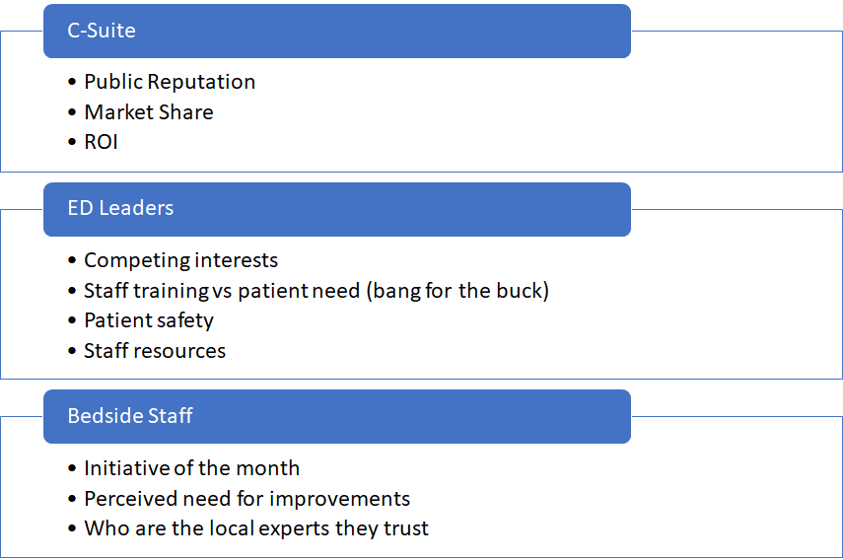
Step 1: Gain Support

Slide 24

Why should we work on this?
Improving Pediatric Disaster Care
Good enough for now
No specific complaints
COVID-19
Community Feedback
Competing initiatives
Market Share creep
No evidence to suggest need for improvement
Tangible benefits from Peds Readiness work
Limited resources

Slide 25

Making the case for improvement
Clinical Case
  Chart reviews of performance-safety issue
  Peer pressure
Tips and Talking Points
Executive ownership
  Market creep
  Volume trend
  Monthly business review
https://emscimprovement.center/collaboratives/pediatric-disaster-preparedness-quality-collaborative/pdpqc-participants-only/modules/
(password: PedsDisasterReady)
“Parent’ hospital responsibility
  Designated outreach directors (MD &RN )
  Commitment to supplies
  On site improvement plans

Slide 26
Module 1: Tasks
Purpose: Collect information
Engage with Emergency Manager and Emergency Management Committee (or self-analyze)
Is there any pediatric expertise on the committee? If no, why?
What do we need to do to improve here?

Slide 27
Module 1: Change Strategies
Do you have a Pediatric/Disaster Champion?
No
Identify a Pediatric/Disaster Champion
Yes
Are his/her roles and responsibilities defined?
No
Define roles and responsibilities
Does he/she have any formal training in pediatric disaster preparedness
(eg FEMA 439 Course)
Yes
No
Identify educational opportunities
Yes
Does he/she carry an official title and authority?
No
Work with leadership to formalize the role
Yes
Is the care team adequately trained on pediatric needs?
No
Develop staff education plan

Slide 28
Current Plan and Drill History
Module 2
July 29 – august 11

Slide 29
Does your plan “Check the Boxes”?
Joint Commission
  Are your hospital’s disaster plans simply created to meet Joint Commission requirements?
Pediatric Considerations
  Unaccompanied Minors
  Family Reunification
  Pediatric Surge Planning
☑
☑
Useable Document
  Are your hospital’s plans user friendly documents that would be of assistance in a disaster?
Drilling
  Do you have a robust drilling program?
  What parts of the hospital are involved in drills?
  Are kids a part of your drills?
☑
☑

Slide 30
Tabletop Exercises
Module 3
August 12 - 25

Slide 31
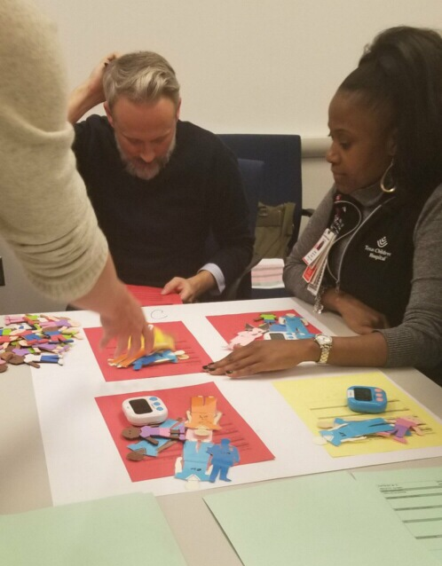
Tabletop Exercises “Going Beyond the ER”
Who Needs a Seat at the “Table”?
Key Clinical Areas
Clinical Support Areas
  Radiology
  Lab
  Blood Bank
Key Support Personnel
  Security
  Social Work
  Admin
  Media Relations
☑
☑
☑

Slide 32
Sneak Peak: Tabletop Exercise Scenarios
SCENARIO #1: SCHOOL BUS ACCIDENT
A school bus transporting elementary school children has been involved in a roll-over accident semi-truck. It is 4 PM during rush hour on a rainy day in April. The accident occurred 10 miles from the hospital. There are multiple injured children. Several are in critical condition. Ambulances are currently at the scene stabilizing and preparing patients for transport. Media has just picked up the story and they will likely arrive to the ED seeking information on injuries sustained during the incident. ETA of the first ambulance is 15 minutes.
SCENARIO #2: ACTIVE SHOOTER
A breaking story on the local news station discloses that shots have been fired at a local junior high school. It is midafternoon on a Friday. Your hospital is the closest to the school. The hospital has started receiving calls from terrified parents seeking information about their children. There are reports that some children have escaped the building with penetrating injuries. The number of those injured is currently unknown. The ETA of any injured arrivals is also unknown.
SCENARIO #3 - LARGER STORM/FLOODING
Your local area is currently under a flash flood warning due to a large thunderstorm. It is currently 2 AM on a Sunday night in December. There are reports of a nearby dam breaking causing a sudden influx of flooding in a highly populated area. A call comes in that EMS has been called to help multiple victims with concern for drowning, near drowning, and hypothermia. You are the nearest hospital to the dam break and are expected to receive the majority of the patients involved.
SCENARIO #4 - BOMB
An explosion has occurred at a local high school during a busy Wednesday morning. The cause is currently unknown, but a large area of the three-story building has collapsed. First responders are currently at the scene and have extracted some of the victims from the debris, but it is unknown how many are trapped. You are the nearest hospital and expected to receive the majority of the injured victims.
SCENARIO #5 – FIRE
There has been an inbound call from EMS bringing pediatric patients involved in a fire. According to EMS, a 3-alarm fire is active at a nearby in-home daycare. There are at least three critically injured children under 3 years of age with large areas of burns. The number of children at the daycare at the time of the fire is currently unknown. There were two daycare workers on site at the time, one is severely injured and the other has minor injuries but is hysterical and unable to focus to answer questions.
SCENARIO #6 - CARBON MONOXIDE POISONING
It is 8 PM on a cold night in January and a man has called EMS for help after coming home to find his wife and children ill. Their youngest child is 18 months old, unconscious, and unarousable. The older five children range in age from 3 to 12 years. These children and his wife have been complaining of nausea, dizziness, and difficulty breathing. There are two ambulances in route to your hospital with the patients.

Slide 33
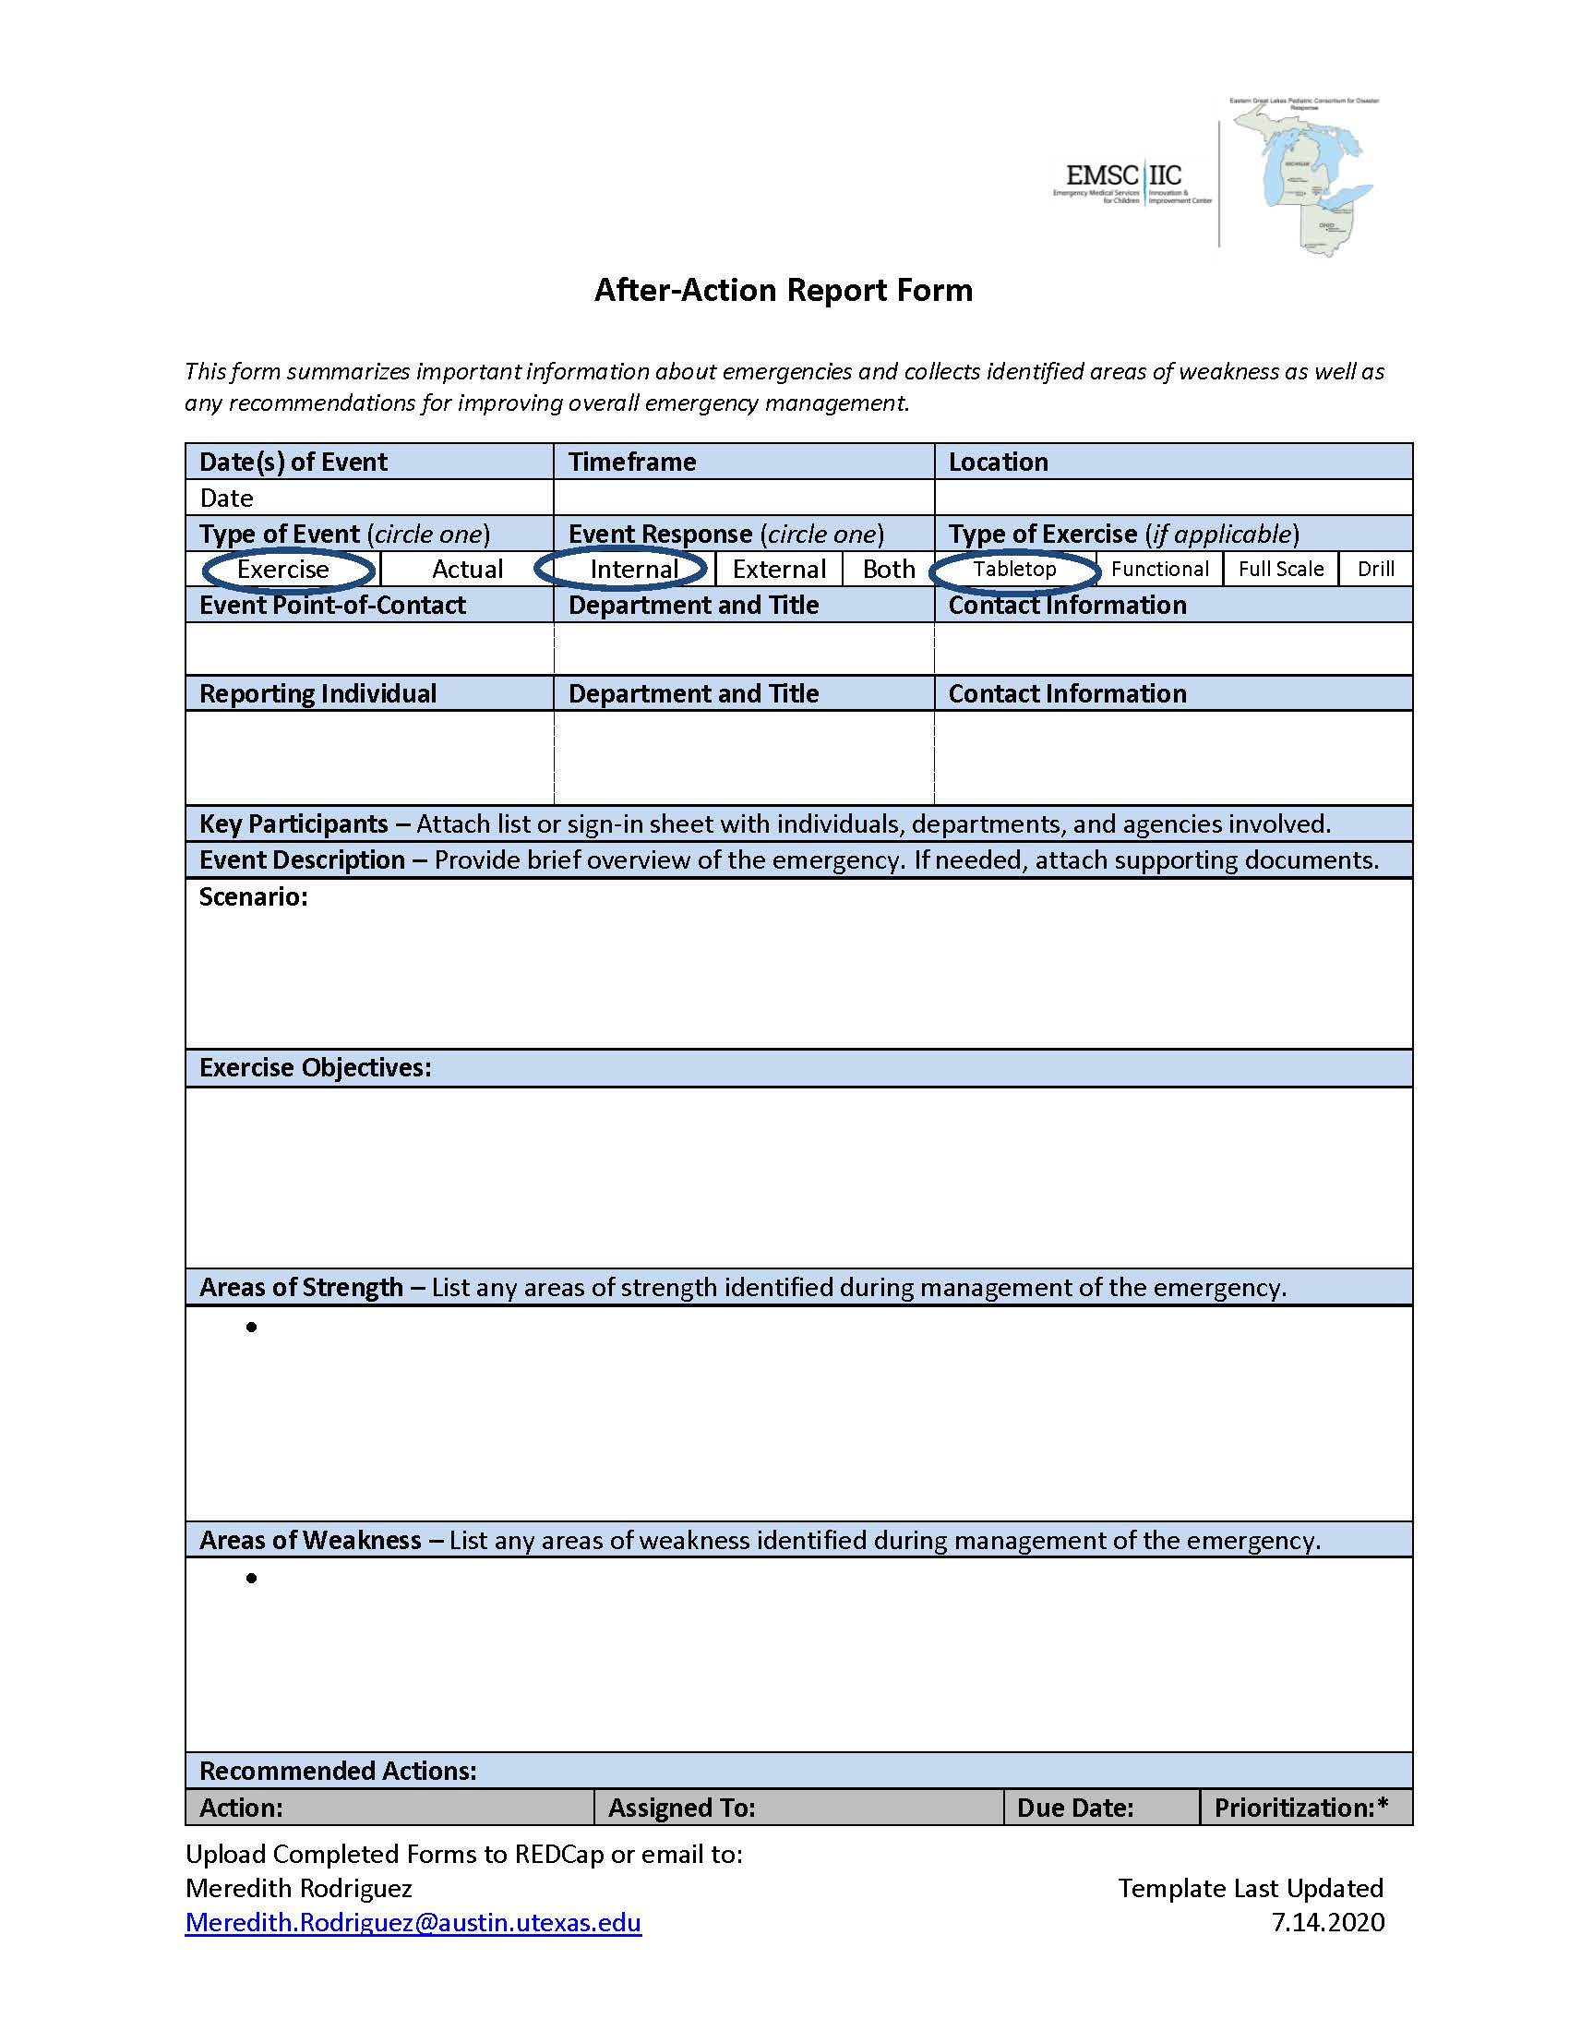
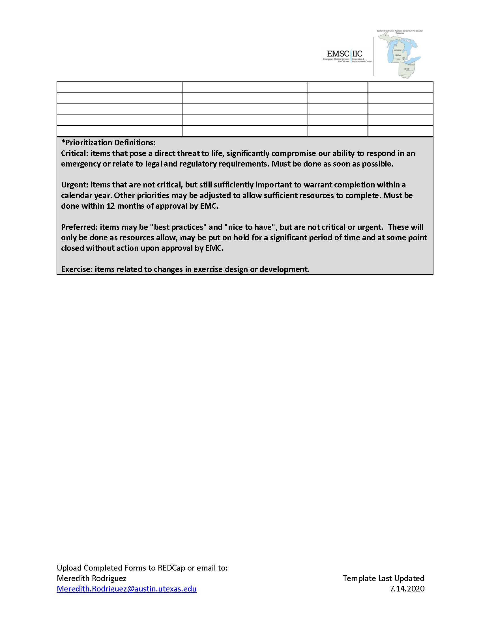
After-Action Report

Slide 34
Housekeeping
Next Learning Session: Regional Disaster Coalitions
  August 25, 12:00 ET / 11:00 CT
  Join Zoom Meeting: https://utexas.zoom.us/j/93073919339 ; Meeting ID: 930 7391 9339
Modules
  Emailed out every 2 weeks on Wednesday
  Can also check the Participants-Only website
Participant Contact List
  Published tomorrow, Wednesday 7/15
  Please let me know if you do NOT want your name/email listed
  Notify me if you would like anyone else included on the list

Slide 35
Discussion & Questions
Thank you!

