Slide 1
Implementing a Disaster Drill at Your Institution
12-February 2019
Presenters: MD, FAAP, FACEP, FAEMS
Sarita Chung, MD, FAAP
Brent Kaziny, MD, FAAP

Slide 2
ACKNOWLEDGEMENTS
The HRSA, MCHB EIIC is supported in part by the Health Resources and Services Administration (HRSA) of the U.S. Department of Health and Human Services (HHS) under grant number U07MC29829. This information or content and conclusions are those of the author and should not be construed as the official position or policy of, nor should any endorsements be inferred by HRSA, HHS or the U.S. Government.

Slide 3
Brent Kaziny, MD, MA, FAAP
Assistant Professor of Pediatrics, Baylor College of Medicine
Section of Emergency Medicine, Texas Children’s Hospital
Director of the EMSC Innovation and Improvement Center’s Disaster Preparedness Domain
Sarita Chung, MD, FAAP
Associate Physician in Medicine, Division of Emergency Medicine
Assistant Professor of Pediatrics and Emergency Medicine, Harvard Medical School
Co-Director of EMSC Innovation & Improvement Center’s Disaster Preparedness and Recovery Domain

Slide 4
WHAT IS AN EXERCISE?
Exercises and their objectives can focus on:
Testing a plan, protocol, or new procedure
Practicing skills (such as those used for patient triage or tracking)
Preparing for more complex exercises
Training on new equipment (such as radio equipment or devices used during patient evacuation)
Assessing/improving ways in which stakeholders work with each other in various situations

Slide 5
PEDIATRIC EXERCISES
Children may need specialized resources related to their needs on the basis of:
Anatomic Differences
Developmental Differences
Immunologic Differences
Psychosocial Differences

Slide 6
PEDIATRIC EXERCISES
Pediatric patients may present to community providers and hospitals that do not routinely care for children.
Important to conduct exercises that focus on pediatric populations, identifying gaps in preparedness, training, response, and recovery for children in disasters and address issues such as:
Treating children who arrive without a parent or caregiver;
Identifying and reuniting children with their families;
Pediatric triage;
Utilizing pediatric-sized equipment; and
Addressing disaster mental health problems in pediatric patients.

Slide 7
THE GOAL
All disaster-related exercises should include a component or subset of pediatric victims based on their representation in the population and likelihood of being affected by mass- casualty events.

Slide 8
HOW TO INCORPORATE?
Pediatric-Specific Exercise Versus Incorporating Pediatrics Into General Exercises
Different Approaches
Pediatric Specific – The “School Bus Accident”
Family Centric – The State Fair Attack
General Population – Children are up to 25% of the victims

Slide 9
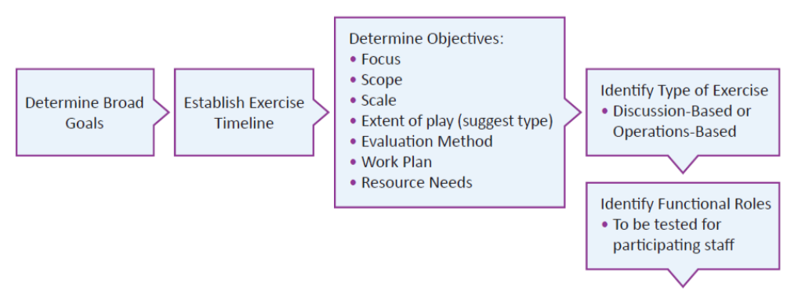
THE EXERCISE CYCLE

Slide 10
THE EXERCISE CYCLE

Slide 11
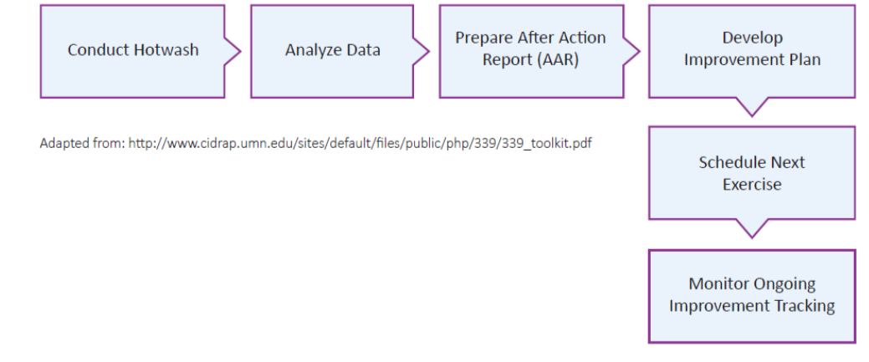
THE EXERCISE CYCLE

Slide 12
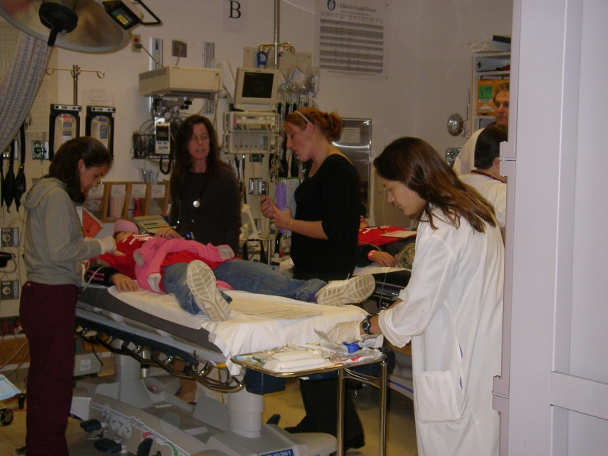
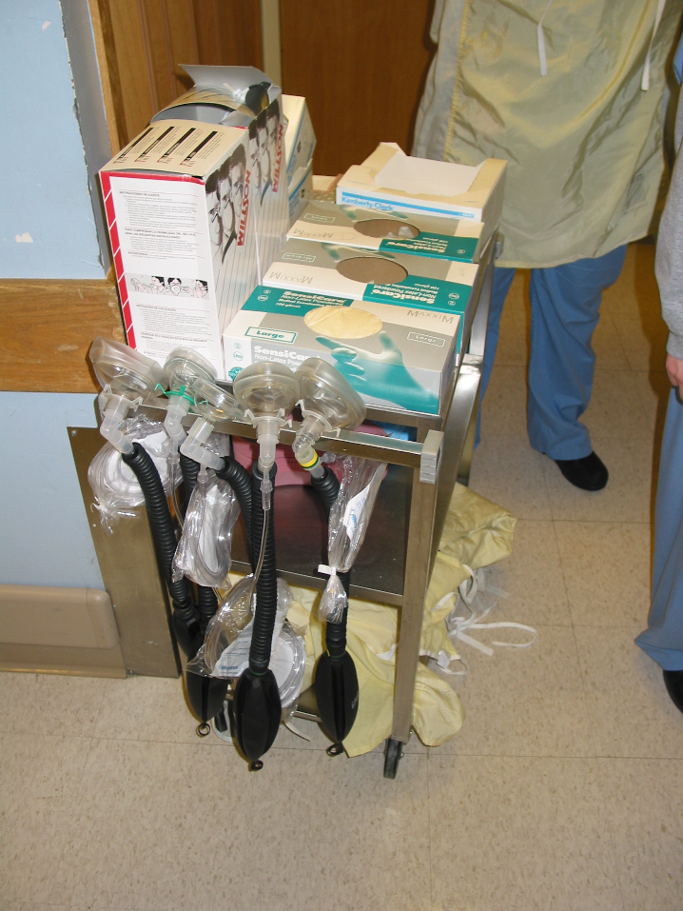
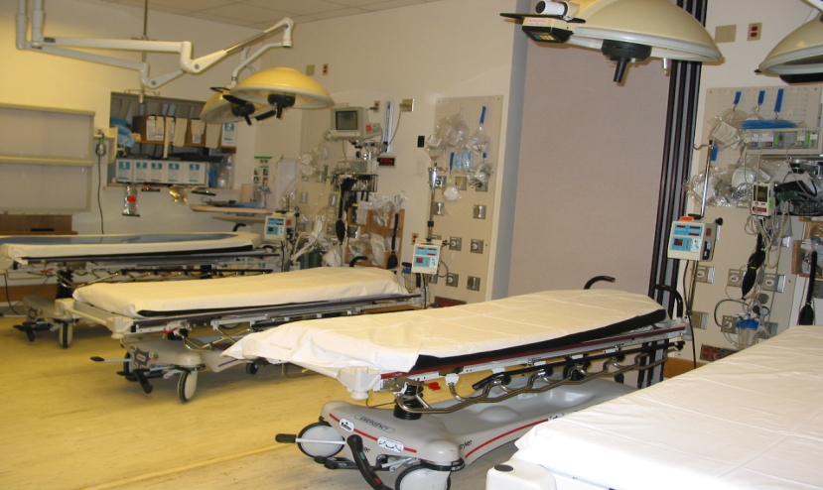
FOR EMERGENCY DEPT
Staff
Stuff
Space
Structure
Kaji et al Acad Emerg Med 2006; 13:1157–1159

Slide 13
DISCUSSION BASED
Seminars
Workshops
Tabletops
Games

Slide 14
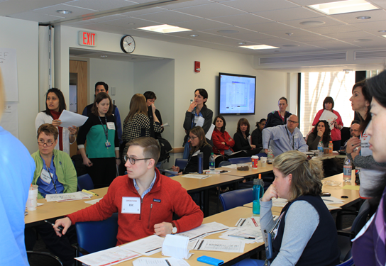
DISCUSSION BASED
Seminars
Orients participants to:
Authorities
Strategies
Plans
Policies
Protocols

Slide 15
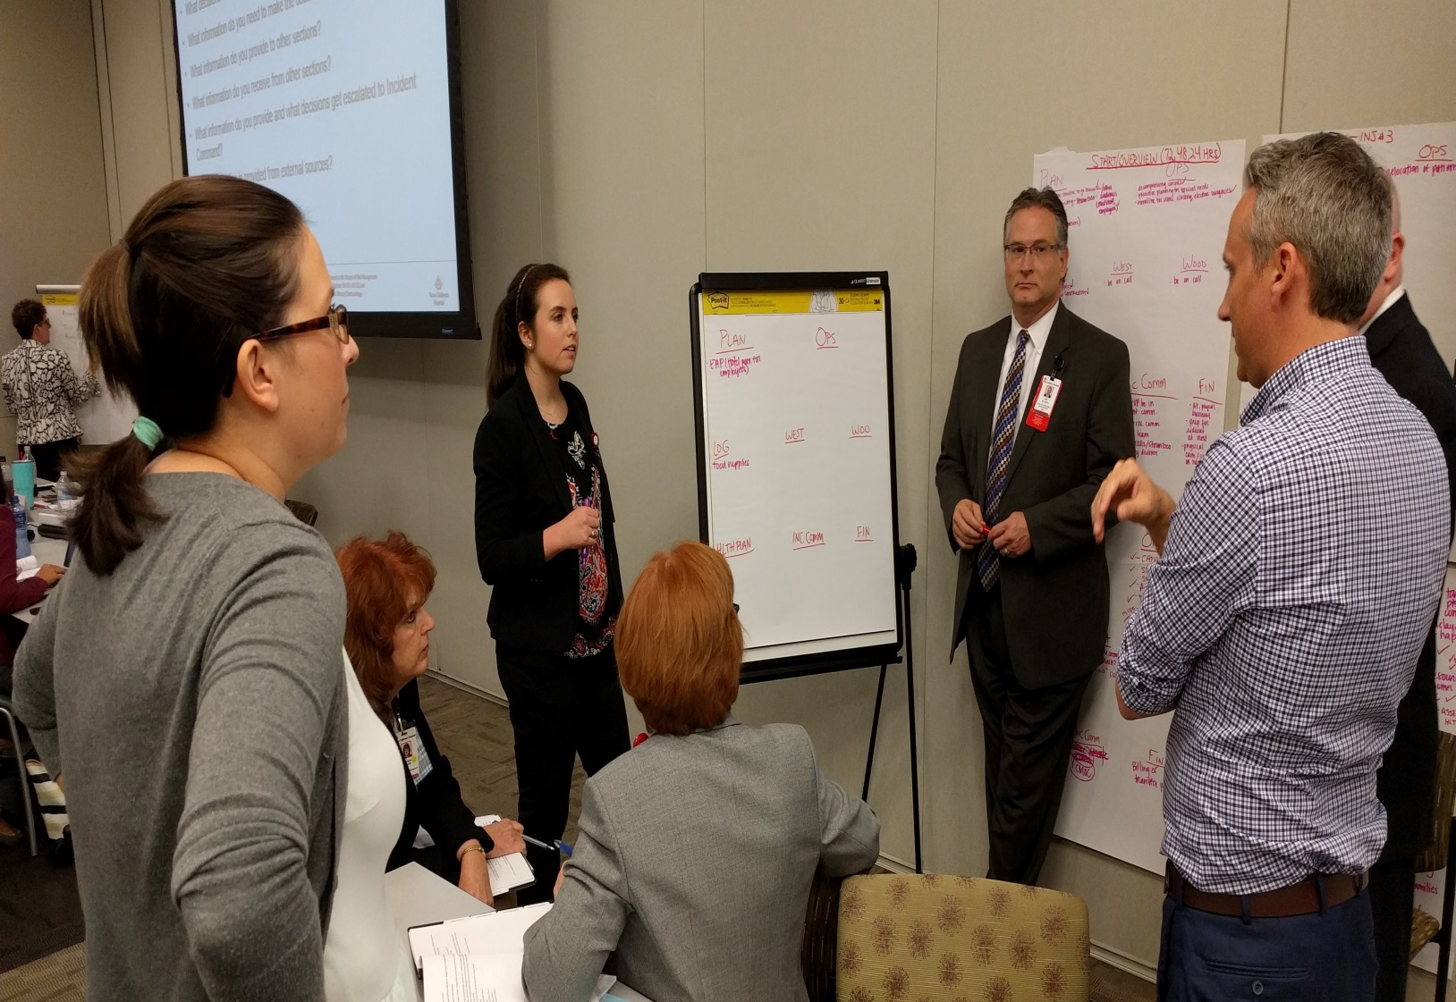
DISCUSSION BASED
Workshops
Increase participant interaction
Focus on improving plans

Slide 16
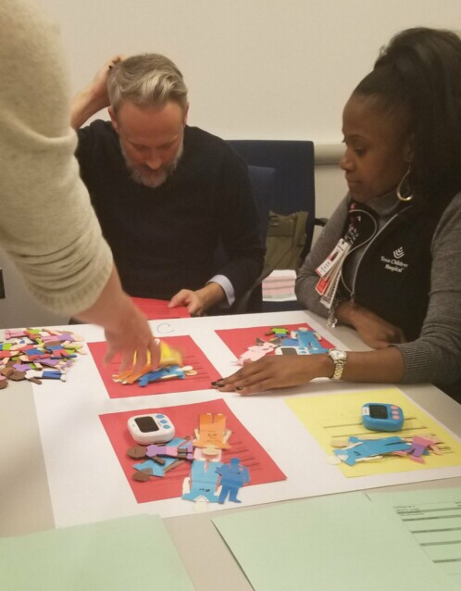
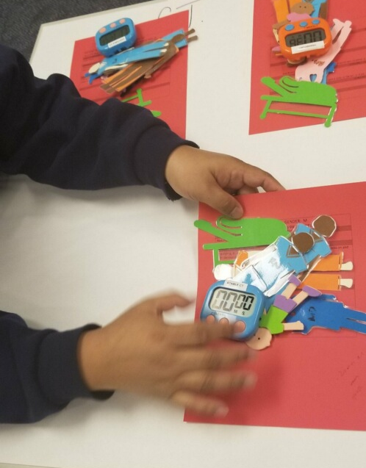
DISCUSSION BASED
Tabletops
Generate discussion around a hypothetical emergency to facilitate understanding

Slide 17
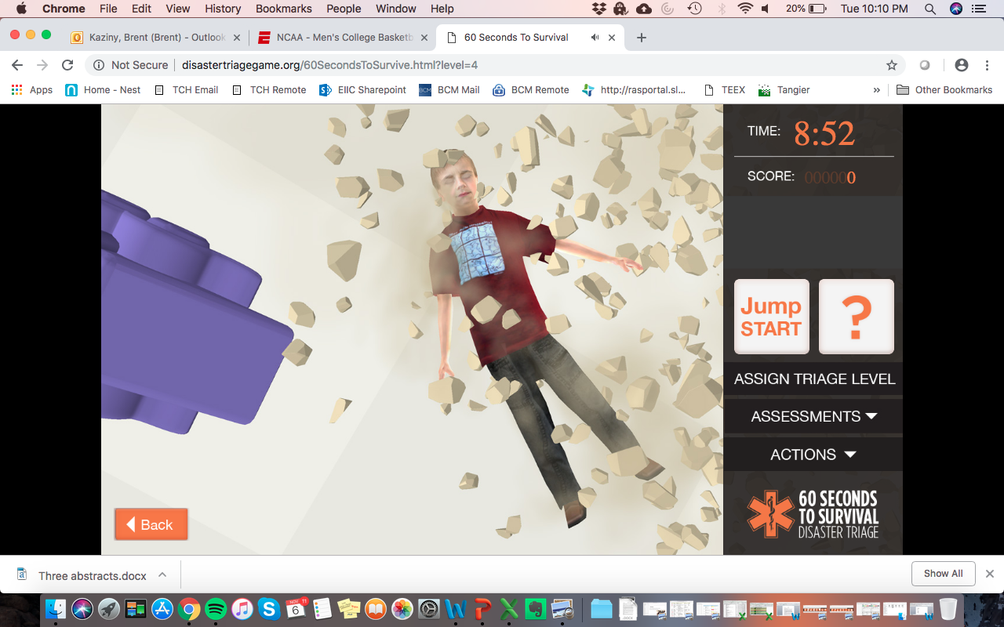
DISCUSSION BASED
Games
Simulations

Slide 18
OPERATION BASED
Drill
Functional Exercise
Full-Scale Exercise

Slide 19
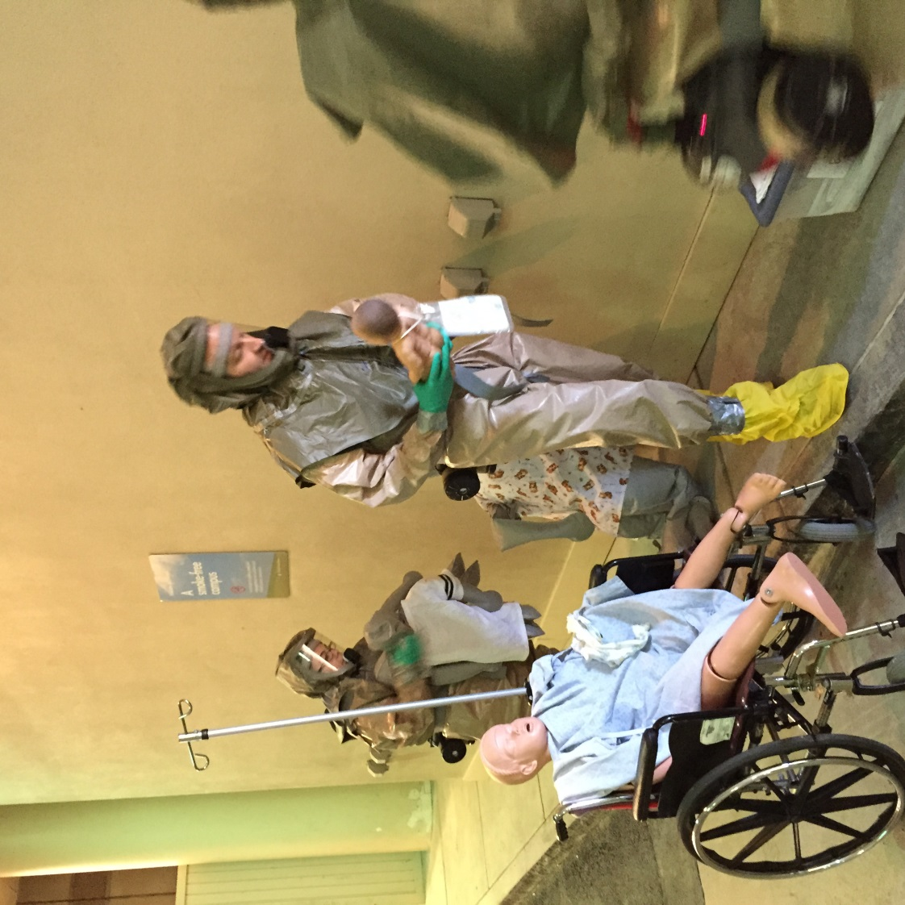
OPERATION BASED
Drill
Test a specific operation

Slide 20
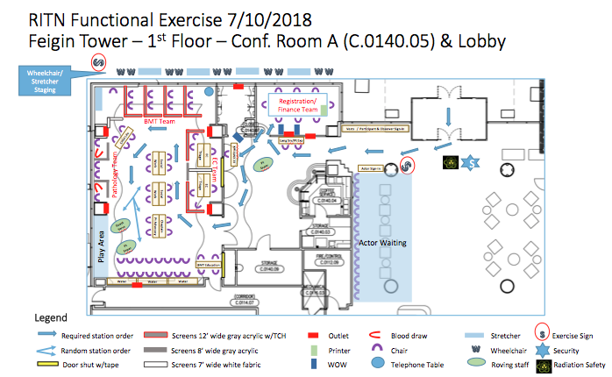
OPERATION BASED
Functional Exercise
Validate and evaluate plans
Exercise scenario with injects

Slide 21
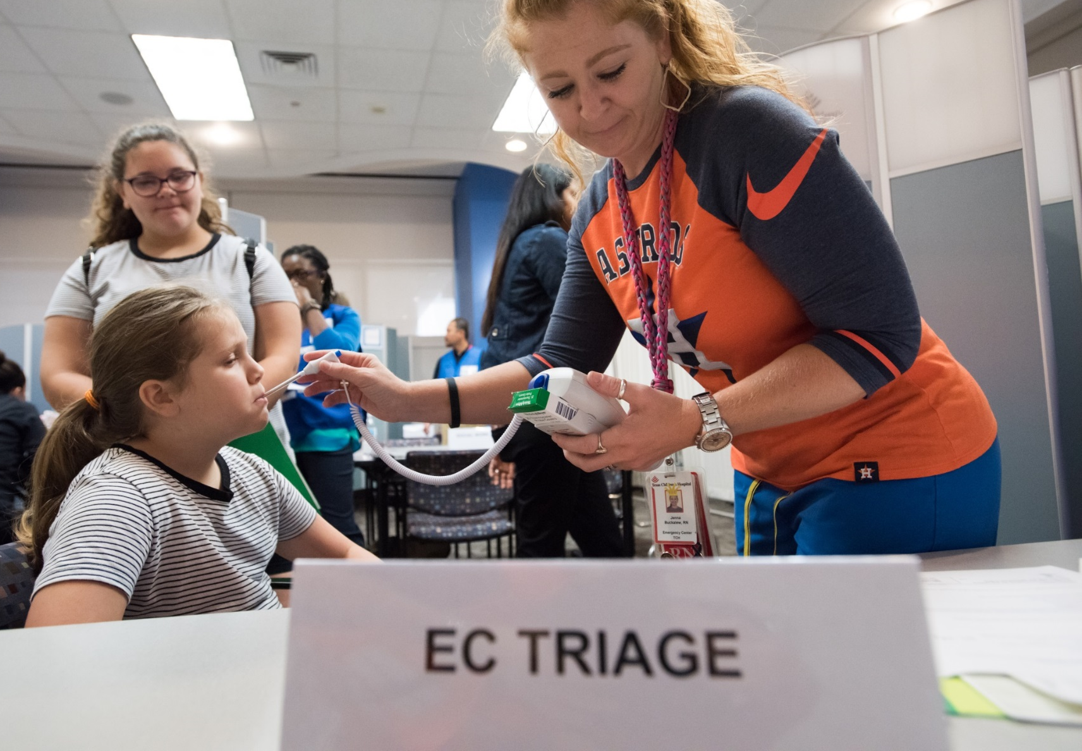
OPERATION BASED
Functional Exercise

Slide 22
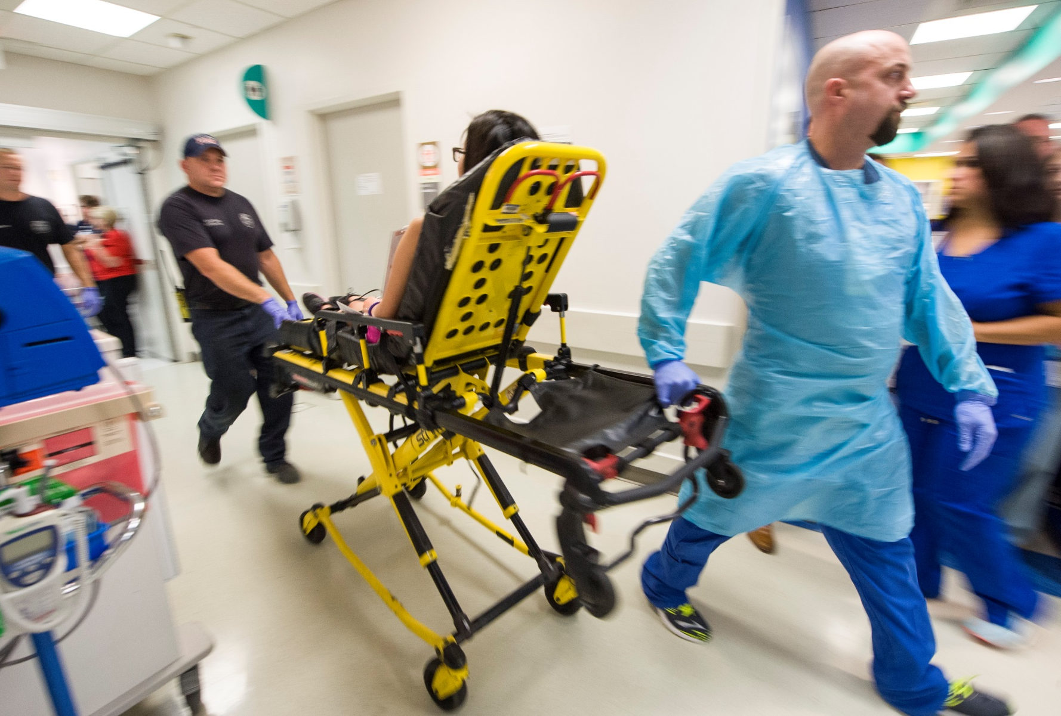
OPERATION BASED
Full-Scale Exercise
Multidisciplinary
Coordination
Communication

Slide 23
Notes:
After Allison an additional

Slide 24
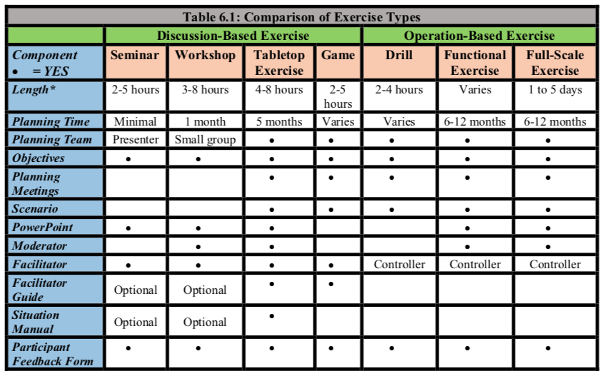
TYPES OF EXERCISES

Slide 25
NEXT STEPS
Revise the plan that was exercised or discussed
Shortly after the exercise to keep up momentum and while the information is still fresh
Most plans are written by a small group of people with an idealistic mindset of how the actual event will be handled
The purpose of certain exercises is to share the plan with exercise participants who can offer input to improve the plan and the professionals’ abilities to use plan concepts in a real-world situation.

Slide 26
RESOURCES
AAP Pediatric Disaster Preparedness and Response Topical Collection: Pediatric Preparedness Exercises https://www.aap.org/en-us/advocacy-and-policy/aap-health-initiatives/Children-and-Disasters/Pages/Pediatric-Terrorism-And-Disaster-Preparedness-Resource.aspx

