Slide 1
Family Reunification Tabletop Exercise
EMSC-IIC
April 27, 2021

Slide 2
Welcome!
Please introduce yourself in the chat!
Institution Name | City | State
Akron Children's Hospital | Akron | OH
Comer Children's Hospital | Chicago | IL
Illinos Department of Public Health | West Chicago | IL
Kishwaukee Hospital | Dekalb | IL
Riley Children's Health | Indianapolis | IN
St. John's Hospital | Springfield | IL
Henry Mayo Newhall Hospital | Valencia | CA
MT DHPPS | Helena | MT
National Pediatric Disaster Coalition | Danville | CA
Woodland Memorial Hospital | Woodland | CA
UF Health Jacksonville | Jacksonville | FL
Institution Name | City | State
Northeast Hospital Corp., dba Beverly Hospital | Beverly | MA
Beaumont Heath | Royal oak | MI
Carle Foundation Hospital | Urbana | IL
Children's Hospital of Eastern Ontario | Ottawa | ON
Children's Hospital Colorado | Aurora/Colorado Springs | CO
CHOC Children's | Orange | CA
Cincinnati Children's Hospital | Cincinnati | OH
Knox Community Hospital | Mount Vernon | OH
New York-Presbyterian-Weill Cornell Medicine | New York | NY
Providence Holy Cross Medical Center | Mission Hills | CA
Providence Saint Joseph Medical Center | Burbank | CA
SSM Health St. Joseph Hospital Lake St. Louis | Saint Louis | MO

Slide 4
Agenda
Introduction -Brent
  Rename self w/ hospital name
  Introduce yourself in the chat
  Ground rules
Background -Sarita
Scenario presentation (10 minutes) – Brent / Sarita
Breakout 1 -5 (10 mins each)
Large group report-out 1-5 (10 minutes each)
  2 hospitals will present each time
  Please select an individual to report-out
Hot Wash – (1 hr) -Deanna
Notes:
Brent and Sarita to alternate giving injects, leading discussion.

Slide 5
Introduction and Background
The importance of family reunification

Slide 6
Ground Rules
This is a safe environment
If you feel overwhelmed, please notify your moderator
Please avoid distractions (phones, emails)
You are playing your role in the hospital
Please try to keep your video on. You are welcome to go off-screen during didactic portions
Please put questions in the chat

Slide 7
Objectives
Recognize how to prepare and manage a mass casualty event via simulation
Test and revise your hospital reunification policies and procedures during a patient surge (share best practices and uncover gaps in planning)
Understand hospital’s integration into a regional reunification plan

Slide 8
Pre-Exercise Polling Questions

Slide 9
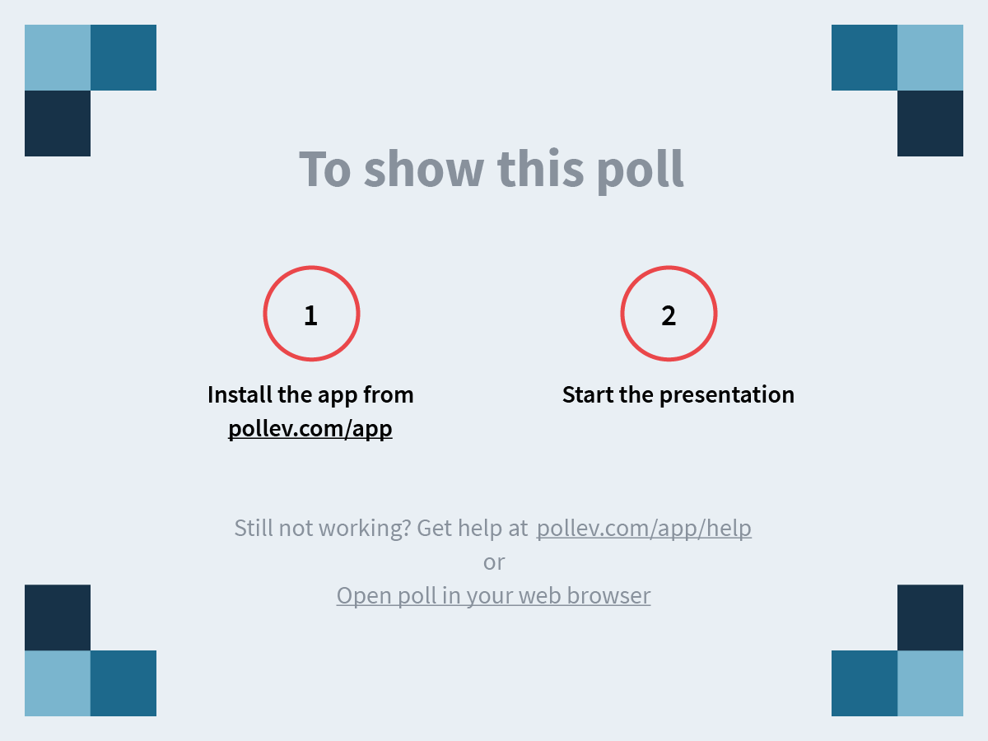
Notes:
Where are you joining us from today?
https://www.polleverywhere.com/clickable_images/WxgLKdjqcSaWBRbcm62BQ

Slide 10
Notes:
What group/department in your hospital are you representing today?
https://www.polleverywhere.com/free_text_polls/rT7ZDx192B4wfRfBqNGmw

Slide 11
Notes:
Do you currently have a patient tracking and family reunification plan that includes pediatric considerations?
https://www.polleverywhere.com/multiple_choice_polls/amm1OeGgzs9GHdHg6fzIL

Slide 12
Notes:
Did you complete the patient tracking and family reunification module of the collaborative?
https://www.polleverywhere.com/multiple_choice_polls/qNyQstjmqvfAuTwXihpRQ

Slide 13
Notes:
What are you most hoping to get out of the exercise today?
https://www.polleverywhere.com/free_text_polls/SWyyYNonFO0mXsbW0ueqW

Slide 14
Background

Slide 15
JumpSTART Triage
JumpSTART Triage colors will
be used for this scenario

Slide 16
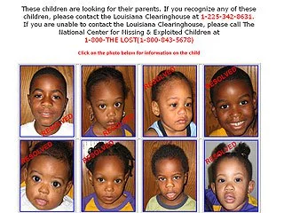
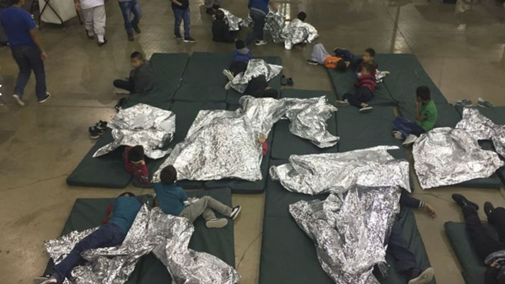
The Need for Family Reunification
Hurricane Katrina - 2005
Border Crisis - 2018
Notes:
Young children cannot provide reliable information about medications or medical history
During Hurricane Katrina, the average age of the separated child was 5.7 years⁴
# children separated can be very high, e.g. after Hurricane Katrina:
5,011 children reported missing
71% of whom were still separated after 17 days
13% of whom were still not reunited after 3 months^{1,3}

Slide 17
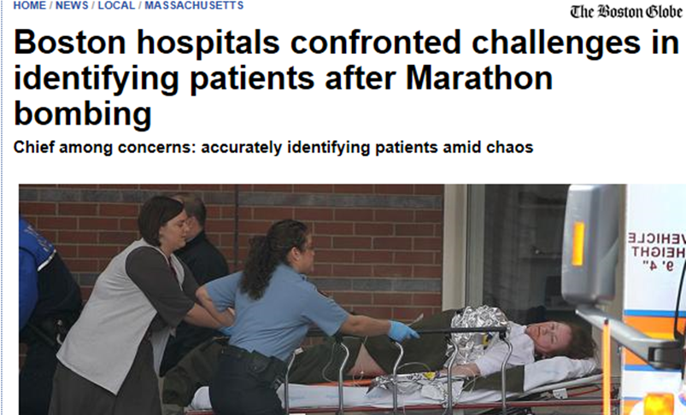

Hospitals = Part of the Solution
Notes:
Need a robust reunification plan to address both the needs of unaccompanied children and anxious families

Slide 18
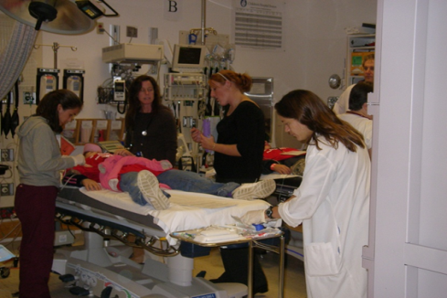
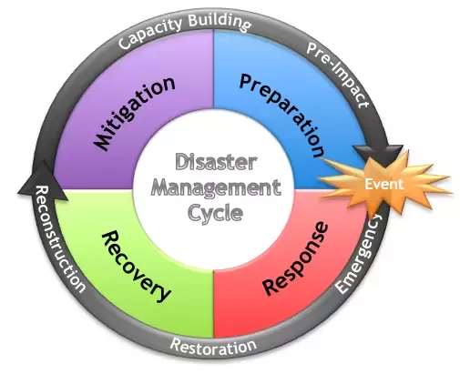
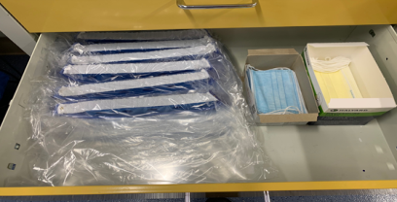
Disaster Cycle and the 4 Ss
  Staff
  Space
  Stuff
  Structure
Kaji et al Acad Emerg Med 2006; 13:1157–1159

Slide 19
Scenario
Preparing for a surge

Slide 20
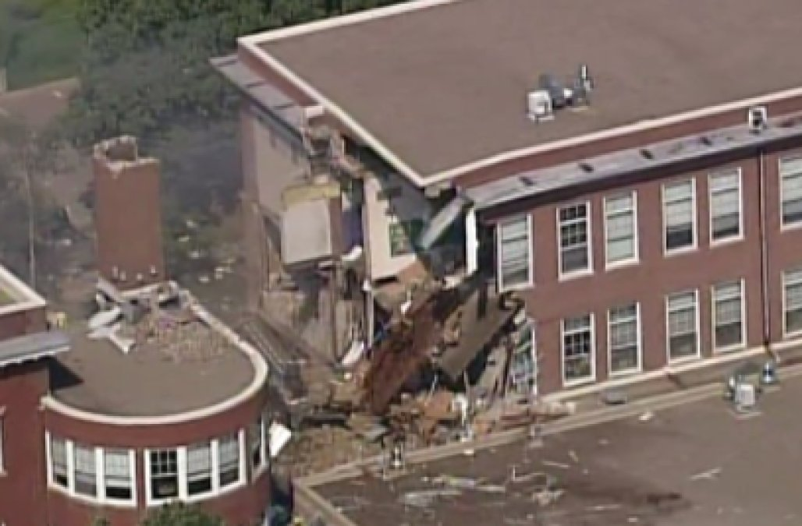
Scenario
Media posting on social media that there has been a loud explosion near a school (police scanner)

Slide 21
Scenario
Police and First Responders are on scene reporting:
  Multiple Explosions at school (K-8)
Incident Command has been set up
  Many injuries and a majority are children
  Triage at the scene
Victims are arriving shortly

Slide 22
Breakout #1: Preparedness for MCI organize by hospital, ED, security, media
What are the initial steps hospital leadership would take? (structure, staff, space stuff)
Is there a community plan for dispersing victims from a large incident?
Does the hospital set up Incident Command?
Anticipation of types of victims and injuries?
How to create space to accommodate victims? ED? OR?
How to increase staffing? Labor pool, community volunteers?
How to obtain needed supplies?

Slide 23
Breakout #1: Preparedness
4Ss: Staff, Stuff, Space, Structure
Who will take the lead in family reunification?
What staff will you need, where will you put families?
What process will you use to reunite families (especially for unidentified patients)
Spaces you will need and where?
How will you inform families if their child is not there?
Report Out: Group 1 & Beaumont Heath

Slide 24
Inject #2: Patients Begin to Arrive
First Group of Patients:
  5 patients:
    Red (5 yo)
    Yellow (6 yo, 10 yo, 9 yo, 32 yo)
  School official accompanying children
  Assume medical management is underway
    Focus on managing the process of identification and reunification

Slide 25
Breakout #2: Response
4Ss: Staff, Stuff, Space, Structure
How would your hospital keep track of patients?
How does your hospital engage with external partners related to external tracking?
As ED staff manage the surge, what other steps will hospital leadership need to consider in the next few hours?
How to handle media?
How to handle family members seeking information?
  Phone calls and in person
  Do you have space identified to receive families presenting to the hospital?
Report Out: Carle Foundation Hospital & Children's Hospital of Eastern Ontario

Slide 26
Inject #3: More Patients Arrive
Second Group of Patients:
11 patients:
  Red (9 yo)
  Yellow (12 yo, 6 yo, 44 yo)
  Green (5 yo x 4, 6 yo x 3)
Another school official accompanies some of the patients

Slide 27
Inject #3: More Patients Arrive
Second Group of Patients:
Family members have started arriving now
  Need to manage people and information
ED staff is busy coordinating care of more critical patients
  Need more staff, especially for children
  School official helpful, but starting to get overwhelmed
Social media has posted that most patients are coming to your hospital
School family members are posting all over social media

Slide 28
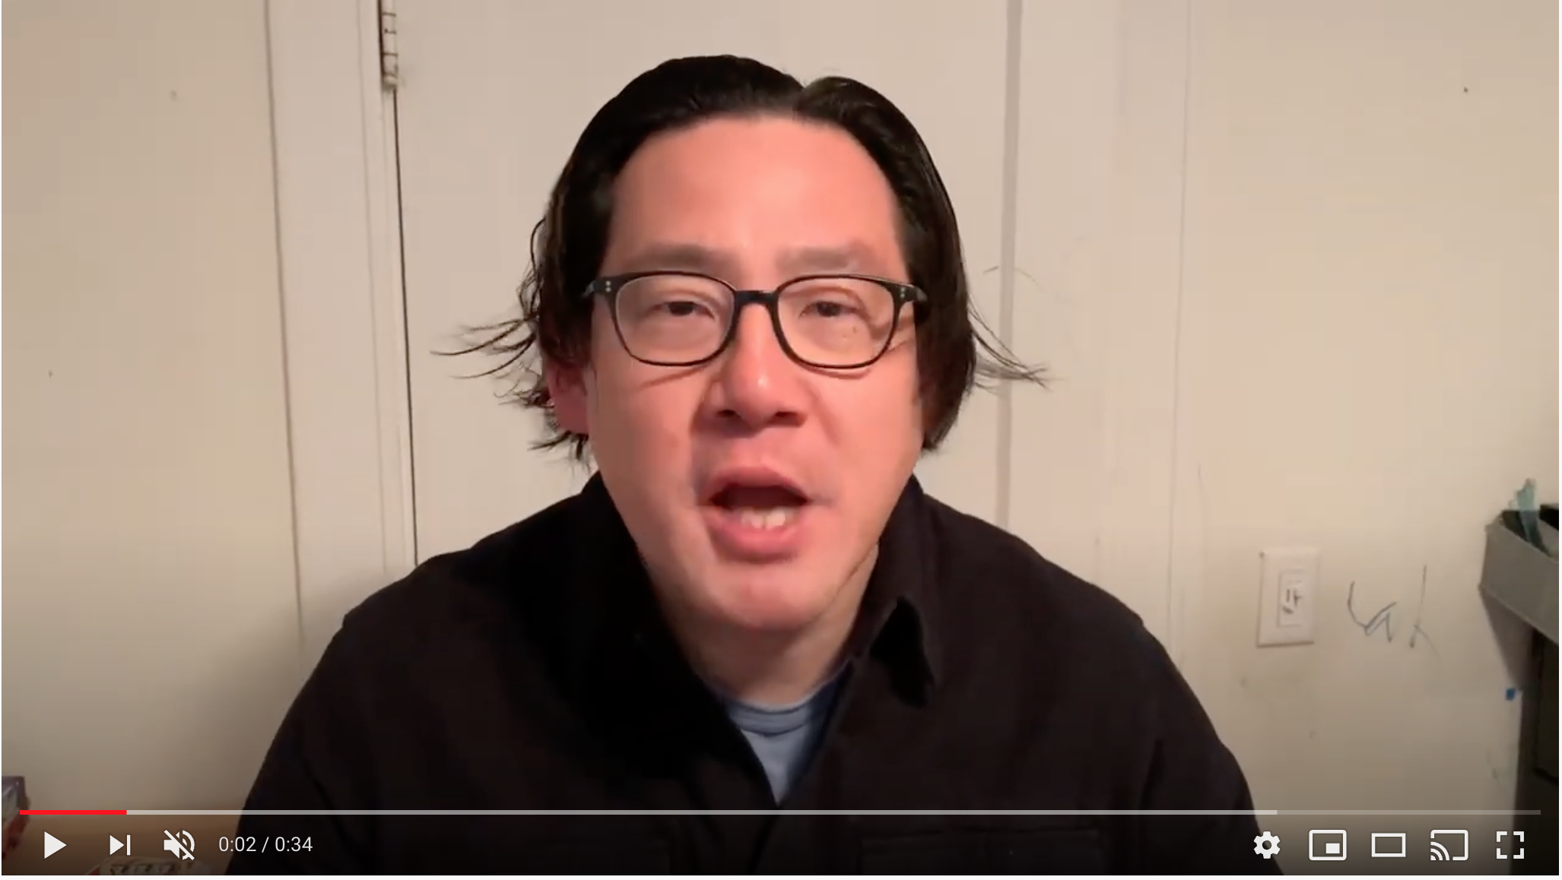
Inject #3: Parents Begin to Arrive
https://youtu.be/7npw6gYKA7w

Slide 29
Breakout #3: Response
4Ss: Staff, Stuff, Space, Structure
How would you approach the angry parent?
Is there extra staff to assist school officials with children?
  Who?
  Vetted?
Do you have space for the children after they are cleared medically?
How are you handling the increased information seeking from media and community members?
Report Out: Group 2 & Children's Hospital Colorado

Slide 30
Break
5-10 mins

Slide 31
Inject #4: More Patients Arrive
Third Group of Patients:
27 patients:
  Black – Expectant (Estimated 7 yo)
  Yellow (10 yo, 8 yo, 7 yo x 2)
  Green 20 additional children
No school officials accompany these patients

Slide 32
Inject #4
Many families are gathered in the ED waiting room and other entrances of hospital, crowding multiple areas
  Families and friends start coming to the hospital
  No clear identification has been made for pediatric patients
  The ED has stated there are over 150 people in the waiting room seeking to reunited

Slide 33
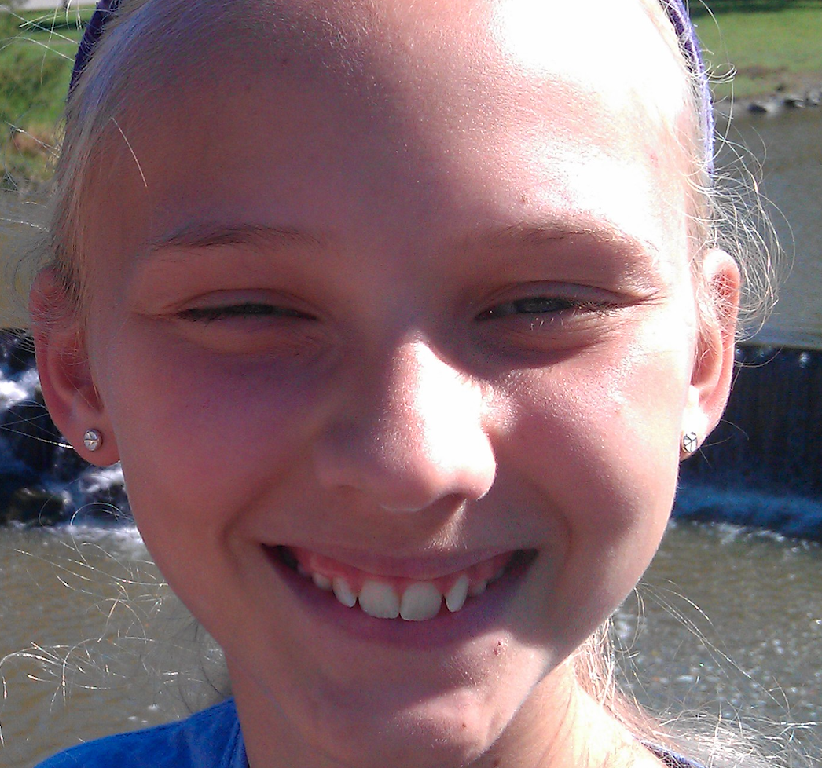
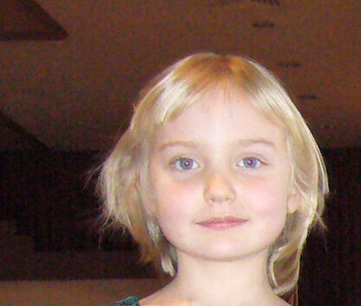
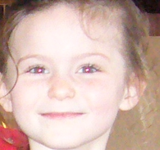
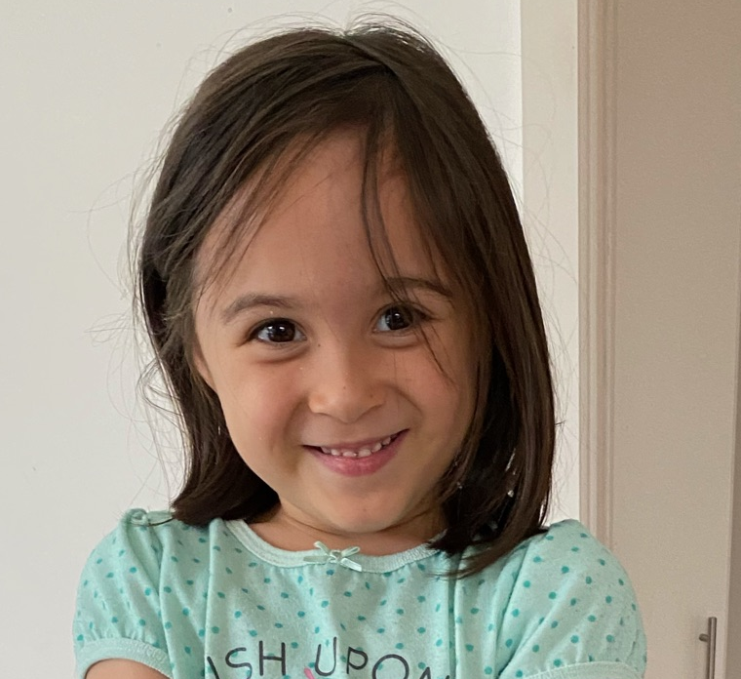
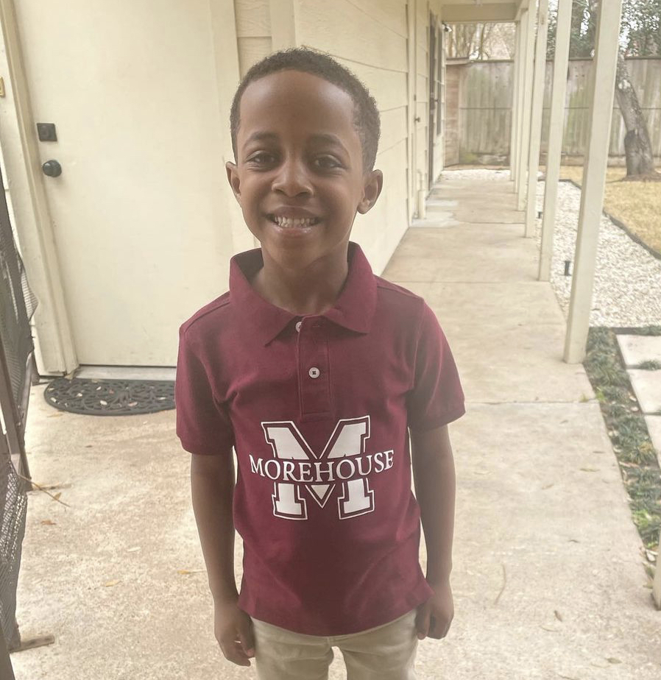
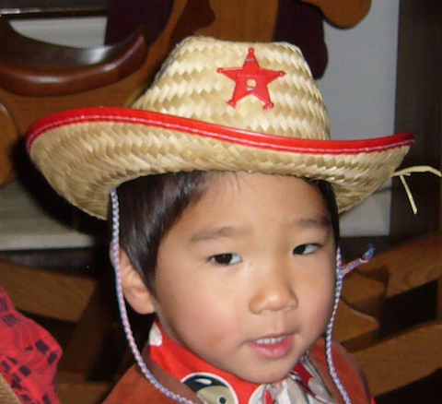
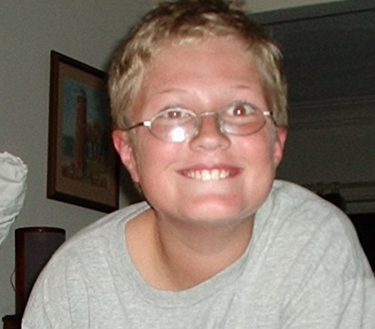
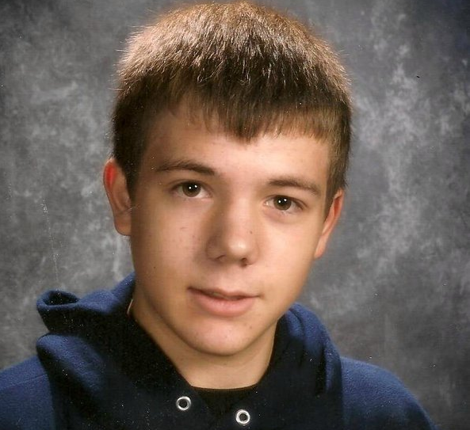
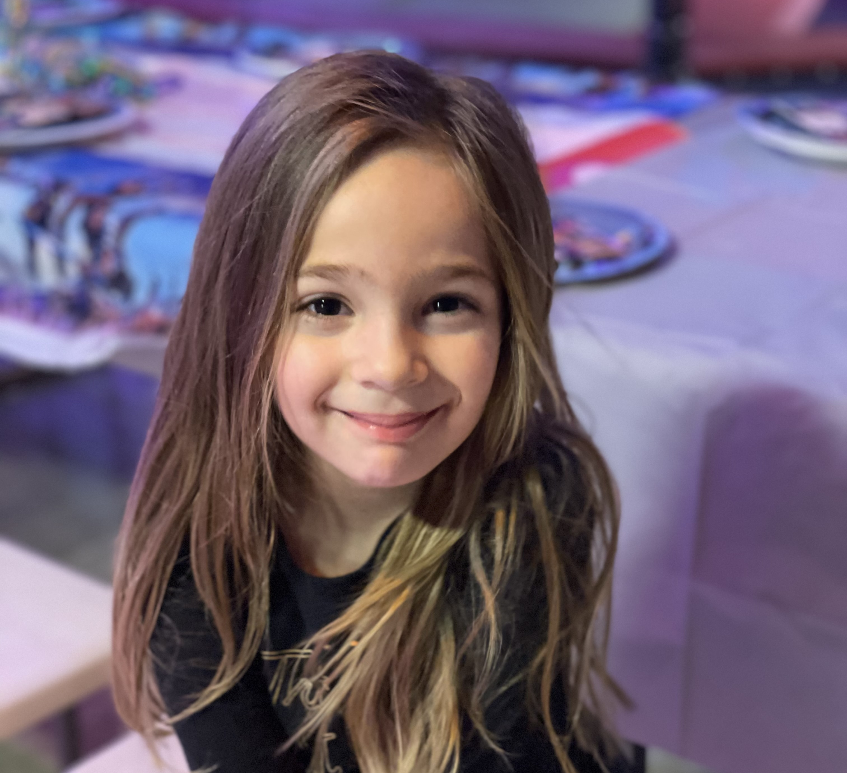
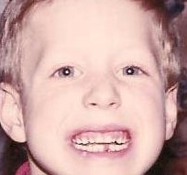
Inject #4: Patients Needing Identification
Notes:
Numbered photos of children. What questions are you asking them. What information are you taking on them? How are you keeping track of all of them?

Slide 34
Breakout #4: Response
4Ss: Staff, Stuff, Space, Structure
What is your plan to deal with the multiple children, no school official and not all are able to assist with full identification of themselves?
Discuss the challenges presented in the video. How would you approach these children?
Who is managing this crowd and how?
Do you have a designated area where parents are reunited with their children that allows for private/sensitive conversations?
What is your plan to deal with the expectant child?
Report Out: CHOC Children’s, Cincinnati Children's Hospital, SSM Health St. Joseph Hospital Lake St. Louis
Notes:
e.g., take photos, communicate information to family reception site, pediatric safe area/floor

Slide 35
Inject #5: Scenario
8 hours later
One 5 yo remains in your child safe area
  No one has arrived to claim them
  They are visibly upset. Child is not making eye contact with anyone in the hospital and is making repetitive movements
  Child repeats a name repeatedly but does not provide any additional information.

Slide 36
Breakout #5: Recovery
4Ss: Staff, Stuff, Space, Structure
How would you approach this child?
What steps would your institution take for recovery?
Report Out: Knox Community Hospital, New York-Presbyterian-Weill Cornell Medicine,
Providence Holy Cross Medical Center, Providence Saint Joseph Medical Center

Slide 37
Post-Exercise Poll

Slide 38
Notes:
The exercise was useful in helping us test and identify areas for improvement in our patient tracking and family reunification plan.
https://www.polleverywhere.com/multiple_choice_polls/FhCTLyyXLbZ1kWsliGerR

Slide 39
Notes:
What areas of you plan do you feel need the most improvement or could use additional SME support?
https://www.polleverywhere.com/free_text_polls/F2nL6SDmtOktpwbO11UBJ

Slide 40
Notes:
What additional groups/departments within your hospital would you have liked to have in the (virtual) room?
https://www.polleverywhere.com/free_text_polls/OZO7VyydVyhnRK6oZglmF

Slide 41
Notes:
For those that completed the module as part of the collaborative, did you feel that it adequately prepared you for the exercise?
https://www.polleverywhere.com/multiple_choice_polls/Yg8vcvK3qNT1Ga1peGUjO

Slide 42
Notes:
I had ample opportunity to interact with the exercise
https://www.polleverywhere.com/multiple_choice_polls/14MPhHScNZpFwDJLbqIaN

Slide 43
Hot Wash
Mitigation: Lessons learned and gaps identified
Notes:
Leave open and then revisit breakout que

Slide 44
Thank you!
Email: Disaster@emscimprovement.center

