Slide 1
Title of presentation
Presenter
title
EMSC LOGO
STAKEHOLDER LOGO
STATE FLAG OR MAP
Notes:
Title Slide
- Consider adding your logos or any relevant stakeholders’ logo that are involved with presentation materials

Slide 2
Disclosures | conflict of interest statement
HRSA
“This project is/was supported by the Health Resources and Services Administration (HRSA) of the U.S. Department of Health and Human Services (HHS) under grant number H33MC08042 EMSC Partnership Grants for $130,000.00 annually. This information or content and conclusions are those of the author and should not be construed as the official position or policy of, nor should any endorsements be inferred by HRSA, HHS or the U.S. Government.”
The HRSA, MCHB EIIC is supported in part by the Health Resources and Services Administration (HRSA) of the U.S. Department of Health and Human Services (HHS) under grant number U07MC29829. This information or content and conclusions are those of the author and should not be construed as the official position or policy of, nor should any endorsements be inferred by HRSA, HHS or the U.S. Government.
PERSONAL
Declare financial or affiliations that may present a conflict of interest
Notes:
Red text indicates that your state-specific information should be entered.

Slide 3
The ems for children program
Federal State Partnership Grant
Add State-Specific Info
59 programs
Applicants: State Board of EMS
Purpose: To assist states in expanding and improving emergency pediatric care
Distributed through HRSA and MCHB
Received initial funding in 1990
EMSC State Implementation Grant
First State Partnership Grant in 1996
Established within KBEMS by KRS 311A.045
KYEMSC Advisory Committee is the “Pediatric” Committee for KBEMS
Committee comprised of physicians, nurses, EMS providers, injury prevention specialists, Family Advisory Network representatives, and others

Slide 4
Are We Ready To Take Care of Children?

Slide 5
A Tale of Two Populations: Addressing Pediatric
Needs in the Continuum of Emergency Care
27% of all annual ED visits are pediatric related
Majority of the 31 million children and adolescents access care in non-pediatric facilities and have different clinical presentations and needs than adults
Department of Health and Human Services – Health Resources Services Administration – Maternal and Child Health Bureau – EMS for Children Program
AIMS: To ensure that pediatric care is well integrated into the entire emergency medical services system so that no matter where a child lives or travels, he or she can receive appropriate and timely care.
Source: Schenk, Ellen et al. Annals of Emergency Medicine, Volume 65, Issue 6, 673-678 (June 2015)

Slide 6
Where is Emergency Medical Care Provided to Children?
Up to 87% of children are treated in general or community emergency departments not in specialty children’s hospitals
Pediatric readiness has increased but there are still opportunities for significant improvement
Source: Ann Emerg Med. 2015 Aug 27. pii: S0196-0644(15)01090-2. doi: 10.1016/j.annemergmed.2015.07.500. [Epub ahead of print] Pediatric Readiness and Facility Verification. Remick K¹, Kaji AH², Olson L³, Ely M³, Schmuhl P³, McGrath N⁴, Edgerton E⁵, Gausche-Hill M⁶. JAMA Pediatr. 2015 Jun;169(6):527-34. doi: 10.1001/jamapediatrics.2015.138. A national assessment of pediatric readiness of emergency departments. Gausche-Hill M¹, Ely M², Schmuhl P², Telford R², Remick KE³, Edgerton EA⁴, Olson LM².

Slide 7
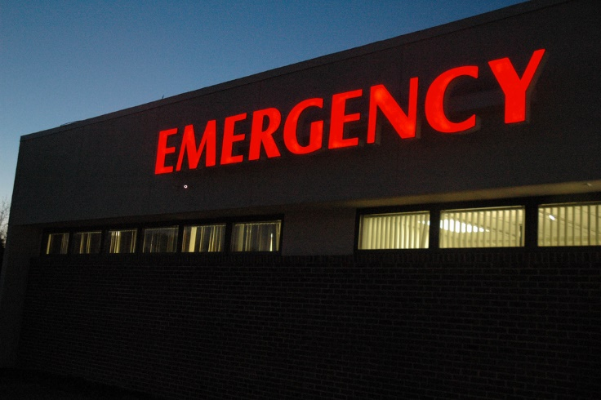
What is the Issue?
Increasing numbers of pediatric patients seek emergency care each year in general EDs
Most children arrive at the ED via personal vehicle
Parents do not know which hospitals are prepared to take care of children and in most cases will not pass an EMERGENCY sign with a sick or injured child
Children are NOT on a hospital’s RADAR screen on a day-to-day basis
With no one minding the store, readiness wanes…
Pediatric facility recognition can ensure pediatric readiness

Slide 8
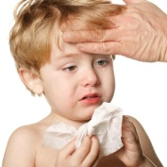
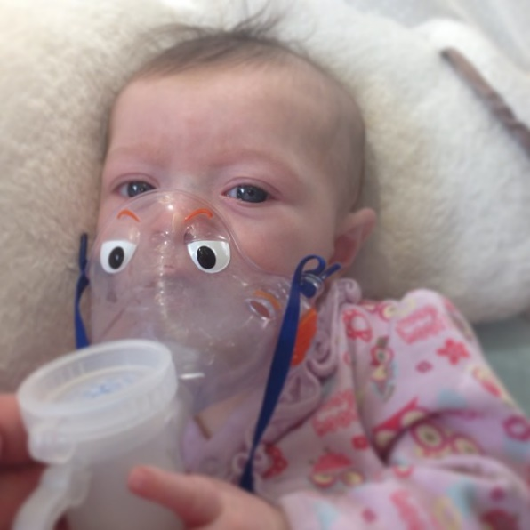
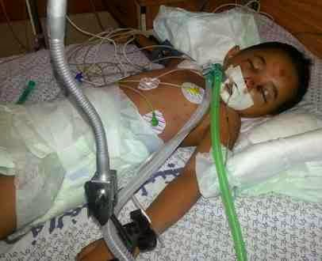
There is an Experience Gap!
Children make 31 million ED visits per year
83-87% of children are cared for in general hospital EDs
50% of EDs see <15 children per day
Relatively few pediatric visits each day – even less critically ill or injured (Less than 5% require tertiary care)
Children account for 5 to 10% of all EMS patients
<1% are critically ill/injured
Limited experience for paramedics with sick children

Slide 9
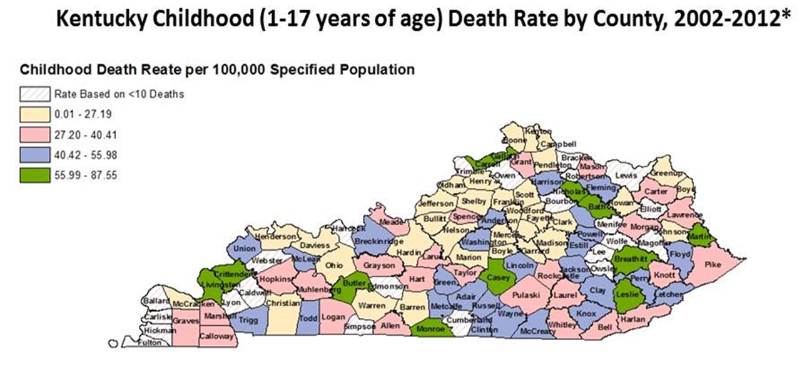
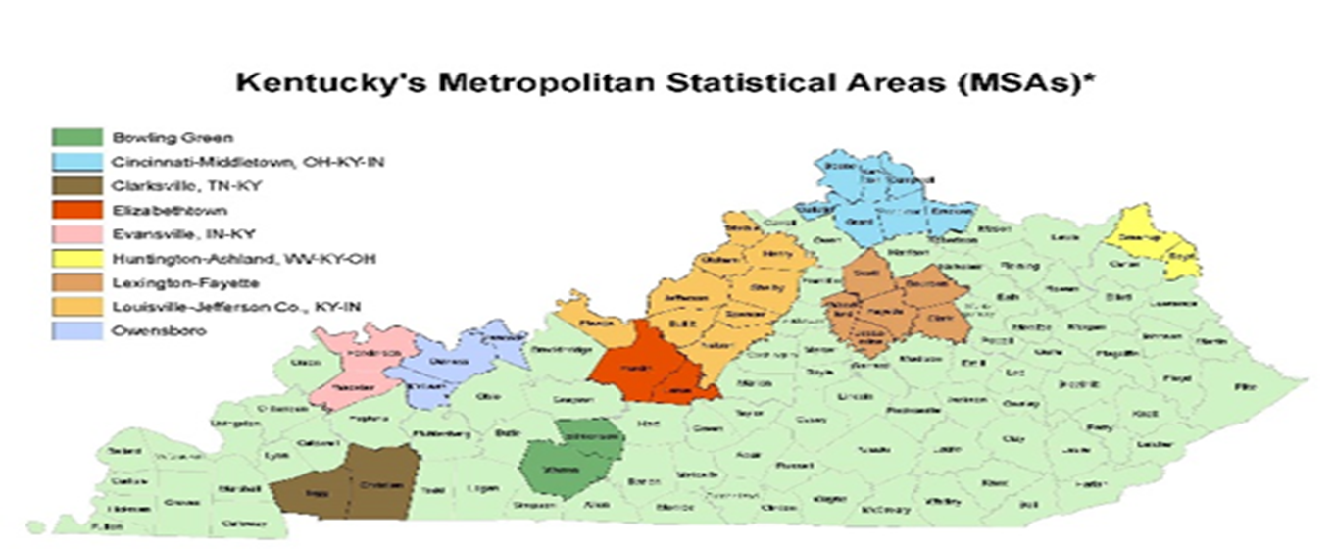
Childhood Death Rate Higher in Rural Areas

Slide 10
Add Florida data maps (mortality rate)

Slide 11
2009 Joint Policy Statement – Guidelines for Care
of Children in the Emergency Department
Guidelines for the Administration and Coordination
of the ED for the Care of Children
Physicians, Nurses, and Other Health Care Providers Who Staff the ED
Guidelines for QI/PI in the ED
Guidelines for Improving Pediatric Safety in the ED
Guidelines for Policies, Procedures, and Protocols for the ED
Guidelines for ED Support Services
Guidelines for Equipment, Supplies, and Medications for the Care of Pediatric Patients in the ED
App 1: Clinical and Professional Competency
App 2: Guidelines for Equipment and Supplies for
Use in Pediatric Patients in the ED
Pediatrics and Annals of Emergency Medicine, Oct 2009
AAP – COPEM
ACEP – Pediatric Committee
ENA – Pediatric Committee
Endorsed by 22 national organizations, including The Joint Commission

Slide 12
2013 National Pediatric Readiness Project
A multi-phase quality improvement initiative to ensure that all U.S. emergency departments (ED) have the essential guidelines and resources in place to provide effective emergency care to children.
Partnership
federal EMSC
AAP
ACEP
ENA
Supported
Joint Commission
HCA
total of 22 other organizations.
National Response Rate – 82.7% (4150 out of 5017 hospitals)

Slide 13
Improvement is Happening

Slide 14
KY and the NPRP (Your Data here)
Kentucky’s Response Rate – 98.1% (103 out of 105 hospitals)

Slide 15
KY and the NPRP (Your data here)

Slide 16
Trauma Designation
Calculated in 2013/2014
L1 Peds, L1 Adult, L3, L4, No Trauma Designation
Comparatively small number of trauma centers, but similar results were found at the national level
Only 1 hospital designated L2, not shown
2016
Include newly designated hospitals
Using their 2013 NPRP score
L3 increased by 1 percentage point
L4 increased by 2.5 percentage points
The difference between the L4 facilities and non-designated facilities has narrowed

Slide 17
Pediatric Coordinators
2003 EMSC survey data
Care Coordinators → more
“ready”
Single role not necessary
Role Responsibilities documents in Readiness Toolkit
2013 Adjusted Scoring demonstrates better readiness scores associated with presence of coordinators when “extra” points deducted

Slide 18
Disaster Plans
Does your hospital disaster plan address issues specific to the care of children?
“Yes” 50 out of 103 hospitals
53 hospitals answered “No”
http://emscnrc.org/pedprepared/

Slide 19
QI/PI Process Includes Children
Does your ED have a pediatric patient care-review process? (separate or integrated into the overall plan)
Yes - only 33 out of 103 hospitals
No = 70 hospitals

Slide 20
Safety – weight in kg only
Are all children seen in the ED weighed in kilograms only? ^{without conversion from pounds}
YES = 65 / NO = 38
Of the 65 that said “yes”
Is the weight recorded in the ED medical record in “kgs” only?
YES = 44 / NO = 21
Of the 27 hospitals that do not weight in kgs only …
20 weigh in pounds and covert to kgs for recoding in the medical record
18 weigh in either pounds or kgs with an option to record in either

Slide 21
Add a “patient experience” story
Select a state-specific story
Be sure to align story with importance of pediatric readiness

Slide 22
Court Rules on Standard of Care for Pediatric Patients in “General” EDs
http://www.ahcmedia.com/articles/135698-court-rules-on-standard-of-care-for-pediatric-patients-in-general-eds retrieved on 8-20-2015
Infant died of complications of enterovirus infection after being discharged from an ED
Plaintiff argued a general EP was not qualified to staff a pediatric ED
“Amicus brief filed by ACEP on behalf of the defendant, stating that general EPs are well-qualified to treat children in EDs and summarizing numerous programs and initiatives to assure the competency of general EPs in handling pediatric emergencies.”
Case resulted in a verdict for the defense.
“The standard of care does not require the EP to be an expert in pediatric care, such as fellowship-trained pediatric EPs, but rather a competent EP who is prepared to treat pediatric emergencies.”

Slide 23
Court Rules on Standard of Care for Pediatric Patients in “General” EDs
Other points shared in the article
The standard of care does not require the EP to be an expert in pediatric care, such as fellowship-trained pediatric EPs, but rather a competent EP who is prepared to treat pediatric emergencies.
For many EDs, the focus in on adults, and pediatric care is almost on a second tier. It’s not a priority.
If a bad outcome in a pediatric patient results in a lawsuit against the EP, the EP’s defense can be strengthened with evidence of the ED’s commitment to pediatric patients.
One way to demonstrate this is to show compliance with [the guidelines]
American Academy of Pediatrics; Committee on Pediatric Emergency Medicine; American College of Emergency Physicians; Pediatric Committee; Emergency Nurses Association Pediatric Committee. Joint policy statement — guidelines for care of children in the emergency department. Pediatrics 2009; 124:1233-1243.
“…‘We are not supposed to get pediatric emergencies’ is a very weak defense.”

Slide 24
Important Points
There are gaps in pediatric readiness across the United States
There are centers of excellence and others where opportunities to improve exist
You don’t need to be a children’s hospital to be pediatric ready and provide high quality of care
Legal liability issues
Participating in a facility recognition program improves readiness
Notes:
Themes – Critical Points:
Audience: C-Suite
Content: Quality, value, cost
Audience: Trauma
Content: Existing data (lack of PR in trauma facilities)
Audience: Provider
Content: Resources to stabilize and/or transfer pedi patients
Audience: Parents
Content: Where Resources Are | Action Plans for Families

Slide 25
State Median Scores

Slide 26
Hospital Scores
The 95% confidence interval
(20.21, 22.82) does not contain 0 which indicates that the difference of median scores is statistically significant.
N=371
N=3775

Slide 27
Add State data from nedarc

Slide 29
Source: Arizona Vital Statistics
Health and Wellness for all Arizonans

Slide 30
Comparing Pediatric Inpatient Injury-related Mortality Rates among Certified and Non-Certified Hospitals, 2009-2014
18
16
Rate per 1,000 Hospitalizations
14
17.5
12
10
10.2
11.8
10.8
8
8.5
6
7.9
4
2
0
2009-2011
2012-2014
All Hospitals
Certified Hospitals
Non-Certified Hospitals
While the overall pediatric injury mortality rate increased from 2009-2011 to 2012-2014 the non-certified hospitals had a much higher mortality rate than the certified hospitals.
Health and Wellness for all Arizonans

Slide 31
Pediatric Readiness is a “Hot Topic”
Hospital Preparedness Program
Draft PM7: Percent of hospitals with an ED recognized through a statewide, territorial, or regional standardized system that are able to stabilize and/or manage pediatric medical emergencies
Alignment with Capability 1 – Foundation for Health Care and Medical Readiness and Capability 4 – Medical Surge
Anticipated Joint Commission requirements to include pediatric specific elements

Slide 32
The Portal is Re-opening!

Slide 33
Resources to help your ED become Peds Ready:
www.pediatricreadiness.org

Slide 34
New link to peds readiness website
Resources/tools available

Slide 35
A Final Thought…
Children don’t decide their circumstances or where they live. They cannot influence how the emergency medical system works or the quality of care available to them…but WE can!

Slide 36
Integrating QI into practice (performance measures Alessandrini (i.e., weight in kg) | ED specific QI collaboratives (i.e., Children’s Hospital Association IPSO “sepsis”)
Minimum criteria (from intervention workgroup)
Slide 20
Action Item: Reach out to Cynthiana Lightfoot for example
Action Item: EIIC (gather family stories from our community | aggregate as a resource for FRC website) Parent to Parent & “Diana” Voices + FAN reps (cases when ED was not prepared)
Slide 10
Approval from Florida – share data maps (deaths)
Add new PR site info

