Slide 1
Fireside Chat: Abnormal Vital Signs
Subject Matter Experts:
Madeline Joseph, MD
Sally Snow, RN
September 10, 2019
S FACEP, FAEMS

Slide 2
ACKNOWLEDGEMENTS
The HRSA, MCHB EIIC is supported in part by the Health Resources and Services Administration (HRSA) of the U.S. Department of Health and Human Services (HHS) under grant number U07MC29829. This information or content and conclusions are those of the author and should not be construed as the official position or policy of, nor should any endorsements be inferred by HRSA, HHS or the U.S. Government.

Slide 3
ACKNOWLEDGEMENTS
This continuing nursing education activity, live session only, was approved by the Emergency Nurses Association, an accredited provider by the American Nurses Credentialing Center’s Commission on Accreditation, for 1 contact hour.

Slide 4
Announcement
Please mute your phone or computer
All lines will be open and interactive. We ask that you utilize your mute features when not speaking.
This call is being recorded. If you have any objections, you may disconnect at this time.

Slide 5
ACKNOWLEDGEMENTS & DISCLOSURES
This continuing nursing education activity was approved by the Emergency Nurses Association, an accredited approver by the American Nurses Credentialing Center’s Commission on Accreditation for 1.0 contact hours.
Note Faculty/Speakers and Planners for this learning session have no conflicts of interest. Additionally, no commercial support has been received for this activity.
Should participants detect any bias in this presentation please note such on the evaluation or reach out to Diana Fendya, nurse planner for continuing education.

Slide 6
TO OBTAIN NURSING CEs
Sign into the webinar: name, email address and name of your facility.
At the completion of the presentation a link will be provided which will take you to a short evaluation form which you will need to complete.
The evaluation must be completed within 2 weeks:
https://tch-redcap.texaschildrens.org/REDCap/surveys/?s=C3CHENDRY8
Within 48 hours of receiving your evaluation, your certificate will be sent to you electronically.

Slide 7
AGENDA
Aggregate Performance
Process Mapping: Identification of AVS
Team Check-in
Housekeeping

Slide 8
Roll Call
The Last Frontier Kids
LifesavERs
MOKAN ROCKS
The Longhorn Kids
-Subject Matter Experts
- Advisory Committee
- NEDARC
- EIIC
- HRSA
North Texas Division HCA
Fight or Flight Response Team
New England EMSC
Eight is Enough
ReTEE FORE Kids
Pit Crew
Remoc Minions
WISPR
WranglER for Kids
Oregon Pediatric Readiness Program
ETCH
Pediatric Peaches

Slide 9
AGGREGATE PERFORMANCE

Slide 11
Focus on AVS…

Slide 12
Reminder of Our Goal…
Aim Statement
By December 2019, 100% of pediatric patients with abnormal vital signs will be identified by health care providers in the ED.

Slide 13
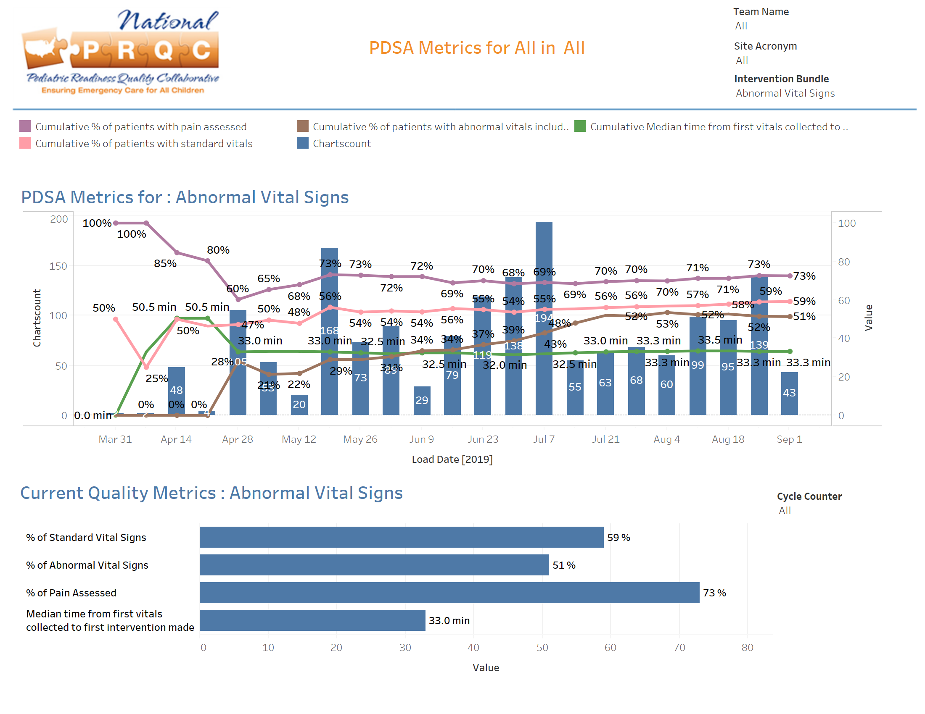

Slide 14
TEAM CHECK-IN

Slide 15
PARTICIPATION: AVS
Team 5: Lone Star Kids
Team 1: The Last Frontier Kids
Cogdell Memorial Hospital
Medical City Dallas
Medical City Denton
Medical City Flower Mound
Medical City Fort Worth
Medical City Las Colinas
Medical City Lewisville
Medical City North Hills
Providence Alaska Medical Center
Providence Seward Medical Center
Questions
What are your enablers?
What is your biggest challenge?
Which vital signs tend to be taken/missed in your triage area?
What is your AVS notification procedure?
How do you document AVS in the chart?
Team 2: LifesavERs
Anderson Hospital
Heartland Regional Medical Ctr
DePaul Hospital
St. Joseph Hospital-Lake St. Louis
Team 6: Fight or Flight Response Team
Clear Lake Medical Center
Lodi Memorial
Enloe Medical Center
Fairchild Medical Center
Team 3: MOKAN Rocks
McPherson Hospital
Norton County Hospital
Ransom Memorial Hospital
Shawnee Mission Medical Ctr
Smith County Memorial Hospital
Via Christi Hospital, Pittsburg
Team 7: New England EMSC
Greenwich Hospital
Hospital of Central Connecticut
Springfield Hospital
Yale New Haven Westerly Hospital
Team 4 : Longhorn Kids
Team 8: Eight is Enough

Slide 16
PARTICIPATION: AVS
Team 9: ReTEE for Kids
Team 13: WranglER for Kids
Questions
What are your enablers?
What is your biggest challenge?
Which vital signs tend to be taken/missed in your triage area?
What is your AVS notification procedure?
How do you document AVS in the chart?
Team 10: Pediatric Pit Crew
Team 14: Oregon Pediatric Readiness
Witham Health
Adventist Medical Center Portland
Blue Mountain Hospital District
CHI Mercy Health
PeaceHealth Southwest Medical Center
Tuality Healthcare
Team 11: Remoc Minions
Advocate Good Shepherd Hospital
Saint Elizabeth Medical Center
Team 12 : WISPR
Team 15: ETCH
Ascension Franklin
Aurora Sheboygan Memorial Med Ctr
Crossing Rivers Health
Mile Bluff Medical Center
Sauk Prairie Hospital
Southwest Health
UnityPoint Health Meriter
East Tennessee Children’s Hospital
Team 16: Pediatric Peaches

Slide 17
Process Mapping:
Identification of Abnormal Vital Signs

Slide 18
Vital Signs
Normal Vital Signs
“Standard set of vital signs” is synonymous with the collection of temp, HR, RR, pulse ox, BP, pain, and mental status (when indicated).
“Standard for vital signs” refers to a vital sign’s normal range based on age or weight
AVS-Managed by Policy
Policy allows nurses to give Motrin/Tylenol for fever.
Repeat elevated HR or BP if patient is crying after distraction, pain control or treating fever.
AVS-Requiring Notification
Unstable patient/Resuscitation
“Sick Patient: compensated shock, mod-severe respiratory, persistent AVS despite intervention

Slide 19
Change Strategies-Documentation of AVS
Develop a written procedure/guideline that provides instructions on how to measure and document vital signs for pediatric patients to include:
Recommended methods of measurement for specific age groups (e.g., temp);
Vital sign norms for pediatric patients (i.e., PALS; Harriet Lane);
Site-specific thresholds for abnormal vital signs;
Preferred timeframes for initial assessment, frequency of reassessment and follow-up of patient procedures. Reassessments should occur at regular intervals to evaluate the patient’s response to treatment, when significant changes in condition/status occur; and/or when a significant change in diagnosis occurs;
Recommendations for Notification based on abnormal vital signs:
Standards for documenting vital signs in the patient’s medical record;
The process for documenting the escalation of care should be noted in guideline.
Consider adopting standing orders that can be used by nurses (e.g., comfort measures; medications).

Slide 20
NOTIFICATION STRATEGIES
ED leadership and the care team must decide the threshold for vital signs that warrant escalation of care. Consider adopting a validated triage tool for certain conditions. Example: Sepsis Protocol
Define the communication process for notifying the care team of an AVS
Verbal communication (Direct relay of information between nurse and physician)
Color coding system in patients’ chart
Electronic alert to providers
A special designation on the ER tracking board
Develop a recommended course of action when vital signs are out of range (e.g., initiate evidence based guidelines, pathways, or protocols

Slide 21
EMR OPTIMIZATION to Improve Notification of AVS
Implement alerts within EMR platform that will notify members of care team when a particular vital sign is out of range. Be aware of alarm fatigue!
Integrate a clinical decision support tool that evaluates a combination of factors (e.g., AAP’s Pediatric Septic Shock Collaborative Triage Identification Tool)
Implement standing physician orders

Slide 22
HOUSEKEEPING

Slide 23
Housekeeping
Fireside Chats
September 17: Inter-Facility Transfer
1:00 CDT
September 24: Weight in Kilograms
2:00 CDT
Learning Sessions
October 1
November 19
December 3rd
Notes:
**rearrange these chronologically
*mention newsletter is coming out end of Sept. We’ve been busy!

Slide 24
CNE Credit
CNE Link: https://tch-redcap.texaschildrens.org/REDCap/surveys/?s=C3CHENDRY8
Google: EMSC PRQC (Password also)
Email: qeca@texaschildrens.org | dcc_prqcsupport@hsc.utah.edu

