Slide 1
Family Reunification Review & Practice

Slide 2
Code Triage Levels 1-4
Level 1- An actual or potential event requiring an increased state of readiness.
Level 2- Event is impacting normal services and operations
Level 3- No longer able to provide reasonable and customary care and services
Level 4- Hospital is no longer able to provide services.
FRC Response-
Level 1- Assess department’s current status and be on alert for possible activation of the FRC.
Level 2- High likelihood of activation of Small Scale or Large Scale FRC response. Staff should respond according to FRC plan if activation of FRC occurs.
Levels 3 & 4- If FRC is activated, staff should respond accordingly.

Slide 3
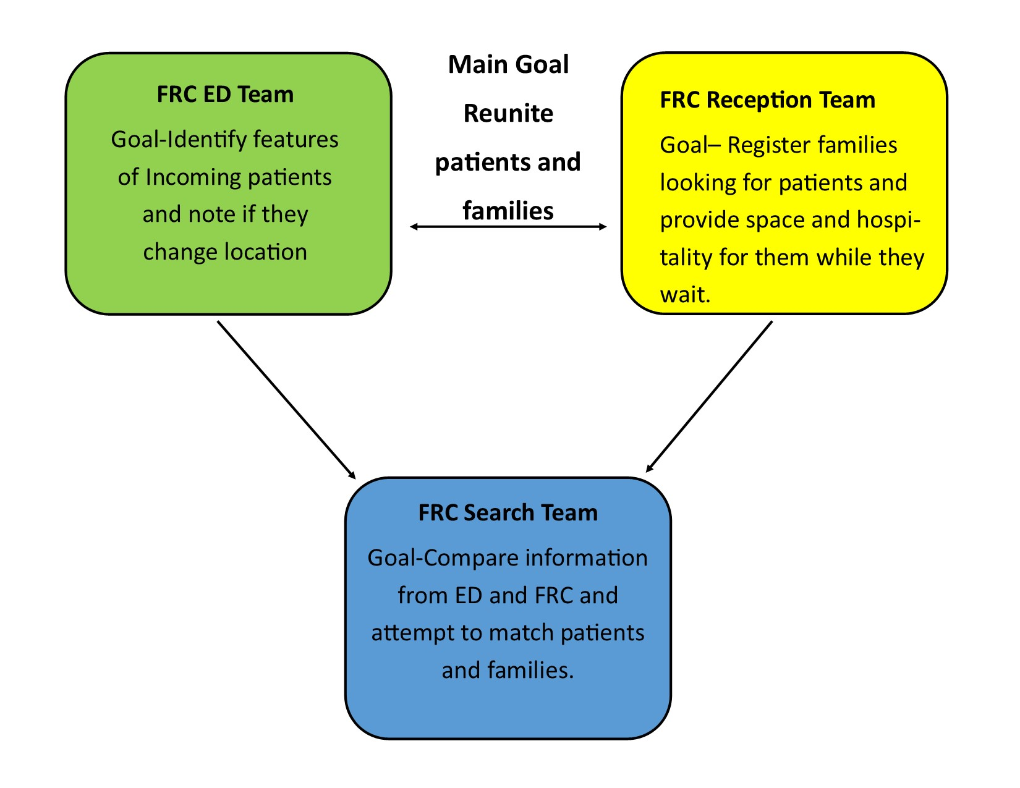
FRC Basic Concept

Slide 4
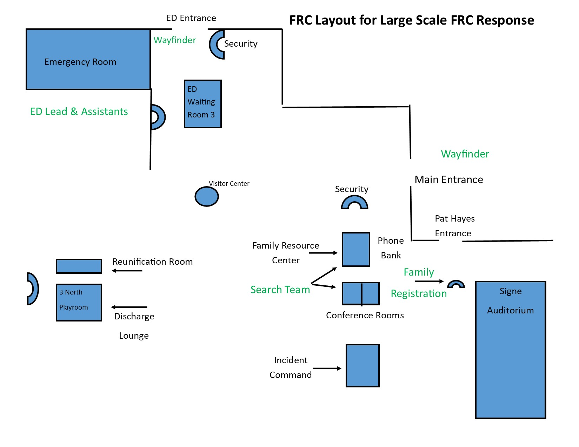

Slide 5
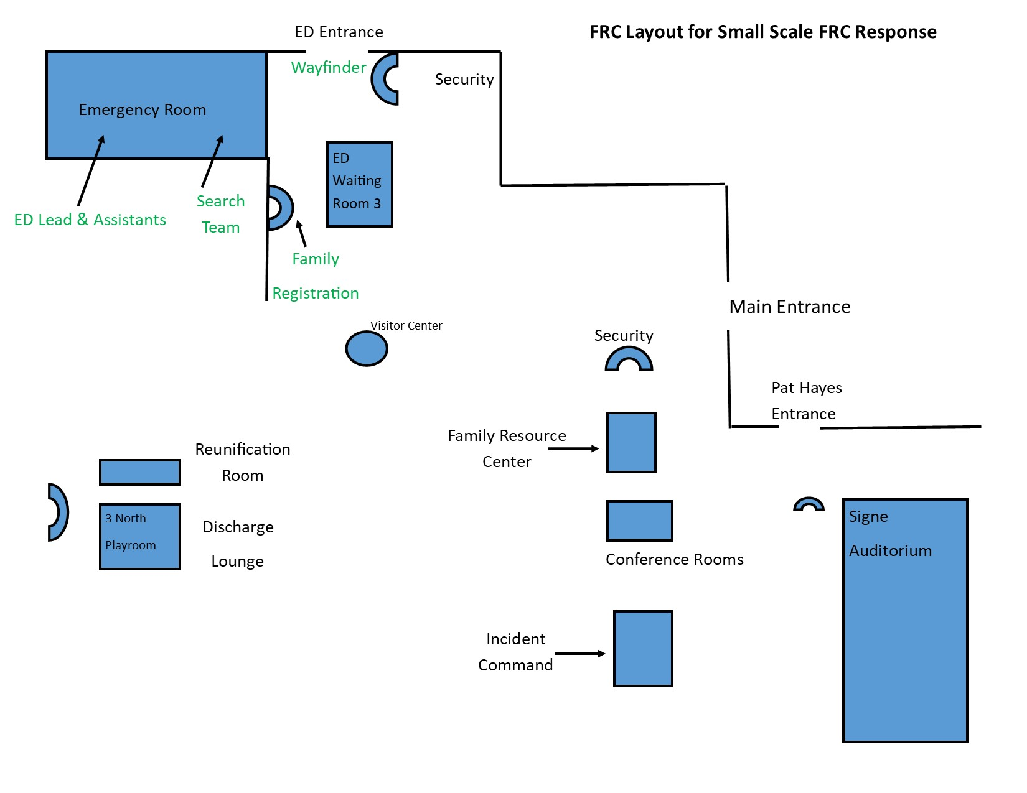

Slide 6
DCMC Family Reunification Basics
By definition the Family Reunification Center is a pre-planned process to receive family members in search of person(s) who they believe has been brought to your hospital during a large scale traumatic or catastrophic event. (Code Triage)
After the code triage has been announced the Incident Command Center (ICC) will assess whether or not to activate the Family Reunification Center (FRC).
Having persons designated to provide leadership for the FRC and staff to provide additional support is paramount to the success of the FRC. DCMC primarily utilizes Chaplain Services, Child Life, Case Management, Patient Representatives and Volunteer Services to staff the FRC. Other staff can be allocated by the ICC as needed.

Slide 7
How the process should work:
Set up FRC, assign roles and notify ICC that FRC is ready for operation. FRC rolling file box will be moved to FRC main location by Patient Access. FRC will begin setting up rooms and assigning roles. Search Team will identify location to set up and begin collecting information when available.
ED FRC staff complete forms for each patient with identifying features and Tiger Text to Search Team.
Families are directed to the FRC entrance by Wayfinders/Greeters located outside of ED entrance and DCMC Main entrance. FRC registration staff will assist families with completion of a registration form. If possible staff will tiger text a photo of child to the Search Team.
Upon completion of forms, families are directed to the Check In table to register and receive a green armband. (Family member should write their name on the armband.)
Family member is directed to the gathering room. (Refreshments are available) Room monitors will ensure supplies are adequate.

Slide 8
6. Completed forms from ED and FRC are sent to the Data Search Team who will attempt to locate the patient in Compass and communicating with hospital staff. (ED Forms may be initially sent by Tiger text, but also may need to be photocopied and run to the Search Team.)
Runners will work with the registrars to take forms from FRC and ED to the Search Team and run other errands as needed.
After confirmation of patient/family match, a Wayfinder will escort the family to reunite them with the patient. In the case of a deceased patient, Wayfinders will coordinate with a chaplain to arrange the plan to inform family and then facilitate viewing if appropriate.
If patients cannot be located, families should be updated of the status and the data search team will continue to search for the patient at other hospitals if necessary.

Slide 9
Positions of Responsibility in the Family Reunification Center, DCMC
FRC Operations Chief
FRC ED Lead
FRC ED Assistants
Search Team
Registrars
Check-in Desk
Room monitors
Runners
Wayfinders
Phone Bank Team
Chaplain
Patient representative
Discharge Lounge RN

Slide 10
Estimate of Staff needed for each Role
FRC Operations Chief-1 (Patient Reps/Chaplain Site Coordinator/CL Manager)
FRC ED Lead-1 (Child Life)
FRC ED Assistants-5 (Child Life or Labor Pool)
Search Team-2 (Ideally one CL and one from Pt Access)
Registrars-3 to 5 (One to two Spanish Speaking if possible)
Check-in Desk-1to 2 (One Spanish Speaking if possible)
Room Monitors-2
Runners-2
Wayfinders-4 (1 Wayfinder/Greeter at ED entrance & 1 Wayfinder/Greeter at Main Entrance) 2 Additional Wayfinders to unite families and patients
Phone Bank Team-1
Chaplain-3
Patient representative-2
Discharge Lounge- 1 RN and 2-3 Room Monitors
Wayfinders, Registrars, Monitors, Runners, Phone Bank roles can all filled with staff from various departments such as Foundation, Chaplain Services, Patient Representatives, Child Life, CARE Team support staff and Volunteer Services.

Slide 11
Table Top Practice
Scenario- Code Triage Level 1: “Possibly 10-15 patients arriving with injuries from a gas line explosion near a middle school in Austin”
What actions are done first?
Who is going where?
Code Triage Level 2: “22 patients will be arriving from gas line explosion- 3 CAT I’s and 6 CAT II’s, 13 other additional”. ETA 10 minutes”
What actions are done first?
Who is going where?
Who are the leads for ED/FRC & Search Team?
What role are you assuming?

