Slide 1
Pediatric Reunification: Module 2
Hospital Family Reunification Center, Pediatric Safe Area
Family Reunification Site
By. Dr. Roxanna Lefort

Slide 2
INTRODUCTION

Slide 3
With this module, we hope you
Obtain a clear understanding of each of those 3 reunification entities:
Start considering how to plan or coordinate planning with other organizations for each of these areas in your own setting
Hospital Family Reunification Center
Pediatric Safe Area
Family Reunification Site
Who should be involved?
Where should this be located?
What items are needed in each of these?
How can we identify and track patients and families in these sites to assist smooth reunification?

Slide 4
Setting the Scene
Consider the fact that many children are away from their parents for most of the day
Risk of disaster when parents/children are separated is high
With social media and current rapid spread of information, parents may find out about an incident through a variety of ways
True and false information is likely mixed
Parents want… need accurate information and to be REUNITED with their child as quickly as possible

Slide 5
PLANNING: THREE PRIMARY SITES

Slide 6
SITE 1: Hospital Family Reunification Center (HFRC)
Why:
If children involved in the disaster are brought to your hospital, there will be a surge of concerned family members, guardians, and friends that will crowd and may overwhelm your lobby or entryway
Location:
A hospital family reunification center (HFRC) should be a private and secure place to direct families presenting to the hospital, looking for information

Slide 7
SITE 2: Pediatric Safe Area (PSA)
Why:
In a pediatric disaster event, consider the children that may be medically treated and discharged but have no guardian present
Location:
The Pediatric Safe Area is a supervised and secured space where children can play or wait safely until reunited with their families

Slide 8
SITE 3: Family Reunification Site (FRS)
Why:
Once the child and appropriate family are identified, they should be brought to a separate location for reunification, away from others still awaiting reunification or further information
Location:
The Family Reunification Site is a location separate from the PSA and the HFRC to safely allow for the emotional reunifications to occur away from the noise and distractions of other areas

Slide 9
HOSPITAL FAMILY REUNIFICATION CENTER (HFRC)

Slide 10
Hospital Family Reunification Center (HFRC)
Do not underestimate the number of calls that will come in or the number of people that will show up looking for family members or information after a disaster
With appropriate planning that includes an HFRC at a separate location, you can avoid overwhelming hospital lobbies and waiting rooms, and create a more controlled and supportive environment during a highly emotional time

Slide 11
Hospital Family Reunification Center (HFRC)
Purpose:
Provide a private and secure area for people to gather while waiting for information about their children or other family members involved in the incident
Support the psychosocial needs of these families
Identify/track family members to facilitate accurate information sharing among different parts of the hospital and among other hospitals/response agencies

Slide 12
Hospital Family Reunification Center (HFRC)
Location:
Consider a location away from the Emergency Dept, media gathering area, and the other two reunification sites discussed here
Easy access to restrooms, food, and water
Consider the ability to communicate in this space, calling out names or finding where people are seated
This should be a secure area, preventing unwanted media exposure of families
Consider accessibility needs

Slide 13
Hospital Family Reunification Center (HFRC)
Staff/Supplies:
Personnel to consider: Chaplains, Security, Social Workers, Interpreters
Clearly marked instructions/signage to reach the location – Families may be hesitant to leave the clinical area without information
Sign-in and Sign-out documentation supplies with clear contact info
Tables and chairs
Phone chargers, computers, forms (either digital or paper) to submit identifying information
Nutritional Services (water, food, bathrooms)

Slide 14
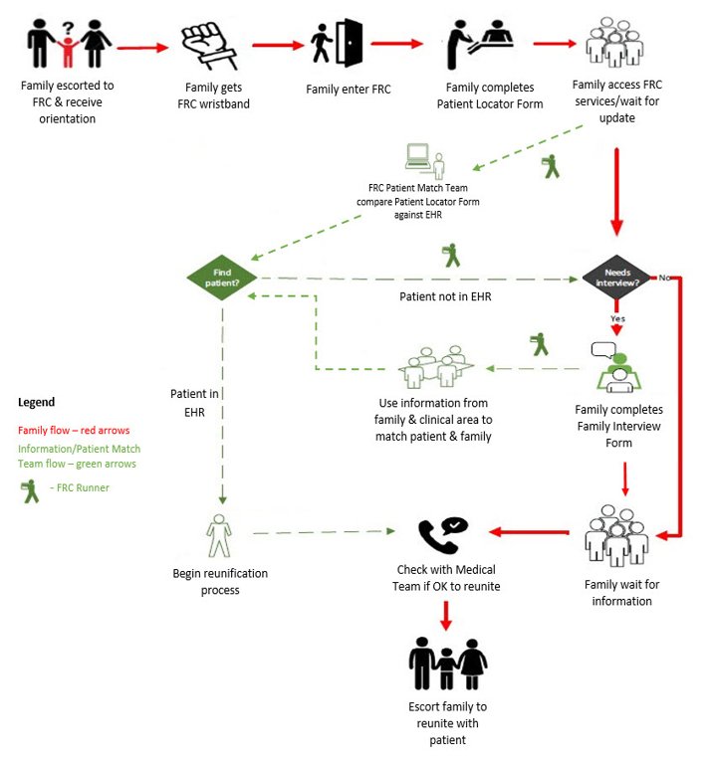
* Diagram from Texas Children’s Hospital Family Reunification Center Plan

Slide 15
Any Questions?
30 seconds - 1 min to answer quick questions on Hospital Family Reunification Center (HFRC)

Slide 16
PEDIATRIC SAFE AREA (PSA)

Slide 17
Pediatric Safe Area (PSA)
Children injured in a disaster, medically treated, and safe for discharge should not stay in the Emergency Department (ED)
In planning for a PSA, consider the high amount of stress these children will be under and their limited ability to process information under these circumstances

Slide 18
Pediatric Safe Area (PSA)
Purpose:
By moving discharged children out of the ED, this clears space/resources for incoming sick/injured children and prevents the child from witnessing further traumatizing events.
The PSA removes the child from the clinical area but keeps them safe until reunification with family
The space allows for monitoring of (additional problematic signs or symptoms of children and their well being) further physical symptoms or emotional support by appropriate clinical staff

Slide 19
Pediatric Safe Area (PSA)
Location:
Away from the Emergency Department, media staging area, and other reunification sites
Security is critical to identify and track anyone entering and exiting the area
Consider safety of the area with young exploring children
Bathroom access, diaper changing areas, and food/water access
Quiet spaces – nap/ behavioral health (if able too)

Slide 20
Pediatric Safe Area (PSA)
Staff/Supplies:
Child life specialists or other available staff to assist with the care and monitoring of the children and documentation/communication efforts
If childcare centers or are part of your healthcare center, consider leveraging those resources
If your center does not have a child life specialist, consider linking out to other hospitals for this need
Security
Games, toys, movies, diapers, snacks/drinks (consider allergies), cribs if age appropriate

Slide 21
Any Questions?
30 seconds - 1 min to answer quick questions on Pediatric Safe Area (PSA)

Slide 22
FAMILY REUNIFICATION SITE (FRS)

Slide 23
Family Reunification Site (FRS)
Purpose:
To safely reunify medically cleared children and their families so they can depart the hospital and begin their healing process
To help decompress the crowds by clearing the other reunification areas and clinical areas, which will assist identification and tracking efforts

Slide 24
Family Reunification Site (FRS)
Location:
Separate from the other reunification areas
Secure and away from the noise and chaos of the event if possible
Near a hospital exit, ideally avoiding media

Slide 25
Family Reunification Site (FRS)
Once a medically cleared child and their guardian is identified, the reunification should occur in a separate safe location, away from clinical areas and away from other families or children awaiting reunification
Planning should consider pathways to moving patients or families between these areas so that reunification occurs as quickly as possible and allows for safe departure from the hospital

Slide 26
Family Reunification Site (FRS)
For children not medically cleared, reunification should occur with primary guardians at the bedside also as quickly as possible to support both patient and guardian
Death notifications (discussed further in other modules) should also occur in a separate location

Slide 27
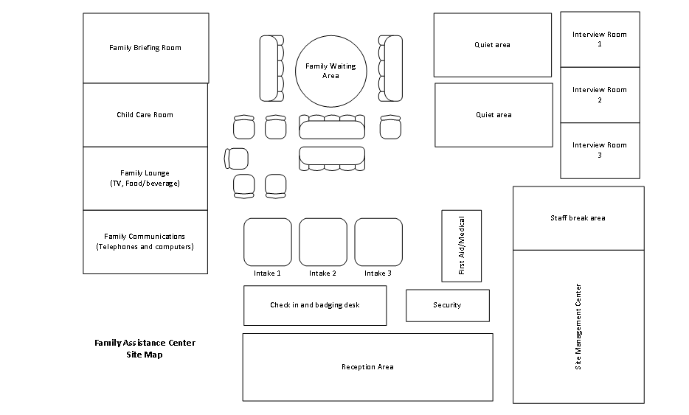
Family Reunification Site (FRS)
Staff/Supplies:
Security or other personnel able to check identity and document the successful reunification, departure, contact info
Medical personnel able to discuss any discharge instructions given at time of medical clearance

Slide 28
References
This AAP resource has sample layouts for the above sites, planning checklists, and several other useful tools for reunification planning:
https://downloads.aap.org/AAP/PDF/AAP%20Reunification%20Toolkit.pdf
Texas Children’s Hospital Family Reception Center Plan
https://media.emscimprovement.center/documents/TCH_FRC_Plan_-_1.24.2019_Approved.pdf

Slide 29
Any Questions?
30 seconds - 1 min to answer quick questions on
Family Reunification Site (FRS)
OR
The rest of the presentation

Slide 30
What to look forward too
Module 3: Security Concerns
Module 4: Plan Activation
Module 5: Recovery

Slide 31
MOC Part 4 Credit
MOC Part 4 Credit: 25 Points
Attend of Asynchronously watch Module Education Series
Complete Post - Reunification Survey
Submit Draft updated reunification plan OR a list of planned reunification plan changes

Slide 32
Acknowledgements & Disclosures
Funding Source:
This publication was made possible by Award Number (U3REP190615-10-10) from the Office of the Assistant Secretary for Preparedness and Response (ASPR). Its contents are solely the responsibility of the authors and do not necessarily represent the official views of ASPR or the Department of Health and Human Services.
Disclaimer:
The content presented here and throughout the collaborative is that of the authors and do not necessarily represent the official views of, nor an endorsement by, ASPR, HRSA, HHS, or the U.S. Government.

Slide 33
ASPR: Region V For Kids Social Media
Email: regionvforkids@gmail.com
LinkedIn: www.linkedin.com/company/region-v- for-kids-coe/
Twitter: @RegionVforKids
Website: QR Code to Website

Slide 34
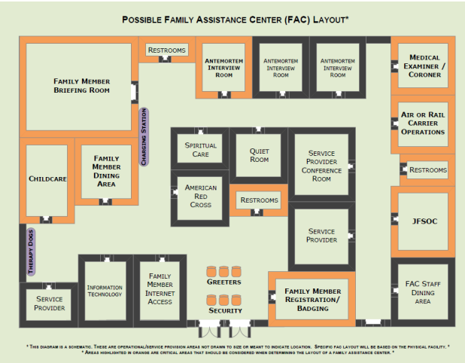
*Main Behavioral Health Family Reunification Plan
https://www.maine.gov/dhhs/mecdc/public-health-systems/phep/documents/mainecdcallhazfru.pdf

