Slide 1
Pediatric Reunification: Module 1
Essential Elements of a Hospital Family Reunification Plan – Registration, Intake, Tracking and Definitive Identification
Maureen Luetje, DO
Notes:
Paper charting system always needs to be easily accessible, in cases of electronic failure or if ease of paper charting allows for safer and faster processing of patients into the healthcare system
If an EMR system is used, there needs to be regular just in time training and review of the system, to ensure all probable staff members can successfully use it during an event
While using electronic medical records is useful for ensuring tracking of patients throughout the course of their stay, a paper registration form should be easy to obtain, in cases of electricity failure, EMR overload, or inability to quickly register and input information in to EMR system.

Slide 2
Family Reunification:
Registration, Intake, Tracking and Definitive Identification
Family reunification is an important piece of disaster medicine and is essential for pediatric preparedness. Yet it is often an after-thought in the planning process.
In order to lead a successful disaster implementation and coordinated family reunification, there needs to be forethought of supplies, strategy and space prior to an event happening.
This module will go through the pre-work necessary for reunification efforts, as well as a process of implementation during the event
This module is the first of 5 modules offered through R54K and PPN collaborative on successful family reunification for a pediatric disaster.

Slide 3
ESSENTIAL ELEMENTS
REGISTRATION
INTAKE
TRACKING
DEFINITIVE IDENTIFICATION
-EMR system
-Paper charting
-Single entrance for registration needs
-Descriptors
-Intake Templates
-Photographs
-Wristbands
-Ambassadors
-Charting
-Hospital Policies
-Transition of Care

Slide 4
REGISTRATION
Electronic medical records (EMR) are useful for ensuring tracking of patients throughout the course of a hospital stay, but a large-scale disaster can cause electricity failure, loss of internet or an EMR overload and this may lead to complete loss of electronic medical systems.
EMR systems require regular training of disaster models and review of the system, to ensure that participating staff members can successfully use it during an event:
Disaster mode nuances
Turnover of staffing
Hospital systems have back-up paper charting available, but having a disaster-specific bin with easy to fill in paper registration can be used in times of high stress on the hospital system. These forms can follow the patient to ensure there is flow of information, when the normal processes have been disrupted.
Notes:
Paper charting system always needs to be easily accessible, in cases of electronic failure or if ease of paper charting allows for safer and faster processing of patients into the healthcare system
If an EMR system is used, there needs to be regular just in time training and review of the system, to ensure all probable staff members can successfully use it during an event
While using electronic medical records is useful for ensuring tracking of patients throughout the course of their stay, a paper registration form should be easy to obtain, in cases of electricity failure, EMR overload, or inability to quickly register and input information in to EMR system.

Slide 5
CONTACT POINT
Registration needs to occur from the moment of arrival into the system.
* Registration personnel at every point of entry in order to capture all patients
* Consider filtering all patients into one entry point to ensure organization and capturing of each person arriving
Any identifying information should be obtained at the start of this registration process (clothes worn, accompanied by whom or what EMS service, location found…).
Some patients may be assigned a disaster pseudonym, but any naming identification obtained during the registration process should be linked to the chart

Slide 6
INTAKE
The use of an instant print camera or easy photo technology within the EMR system provides an important layer of identification and is strongly recommended to help with the organization and ability to identify patients
Notes:
The purchase of an instant print camera or photo technology in the EMR system will provide an important layer of identification and should be used if at all possible.

Slide 7
INTAKE INFORMATION
Intake forms are a useful way to gather descriptive information about a person. This information can then be organized into groupings, which can decrease the burden of possible matches to compare during a large-scale reunification need.
Logically it would seem that the more information given on an intake form, the better chance of making a reliable match
A recent study by Rebmann, Charney and Marzarra,¹ collecting the most useful identifying information is key to making the reunification system efficient for speed and accuracy
Age
Gender
Race
Eye Color
Brown vs non-brown
¹ Rebmann, PhD, RN, CIC, FAPIC, T., Charney, MD, R. L., & Mazzara, MPH, R. L. (2022). Utility of child physical characteristics and verbal descriptors to aid in family reunification during disasters. American Journal of Disaster Medicine, 17(1), 5–12. https://doi.org/10.5055/ajdm.2022.0415
Notes:
A novel image-based tool to reunite children with their families after disasters - Acad Emerg Med . 2012 Nov;19(11):1227-34.
Utility of child physical characteristics and verbal descriptors to aid in family reunification during disasters. - American Journal of Disaster Medicine, [S.l.], v. 17, n. 1, p. 5-12, mar. 2022.
Terri Rebmann, PhD, RN, CIC, FAPIC; Rachel L. Charney, MD; Rachel L. Mazzara, MPH

Slide 8
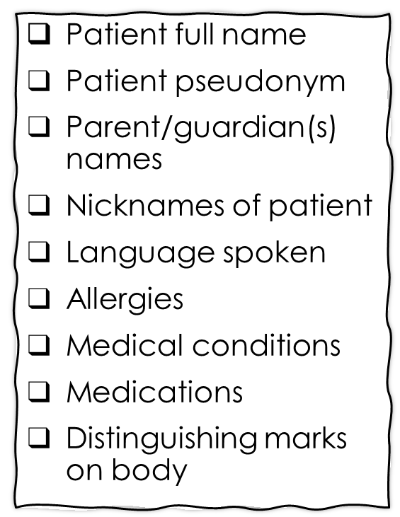
INTAKE FORM FOR UNACCOMPANIED MINORS
Date of birth
Height
Weight
Eye color
Hair color
Race/ethnicity
Gender
Picture of child at time of presentation
School or daycare name
Pet name or favorite stuffed animal
Clothing worn at time of event
Significant belongings that patient may have with them - jewelry
Location patient came from
Mechanism of arrival from the event
Ambulance number
Police car info
Good Samaritan info

Slide 9
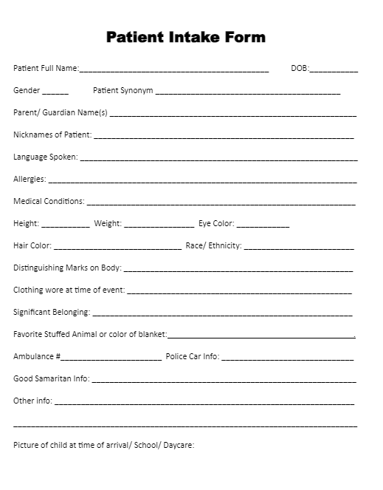
Disasters and Reunification – Template Intake Form for Unaccompanied Minors
Patient Intake Form Template

Slide 10
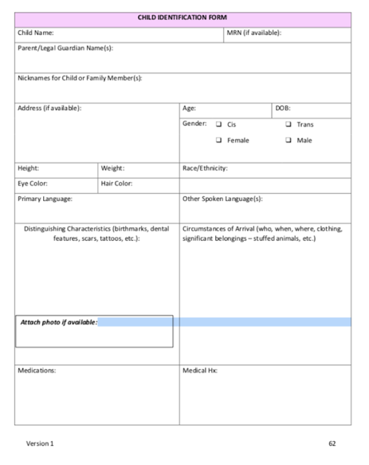
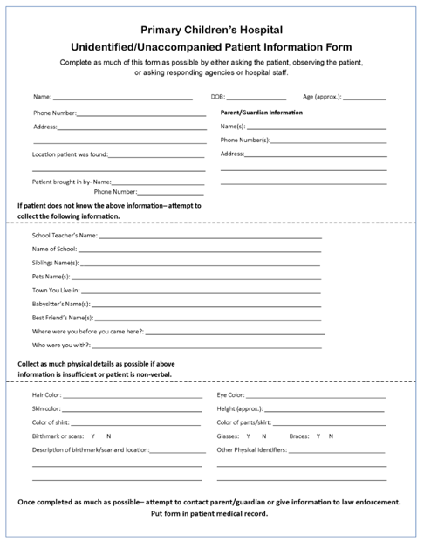
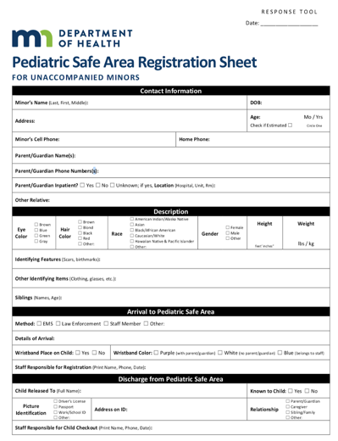
Registration and Intake Template Forms
National Center for Missing and Exploited Children
Coyote Campaign
Utah Crisis Standards of Care
MN Dept of Health – Registration Sheet

Slide 11
TRACKING TOOLS
Wristbands
Color coded for unaccompanied children
Patient Ambassadors
Assigning a staff member to each unaccompanied minor
EMR
Epic Disaster Mode
Juvare
Paper Chart
QR codes for EMR integration

Slide 12
DEFINITIVE IDENTIFICATION
Many hospital systems have a policy in place for confirming identification and appropriate placement of a minor. Please reach out to your hospital for specific rules.
Definitive Identification may be different based on the degree of the event
During a large-scale event, the typical procedures for identification may not be feasible- internet access unavailable, no legal identification on guardians or for minors, unable to obtain photos of minors, overwhelmed governmental child services or law enforcement due to ongoing event.
The placement of minors to their guardians may take hours to days to ensure no misplacement occurs. This should be transparent from the start of the reunification process.

Slide 13
DEFINITIVE IDENTIFICATION
If a child cannot be definitively identified and placed with an appropriate guardian, the hospital should have plans in place to maintain care for children who do not require ongoing medical care for a specific timeframe. Preparations should be made for this temporary care prior to an actual event occurring.
For minors unable to be reunited to their guardian, the state’s child and family services should be contacted for temporary custody of the child.
Child services will work with local law enforcement to continue the reunification of minors with their families.
Notes:
If a child cannot be definitively identified and placed with an appropriate guardian, the hospital should have plans in place to maintain care for children who do not require ongoing medical care. The hospital should also have plans to transition the reunification of unidentified children from a hospital-based operation to a community-based operation if reunification efforts are ongoing for days.
There may be a timeframe that the hospital maintains care of unaccompanied children prior to Child services involvement. Preparations should be made for this temporary care prior to an actual event occurring.

Slide 14
FAMILY REUNIFICATION RESOURCES
AAP – Reunification Toolkit
EIIC - Patient Tracking and Family Reunification
Western Regional Homeland Security Advisory Council – Family Reunification Plan Template:
https://wrhsac.org/wp-content/uploads/2017/10/Family-Reunification-Plan-Template_FINAL_8-31-17_incl.-appendices-pages-all-portrait.pdf
ASPR TRACIE:
https://asprtracie.hhs.gov/technical-resources/64/family-reunification-and-support/0
Coyote Campaign:
https://coyotecampaign.org/wp-content/uploads/2023/02/Hospital-Reception-Site-Planning-Guide-Final-for-Arizona-2-14-23.pdf
Notes:
Western Regional Homeland Security Advisory Council - Family Reunification Plan Template

Slide 15
What to look forward too
Module 2: Hospital Family Reunification Center, Pediatric Safe Area and Family Reunification Site
Module 3: Information Sharing, Security Concerns and Legal Considerations
Module 4: Plan Activation and Exercising Family Reunification Plans
Module 5: Recovery

Slide 16
REFERENCES
US Hospital Preparedness to Manage Unidentified Individuals and Reunite Unaccompanied Minors with Family Members During Disasters: Results from a Nationwide Survey. Health Secur. 2021 Mar-Apr;19(2):183-194. doi: 10.1089/hs.2020.0065. Epub 2020 Dec 1. PMID: 3325975
Federal Emergency Management Agency (FEMA) Ready Campaign. (2013). Post-Disaster Reunification of Children: A Nationwide Approach. https://www.ready.gov/sites/default/files/2019-06/post_disaster_reunification_of_children.pdf
Separated after a disaster: trust and privacy issues in sharing children’s personal information. Disaster Med Public Health Prep. 2019;13(5-6):974-981.
A novel image-based tool to reunite children with their families after disasters. Acad Emerg Med. 2012 Nov;19(11):1227-34. (Is free on Pubmed)
Utility of child physical characteristics and verbal descriptors to aid in family reunification during disasters. American Journal of Disaster Medicine, [S.l.], v. 17, n. 1, p. 5-12, mar. 2022.
Utah Crisis Standards of Care. Version 2 – 2018. https://health.utah.gov/wp-content/uploads/Utah-Pediatric-CSC-Guidelines.pdf
Minnesota Department of Health – Pediatric Safe Area Registration Sheet. https://www.health.state.mn.us/communities/ep/surge/pediatric/minors.pdf
Coyote Campaign – Hospital Reception Site Planning Guide 2023. https://coyotecampaign.org/wp-content/uploads/2023/02/Hospital-Reception-Site-Planning-Guide-Final-for-Arizona-2-14-23.pdf

Slide 17
ASPR: Region V For Kids

Slide 18
MOC Part 4 - Credits
MOC Part 4: Points: 25
Qualifications:
Participation OR Asynchronous view of the 5 educational modules
Participation in the Reunification Post-Survey
Submit list of Reunification Plan Improvements to RVFK

Slide 19
Region V For Kids Social Media
Email: regionvforkids@gmail.com
LinkedIn: www.linkedin.com/company/region-v- for-kids-coe/
Twitter: @RegionVforKids
Website: QR Code to Website

Slide 20
THE END

