Slide 1
Foundational Elements of Quality Improvement
Nprp toolkit

Slide 2
Content
Aim Statement
Stakeholder Engagement
Key Driver Diagrams
Institute for Healthcare Improvement Model for Improvement
Process Map
Fishbone Diagram

Slide 3
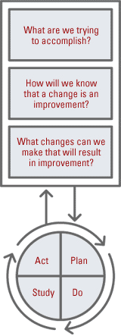
IHI Model for Improvement
AIM
MEASURES
CHANGES
Notes:
Institute for Healthcare Improvement (IHI) model for improvement provides a systematic approach for planning, testing, and implementing changes in clinical processes and systems of care. It has been used extensively in health care and non–health care settings to implement process changes quickly and effectively.

Slide 4
AIM
IHI Model for Improvement
Creating a SMART Aim Statement
Specific
Measurable
Actionable/Attainable
Realistic
Timely
Notes:
• S – Specific (clearly stated)
• M – Measurable (measurable numeric goals)
• A – Actionable/Attainable (within the control/influence of your team)
• R – Relevant (aligned with the organization’s priorities)
• T – Time bound (specific time frame)

Slide 5
Examples
By December 2018, 75% of hospitals in the Texas Medical Center will have written agreements for the transfer of patients to specialty care.
By January 2020, we expect a 10-point increase in pediatric readiness scores across the state of Texas.
Our ED team will attain a 5% reduction in sepsis-related deaths following 6 months of targeted education and integrating evidence-based guidelines into practice.

Slide 6
Tips and Tricks
Consider the problem you are trying to solve… how can you demonstrate it is “solved”?
Global vs SMART AIM
Global AIM: Create a standardized PHM handoff process that ensures patient safety, workflow efficiency, and patient/attending satisfaction.
SMART AIM statement: Within six months of implementation of a standardized handoff checklist on the Pediatric Hospital Medicine service, verbal handoff time to completion will be decreased by 50% and physician satisfaction of handoff process will be improved by 50%.
BY doing an intervention on the system, WE WILL CHANGE some part/all of the system, WHICH WILL RESULT IN these outcomes (i.e. metrics).
http://www.clipartkid.com/images/419/target-marketing-the-official-site-of-joe-searle-YDu1Ql-clipart.jpg

Slide 7
Stakeholder Engagement
Identify stakeholders
Prioritize stakeholders
Understand KEY stakeholders
*Organizations and People
*Brainstorming
*Stakeholder grid
Notes:
Step 1 in this exercise is to: Identifying your stakeholders (are they members of an organization such as AAP, ACEP, ENA); member of family advisory network; state/territories’ trauma program;
On your handout scribble the list of stakeholders that you know off the bat —
Next Step: We will prioritize the individuals on that list and that’s when the stakeholder grid comes into play

Slide 8
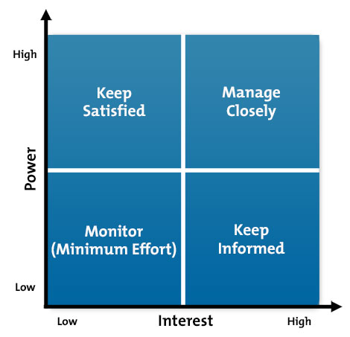
Stakeholder Grid
www.mindtools.com
Notes:
Here’s the layout:
x-axis we have interest ranging from low to high
y-axis we have power ranging from low to high
To read the grid…the bottom left quadrant means that an individual has low interest and low power or influence
While someone in the first quadrant has low interest in the initiative but may possess a great deal of power and influence

Slide 9
Stakeholder Grid
www.mindtools.com
Notes:
Does anyone have any thoughts about who/what belongs in these boxes? Or how do you approach those people?
How about someone with low interest and low power — how would you engage/attend to that person?
Which box do you think you’d given the greatest priority to?
[walk through each quadrant]
Those people that are lowl/low we will monitor but exert minimum effort
stakeholders with high interest but low power — goal: keep them informed
..
..

Slide 10
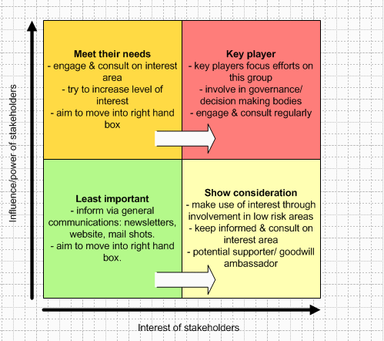
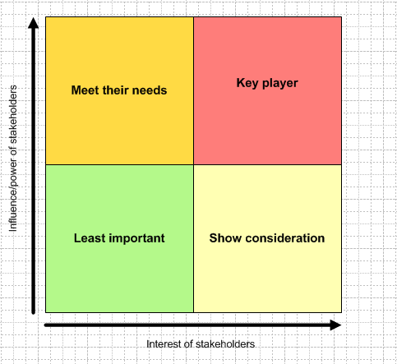
Stakeholder Grid
www.stakeholdermap.com
Notes:
Here’s Another snapshot of the grid with pointers/tips on how to classify stakeholders in each quadrant. At some point you are going to work to move individuals from the low interest to higher interrest categories. So in the back of your mind think about how you’ll really help make that transition “increase their interest” in your initiative.
I’ll leave this one up on the screen as reference.
Now we are going to have a breakout session — you’ll work as a group to complete a stakeholder grid [tool kit has a copy of the grid] | we encourage to use the flip charts to share at the table
Joyee and I will circle the room helping tables — you’ll work on this exercise for about “x” minutes.
Trying to figure out where to start…begin by jotting down your stakeholders and then try prioritizing them in the grid!

Slide 11
Stakeholder Engagement
Prioritize stakeholders → Stakeholder grid
High power, interested people: must fully engage and make the greatest efforts to satisfy
High power, less interested people: keep satisfied, but not so much that they become bored with your message.
Low power, interested people: keep adequately informed, and ensure that no major issues are arising. Can often be very helpful with the detail of your project.
Low power, less interested people: monitor but do not bore them with excessive communication.
Notes:
As a quick recap when we prioritize stakeholders…one option is to make a stakeholder grid
For those high power interested people….(read slide)

Slide 12
Stakeholder Engagement
Identify stakeholders
Prioritize stakeholders
Understand KEY stakeholders
*Organizations and People
*Brainstorming
*Stakeholder grid
Understand KEY stakeholders:
*What motivates them (financial, emotional, etc)?
*What info do they want from you and how do they want to receive it (communication)?
*What is their opinion of your work and from what info is it based?
*If not likely positive, how will you manage the opposition?
Notes:
The final step in stakeholder engagement is making an effort to really understand who your “KEY” stakeholders are.
Find out what motivates them (financial/emotional)
What’s their preferred method of communication (agendas before mtgs / quick recaps afterwards / via email and so forth)
Consider what is their opinion of your work and how did they reach that viewpoint
We know that sometimes our stakeholders may not be positive, and in those cases you want to consider how you’ll manage opposition

Slide 13
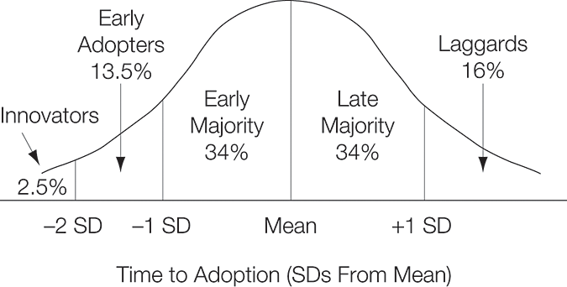
Time to Adoption
http://jamanetwork.com/journals/jama/article-abstract/196400
Berwick D JAMA 2003
Notes:
This is the time to adoption curve.
I’m sure some of you have seen this before.
You want to partner with those innovators and early adopters – you’ll have those individuals that adopt project somewhere in between and lastly there’s always laggards.

Slide 14
Dissemination
Find and support "innovators“
Invest in "early adopters“
Make early adopter activity observable
Trust and enable reinvention
Create slack for change
Lead by example

Slide 15
Key Driver Diagram
A diagram that connects the aim/outcome, key drivers, and interventions for a specific project
Helps focus/select changes to test
Key drivers are the WHAT; interventions are the HOW
Initial diagram (version 1) illustrates team’s current theories and ideas of improved outcomes that can then be tested/enhanced with PDSA cycles → Subsequent diagrams can be updated and used to track progress for the question “What changes can we make that will lead to improvement?”
The Improvement Guide: A Practical Approach to Enhancing Organizational Performance. Langley, Moen, Nolan, Nolan , Norman, & Provost. (2nd edition)

Slide 16
Key Driver Diagram Layout
KEY DRIVERS
CHANGE STRATEGIES
Intervention #1 – The How
Intervention #2
AIM Statement
• Make it SMART!
“The What”
Intervention #3
Intervention #4
“The What”

Slide 17
Example
SPECIFIC AIM(S)
PRIMARY DRIVERS
CHANGE STRATEGIES
Calories in
Not drinking soda
Not eating dessert after dinner
Lose 5 pounds by December 31, 2016
Calories out
- Going to gym
Reduce colonization and infection with MRSA
Screening patients
Good hygiene
Reliable precaution routines
Reduce MRSA spread and colonization
Reduce infection once colonized
Integrate bundles into practice
IHI Open School: https://www.youtube.com/watch?v=yfcE_Q-IRFg

Slide 18
Process Map
Draws a picture of the way a process actually works
Can be simple or quite complex
Oval = start/end of a process
Rectangle = step in the process
Diamond = decision point
Flow line to show direction of process and connects the steps

Slide 19
Why might a process map be helpful…
Shows the components, relationships, and sequence in which a system functions
Forces you to understand how each step occurs
The current process is likely very different from the ideal process
Provides a shared model for team
Identify waste and simplify system
Identify leverage points
Generate ideas for improvement

Slide 20
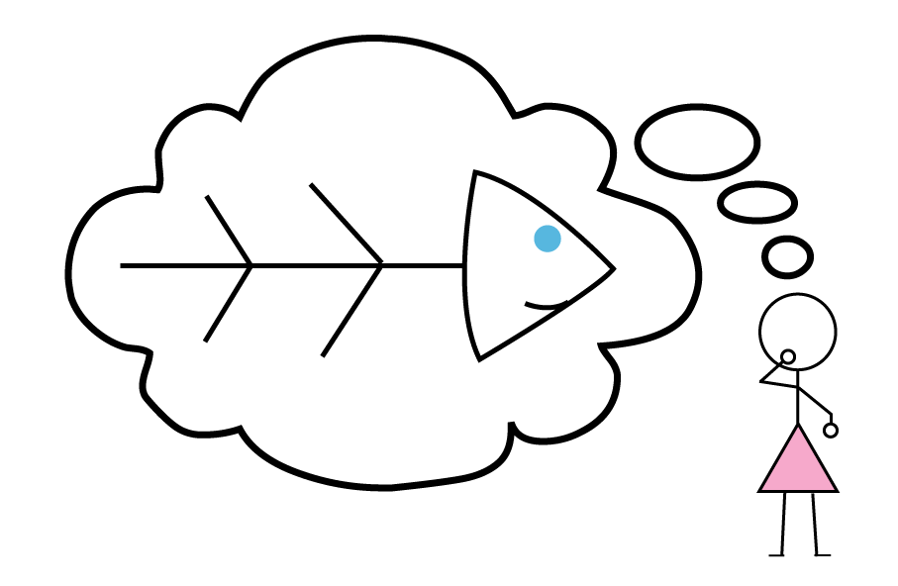
Fishbone, Cause/Effect, or Ishikawa Diagrams

Slide 21
Fishbone Diagram
Structured brainstorming tool → facilitate discussions
Recognize many causes contribute to an effect
Identify areas for improvement

Slide 22
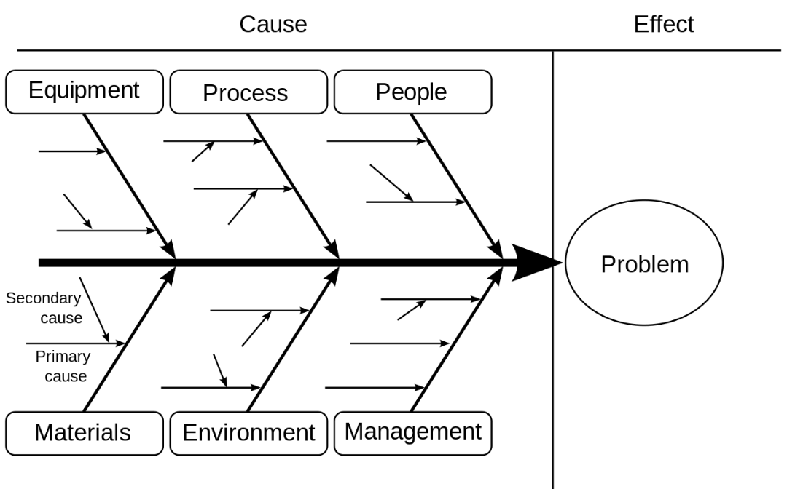
Fishbone Layout

Slide 23
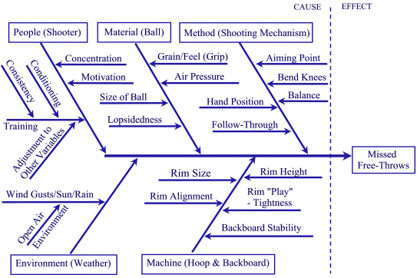
Example

