Slide 1
PWDC Trauma Improvement Sprint
Day 2 | March 2

Slide 2
The planners and presenters of this course have no conflicts of interest to disclose.
This session is being recorded. A recording of this session will be posted to the Trauma Improvement Sprint website: https://emscimprovement.center/collaboratives/pwdc/trauma/

Slide 3
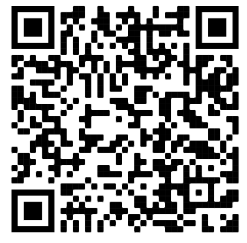
Welcome!
Audio / Video
You are muted and in listen-only mode
Please use the chat for comments and the Q&A box for questions.
Join us for the discussion hour at the end of each day. Here, you will be able to come off mute and have video.
Slides & Recording
The sessions are being recorded.
The slides and recordings will be available here: https://emscimprovement.center/collaboratives/pwdc/trauma/recording/
If you have any questions, please email collaboratives@emscimprovement.center
Download the agenda

Slide 4
Continuing Education (CE)
The planners and presenters of this course have no conflicts of interest to disclose.
Learning Objectives
Understand how the new VRC Standards will incorporate pediatric readiness to improve pediatric care at all trauma centers.
Describe the responsibilities of a Pediatric Emergency Care Coordinator (PECC) and who at your center could potentially fill this role, and how that role can improve pediatric patient care at your center.
Understand how best to implement pediatric readiness efforts within your trauma center
To Claim
You must attend the live session to be eligible for credit.
Complete the post-session evaluation each day. This will be automatically emailed to you following today’s session.
If you have any questions, please email collaboratives@emscimprovement.center
The nursing continuing professional development activity was approved by the Emergency Nurses Association, an accredited approver by the American Nurses Credentialing Center’s Commission on Accreditation.

Slide 5
Today’s Agenda
Download the agenda
Day 2
Time (ET) | Topic | Speaker
11:00 – 11:15am | Welcome | Meredith Rodriguez, PhD Senior Project Manager, QI Collaboratives EMSC Innovation & Improvement Center
11:15am – 12:10pm | Policies & Procedures | Sally Snow, BSN, RN, CPEN, FAEN Nursing Consultant Pediatric Emergency and Trauma (Graham, TX)
Break (5-minutes)
12:15 – 1:15pm | Patient Safety & Family-Centered Care | Karen Groeneweg, HBSc, CLSt Dipl, CCLS Certified Child Life Specialist Children’s Hospital, London Health Sciences Centre (London, ON, Canada)
Lunch (30 minutes)
1:45 – 2:40pm | Communication & Collaboration Across Systems of Care | Lisa Nichols MBA, BSN, RN, CCRN-K Pediatric Trauma Program Manager Wolfson Children’s Hospital (Jacksonville, FL)
Break (5-minutes)
2:45 – 3:45pm | Quality Improvement | Meredith Rodriguez, PhD Senior Project Manager, QI Collaboratives EMSC Innovation & Improvement Center
3:45 – 4:00pm | Summary & Adjourn | Meredith Rodriguez, PhD Senior Project Manager, QI Collaboratives EMSC Innovation & Improvement Center
Break (5-minutes)
4:00 – 5:00pm | Open Discussion Hour (optional) https://dellmed-utexas.zoom.us/j/99748490666

Slide 6
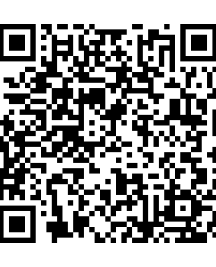
We will be using Poll Everywhere to ask a few questions during each session.
Today’s Poll Everywhere can be accessed through:
Your web browser (use QR code or https://pollev.com/traumasprint )
OR
The mobile app – enter TRAUMASPRINT (Apple Store or Google Play)
OR
Text TRAUMASPRINT to 22333

Slide 7
Notes:
Do not modify the notes in this section to avoid tampering with the Poll Everywhere activity. More info at polleverywhere.com/support Where are you joining us from today?
https://www.polleverywhere.com/clickable_images/zTtTKxzg9mNsnScsiwAPk

Slide 8
Notes:
Do not modify the notes in this section to avoid tampering with the Poll Everywhere activity. More info at polleverywhere.com/support What is the strangest gift you have ever received?
https://www.polleverywhere.com/free_text_polls/Gk6LqV59x4d9PsyUcaGBG

