Slide 1
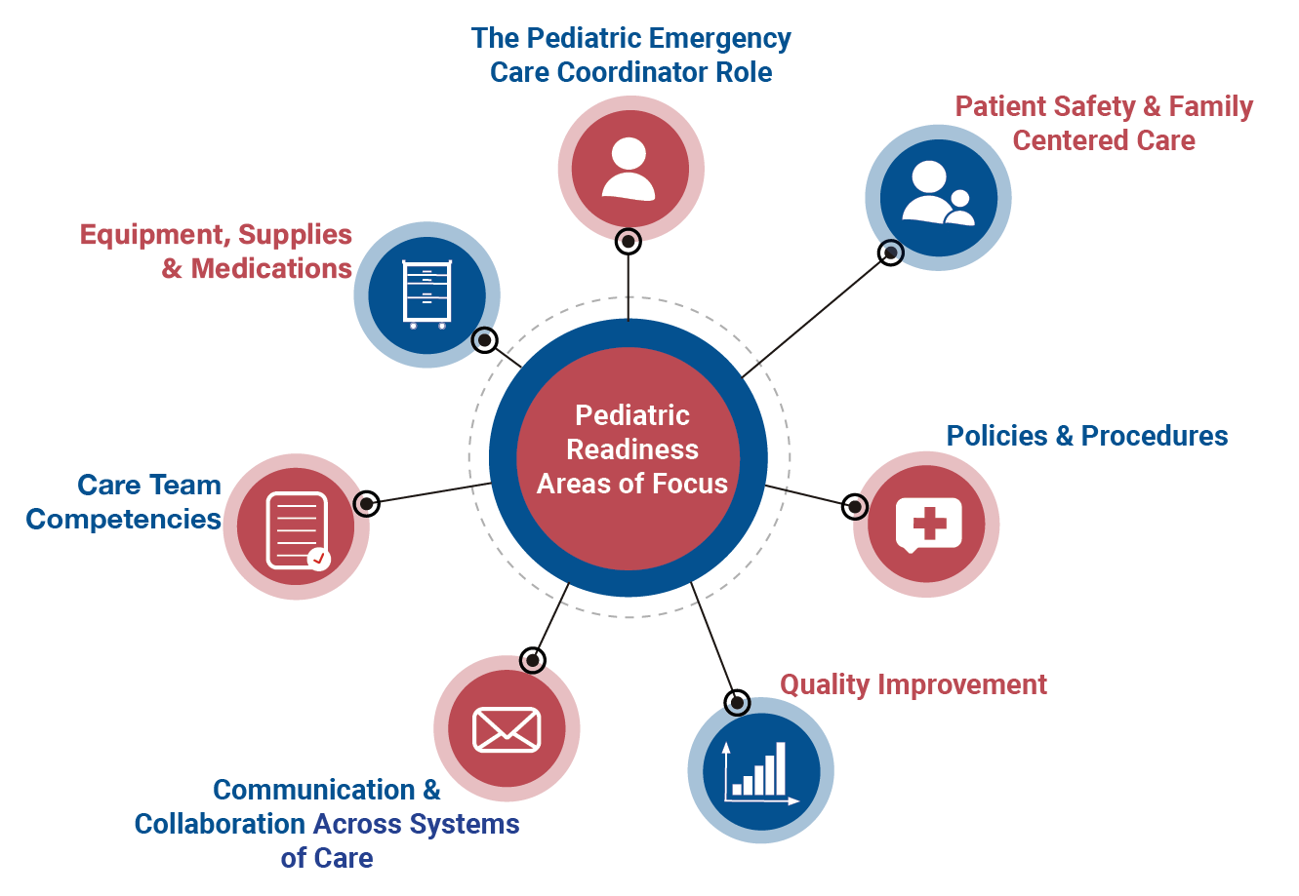
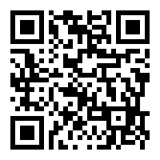
Registration Now Open!
September 1, 2021 – June 30, 2022
Time Commitment
2 hr. / month
Purpose
Develop any healthcare professional working in the prehospital or emergency department systems into a highly effective champion of pediatric readiness.
Who Should Participate?
Prehospital Practitioners
Nurses & Other Healthcare Professionals
Physicians & Advanced Practice Providers
EMSC State Partnership Managers
Learn More & Register: https://emscimprovement.center/collaboratives/pwdc/
Notes:
Registration is now open Pediatric Emergency Care Coordinator Workforce Development Collaborative. The goal of this collaborative is to give any healthcare professional with an interest in pediatrics the tools to champion improvement in the care of ill and injured children in their community. There is no cost to participate, and no pediatric-specific expertise or training is required.
The collaborative will occur in two phases. During the first part (September through March), participants will attend monthly learning sessions where we will explore one of the seven pediatric readiness focus areas listed here with a focus on current best practices and exchanging strategies for improvement. During phase 2 of the collaborative, which will last from March through June, participants will be coached through implementing an improvement plan of their choice at their agency, ED or hospital.
To learn more or register visit the link at the bottom or scan this QR code.

